Slide 1

Systems that Support Disciplinary Literacy
For Leaders

Slide 2
Opening Reflection: Disciplinary Literacy Is a Gateway to Career Success
“To succeed, adolescents need excellent instruction combined with a sense of belonging as valued members of the class and school community. This means recognizing the genius and persistence each student brings to their learning and demonstrating the belief that students are capable of learning, achieving and thriving academically.” (Oregon Adolescent Literacy Framework, page 27)
“Disciplinary literacy cultivates adolescents’ ability to think, read, write and communicate like experts in a field of study.” (Oregon Adolescent Literacy Framework, page 14)
“Effective classrooms begin by helping students establish authentic purposes.” (Oregon Adolescent Literacy Framework, page 20)
Reflection: What “genius and persistence” have you seen students bring to your class that might have been overlooked in other disciplines?
Notes:
Talking Points
Ask participants to read the quotes and share out words or ideas that resonated with them.
Reflection prompt: What “genius and persistence” have you seen students bring to your class that might have been overlooked in other disciplines?
Facilitator Considerations
This slide lays the groundwork for the importance of disciplinary literacy to course and career success.

Slide 3
Session Agenda
Opening reflections and discussions:
The role of leaders in supporting disciplinary literacy
Practice 1: Promote a culture of shared responsibility.
Practice 2: Foster a schoolwide approach to literacy.
Practice 3: Conduct purposeful classroom visits.
Final reflection: Take action.
Notes:
Talking Points
Session purpose: Help leaders reflect on ways they can support disciplinary literacy in their schools and districts.
Review the agenda, highlighting that the session begins and ends with reflection. The bulk of the time focuses on three practices leaders can enact to support disciplinary literacy in their context.
Practice 1 is focused on promoting a culture of shared responsibility.
Practice 2 is about fostering a schoolwide approach to literacy.
Practice 3 is to conduct purposeful classroom visits.
The session concludes with an opportunity for reflection and forward planning.
Facilitator Considerations
This slide describes the arc of the session and can help participants understand what’s to come.

Slide 4
Making Connections

Slide 5
Making Connections (1)
With your role in mind, reflect on one or both of the following questions:
How does your role naturally position you to support literacy development? What existing responsibilities already connect to fostering literacy across disciplines?
How does the concept of shared responsibility for literacy connect to other collaborative initiatives in your school? What parallels do you see with other whole-school efforts you've led or supported?
Notes:
Talking Points
Equitable literacy instruction is vital for preparing all students for success in career and college. School leaders play a crucial role in supporting student literacy development across all disciplines by fostering a culture of literacy, providing necessary support and resources to teachers and ensuring that literacy instruction is a shared and collaborative effort. By prioritizing the following practices, school leaders can create an environment in which every student has the opportunity to develop strong literacy skills.
This slide introduces the core purpose of our session: recognizing that equitable literacy instruction is vital for preparing all students for success. As leaders, you have a unique vantage point and sphere of influence that positions you to support literacy development across all disciplines.
When literacy is seen as everyone's responsibility—not just that of Language Arts teachers—students benefit from consistent strategies and support across their entire school experience.
Consider your own role and how it naturally connects to fostering literacy. Whether you're a principal conducting classroom visits, an instructional coach supporting teachers, or a department chair facilitating PLCs, you're positioned to influence literacy practices.
Facilitator Considerations
This opening reflection slide sets the tone for personal connection and self-assessment.
Considerations for interactivity:
Give participants 2 minutes of quiet reflection time to consider both questions.
Use think-pair-share: participants discuss their chosen question with a partner (3 minutes).
Ask for 2-3 volunteers to share insights about how their role connects to literacy support.

Slide 6
Three Practices to Support Classroom Instruction
Promote a culture of shared responsibility.
Foster a schoolwide approach to literacy.
Conduct purposeful classroom visits.
Notes:
Talking Points
These three practices form the foundation of leadership support for disciplinary literacy. They're interconnected and mutually reinforcing.
Notice these aren't add-ons to your existing work. These practices integrate into what you're already doing as instructional leaders, giving you a framework for making that work more intentional around literacy.
Each practice will be explored in depth, including concrete examples and potential pitfalls to avoid. Think about which practice might be your starting point based on your school's current context.
Facilitator Considerations
This overview slide provides the roadmap for the session's main content.
Considerations for interactivity:
Quick poll: Which practice feels most challenging in your context? (show of hands)
Brief discussion: How do these three practices connect to initiatives already underway in your school?
Preview that each practice includes both examples and pitfalls to learn from.

Slide 7
Practice 1: Promote a Culture of Shared Responsibility (1)
Disciplinary literacy cultivates adolescents’ ability to think, read, write and communicate like experts in a field of study. Leaders advance student success by setting clear expectations that literacy is a cross-disciplinary responsibility and developing systems that support disciplinary teachers to implement strong literacy instruction.
Ways to enact the practice:
Establish a learning culture and trusting relationships for adults and students alike.
Develop and disseminate a compelling vision—that is relevant, attainable and inspiring—for schoolwide and districtwide literacy efforts.
Communicate expectations for shared literacy responsibility.
Set up accountability and support structures for disciplinary literacy instruction.
Notes:
Talking Points
Disciplinary literacy means students learn to think, read, write and communicate like experts in each field. A chemistry student learns to read like a chemist, write lab reports like a scientist, and discuss findings using precise scientific language. This specialized approach requires all teachers to see themselves as literacy teachers within their discipline.
Creating a culture of shared responsibility starts with establishing trust and a learning culture for adults. Teachers need to feel supported, not judged, as they develop new skills in literacy instruction. This culture extends to students, who need to understand that literacy skills are essential for success in every subject.
Your vision for literacy should be compelling and clear. Teachers need to understand not just what you expect, but why it matters for student success. Accountability structures should be balanced with support, such as professional development, coaching, resources and time for collaboration.
Facilitator Considerations
This slide introduces the first practice with practical applications.
Considerations for interactivity:
Table discussion: What does "shared responsibility" look like in your school currently? (2 minutes)
Identify one concrete step from the "ways to enact" list that could be implemented immediately.
Consider sharing a brief example from your own experience about building shared responsibility.

Slide 8
Practice 1: Promote a Culture of Shared Responsibility (2)
Example
A school leadership team facilitates professional learning communities in which educators examine discipline-specific text types and discourse. The educators identify the skills and explicit instruction needed for students to be successful in the discipline they teach.
Potential Pitfall
Teachers may need additional support to effectively provide explicit instruction in these skills.
Possible Solution
Provide job-embedded training, coaching and structured collaborative time where teachers can plan, share how lessons went and get feedback for improvement.
Notes:
Talking Points
This example shows how professional learning communities can be leveraged to build shared responsibility. Notice that educators examine actual texts from their disciplines and identify the specific skills students need. This grounds the work in their content, making it relevant and authentic.
The potential pitfall is critical to understand. Even when teachers recognize what students need, they may lack the pedagogical knowledge to teach these literacy skills effectively. Identifying the need is only the first step; learning something new requires ongoing support to translate awareness into classroom practice.
The solution helps to create a sustainable support system. Teachers learn from each other, share successes and challenges, and refine their practice together. This collaborative approach builds both competence and confidence.
Facilitator Considerations
This slide provides a concrete scenario to ground the theoretical discussion.
Considerations for interactivity:
Partner discussion: Have you seen similar (or different) pitfalls in your school? What worked to address them? (2 minutes)
Brainstorm additional solutions beyond the one provided.

Slide 9

Reflecting on Practice (1)
Pair-Share
What would you include in a compelling vision for schoolwide and districtwide literacy efforts?
Why are these elements important to you?
Notes:
Talking Points
A compelling vision for literacy goes beyond test scores or graduation requirements. It connects to your deeper beliefs about education and student potential. Your vision should inspire teachers to see literacy instruction as integral to their subject's success, not an add-on.
Consider what elements would resonate with your specific school community.
The "why" behind each element matters.
Facilitator Considerations
This reflection deepens participants' thinking about vision and motivation.
Considerations for interactivity:
Ask participants to write key vision elements during pair-share.
Create a word cloud or affinity map of common themes across participants' visions.
If time allows, have one pair share their discussion with the whole group.
Connect back to participants' earlier reflections about their roles.

Slide 10
Practice 2: Foster a Schoolwide Approach to Literacy (1)
Equitable literacy instruction requires a schoolwide approach. Leaders advance student success by building a system that helps all teachers effectively integrate literacy into their disciplinary instruction.
Ways to enact the practice:
Offer educators ongoing, job-embedded discipline-specific and curriculum-based professional learning that builds teachers’ capacity to teach literacy strategies within their discipline.
Provide regular protected time for planning, collaboration and communicating about student needs.
Provide supports for instructional improvement (e.g., instructional coaching, formative feedback).
Partner with families and communities to enrich students’ literacy learning.
Notes:
Talking Points
This second practice builds directly on the shared culture of responsibility we just discussed. Once you've established that literacy is everyone's responsibility, you need concrete systems to support teachers in making that vision a reality.
Notice how these "ways to enact" are systemic rather than individual. As leaders, you're not just supporting one teacher at a time; you're building infrastructure that supports all teachers consistently.
Discipline-specific professional learning is crucial. Generic literacy strategies often don't translate well to content areas. A science teacher needs to understand how to teach students to read lab procedures differently from how they read historical documents.
Protected time for collaboration is a strategic resource allocation. When you prioritize literacy planning time, you're sending a clear message about what matters for student success.
Facilitator Considerations
This slide introduces systemic supports with emphasis on infrastructure building.
Considerations for interactivity:
Quick poll: Which of these four ways to enact the practice is strongest in your school? Which needs the most development?
Turn and talk: Share an example of how you've provided or could provide discipline-specific professional learning in literacy. (2 minutes)
Collect 2-3 examples from participants about successful scheduling practices that allow collaborative time for teachers.

Slide 11
Practice 2. Foster a Schoolwide Approach to Literacy (2)
Potential Pitfall
Teachers may disregard the literacy component of their instruction or use a siloed approach to teaching content and literacy if they do not understand how the two can be integrated.
Possible Solution
The literacy coach models, and teachers role play how they will teach, a specific skill in an upcoming lesson.
Example
A principal asks a literacy coach to facilitate a session during science department collaboration time. The session focuses on teachers identifying opportunities to provide explicit literacy instruction in their upcoming units, which focus on explaining scientific concepts precisely. The literacy coach also conducts a series of follow-up sessions in which science teachers reflect on their instruction and plan next steps.
Notes:
Talking Points
This example demonstrates the power of embedded support. Rather than sending teachers to external workshops, the principal brings expertise directly to where teachers are already collaborating.
The follow-up sessions are critical. One-time professional development rarely changes practice. The series of sessions allows for implementation, reflection, and refinement, a cycle that supports lasting change.
The pitfall highlights a common challenge: teachers may intellectually understand the importance of literacy but struggle to see how it authentically integrates with their content. They might teach a reading strategy in isolation rather than teaching literacy and content in tandem.
The solution moves beyond telling to showing. When teachers experience and practice the integration through modeling and role-play, they build confidence and competence simultaneously.
Facilitator Considerations
This concrete example helps leaders visualize collaborative professional learning in action.
Considerations for interactivity:
Partner discussion: What would this look like in your context? What department or team could benefit from this approach? (3 minutes)
Connection to role: How could instructional coaches, department chairs, or principals each play a part in this kind of embedded professional learning?

Slide 12

Reflecting on Practice (2)
Pair-Share
Think about a time when a schoolwide change was effectively implemented? What made it effective?
How might some of these elements be used when strengthening disciplinary literacy instruction?
Notes:
Talking Points
Say: As seasoned leaders, you've likely seen both successful and failed change initiatives. Mining that experience helps you apply those lessons to literacy improvement.
Facilitator Considerations
This reflection helps participants connect their change leadership experience to literacy improvement.
Considerations for interactivity:
Give participants 3 minutes to think individually about their chosen successful change before sharing
Use structured pair-share: one partner shares their example (2 minutes), the other partner shares (2 minutes), then discuss connections to literacy (2 minutes)
Ask for 2-3 volunteers to share insights about transferable elements
If time allows, flip the question: What made a change initiative fail, and how can we avoid those pitfalls?

Slide 13
Practice 3: Conduct Purposeful Classroom Visits (1)
Leaders enhance teachers' instructional practices through regular classroom visits and observations. These visits provide firsthand insights into literacy instruction, enabling leaders to offer effective feedback and guidance and to adjust support and accountability structures.
Ways to enact the practice:
Build your own capacity for instructional leadership by knowing what high-quality literacy instruction looks like in each content area and within each curriculum being taught.
Partner with teachers to maximize the value of formal classroom visits. Set goals collaboratively, define the focus of the visit and debrief and support planning for instructional next steps.
Build trusting relationships with educators through informal classroom visits focused on learning about disciplinary literacy practice and supporting problem-solving.
Notes:
Talking Points
This third practice is where your instructional leadership becomes potentially most visible and impactful. Classroom visits are your primary tool for understanding what's actually happening with literacy instruction in classrooms and how you can use that understanding to support teachers' growth.
"Build your own capacity" comes first for good reason. You can't effectively support what you don't understand. This doesn't mean becoming a literacy expert in every discipline, but understanding more about what high-quality literacy instruction looks like across content areas. There are resources for teachers in the Adolescent Literacy Framework bank of resources, including spotlights, slide decks similar to this one (one per disciplinary area), professional learning modules, and collaborative learning session guides. These are a great place to start building your own capacity.
Classroom visits should be collaborative rather than evaluative when focused on literacy development. When teachers help set goals and define focus areas, they're more invested in the process and more open to feedback.
Informal visits build relationships and trust. These aren't "gotcha" moments but genuine opportunities to learn alongside teachers and offer support. A department chair might pop in to see how a new strategy is working, or a principal might visit to understand challenges teachers are facing.
Facilitator Considerations
This slide introduces the most hands-on leadership practice.
Considerations for interactivity:
Self-assessment: How confident do you feel recognizing high-quality literacy instruction in content areas outside your expertise?
Pair discussion: How do you currently structure classroom visits? What would "purposeful" look like for literacy? (3 minutes)
Role-specific planning: Have participants consider for their specific role: What would building trust through informal visits look like for a principal, versus an instructional coach, versus a department chair?

Slide 14
Practice 3: Conduct Purposeful Classroom Visits (2)
Example
A health teacher and administrator collaborate to plan for the administrator’s observation of the teacher’s lesson in which students reflect on their strengths and challenges in evaluating the legitimacy of health claims in popular media. The teacher and administrator meet afterward to plan an observation where the other health teachers can observe a similar lesson as a basis to discuss student experiences and plan future lessons.
Potential Pitfall
In planning the observation for other teachers, the health teacher and administrator do not provide sufficient guidance about what the teachers should look for. This results in an unfocused discussion after the observation and a struggle in planning for future lessons.
Possible Solution
Develop a “look-for guide” or some key questions for the visiting teachers to use to guide their observation.
Notes:
Talking Points
This example shows collaborative planning in action. The administrator and teacher are partners in improving instruction. This collaborative approach leads to the innovative idea of peer observation.
The peer observation component is powerful because it positions the health teacher as a literacy leader among colleagues. This builds capacity beyond just one classroom and creates a culture where teachers learn from each other.
The pitfall is common and important. Even well-intentioned peer observations can become unfocused rather than targeted professional learning. Teachers might discuss everything they noticed rather than analyzing specific literacy practices.
The "look for guide" solution provides structure that focuses attention and conversation. It might include questions like "How did students demonstrate understanding of health claims?" or "What evidence shows students are developing evaluation skills?"
Facilitator Considerations
This example demonstrates the evolution from individual to collective literacy leadership.
Considerations for interactivity:
Experience sharing: Has anyone facilitated or participated in peer observations? What made them effective or ineffective? (2-3 volunteers share briefly)
Problem-solving: What other solutions might address the unfocused discussion pitfall? (brainstorm alternatives)
Application thinking: What would a "look for guide" include for literacy instruction in your school's context?

Slide 15
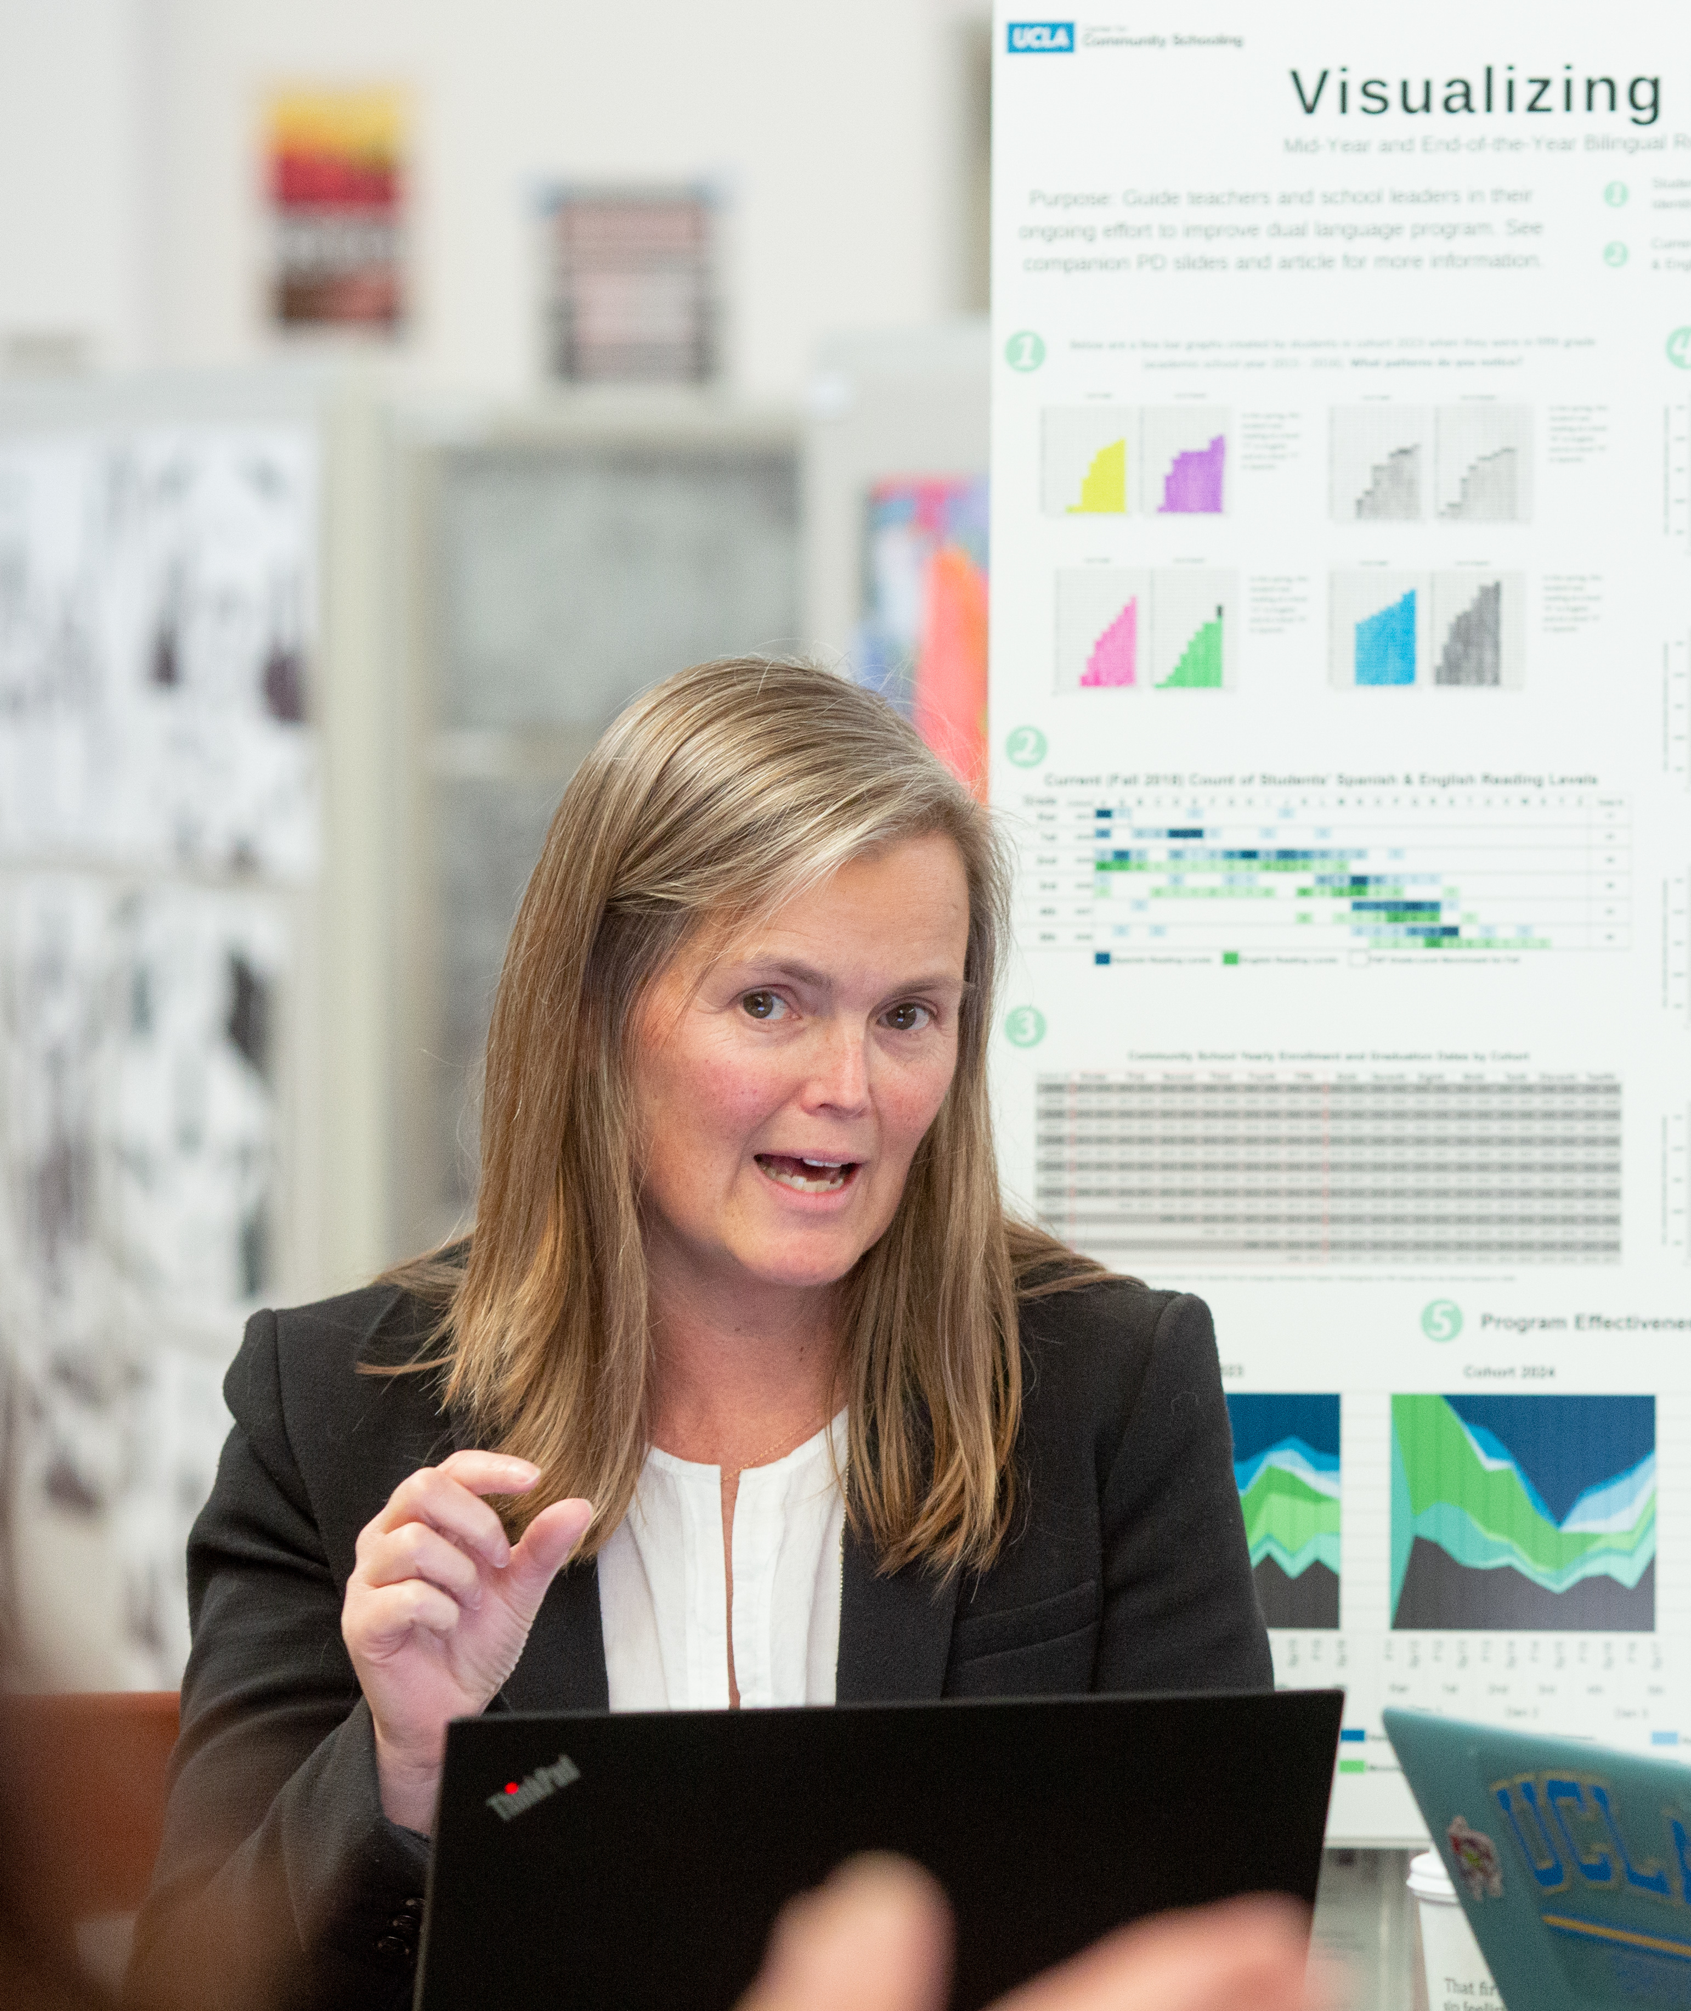

Reflecting on Practice (3)
Pair-Share
To facilitate effective feedback cycles, what is one step you can take to build trust with teachers?
Notes:
Talking Points
Trust is the foundation of effective feedback cycles. Without it, even the most skillful feedback falls flat, and teachers may become defensive or compliance-focused rather than growth-oriented. Consider trust from the teacher's perspective. Do they believe you understand the challenges of their work? Do they feel you're there to support rather than judge? Do they see you as invested in their professional growth?
Facilitator Considerations
This reflection focuses on the relational foundation necessary for instructional leadership.
Trust-building looks different depending on your role. A principal might focus on creating safe spaces for risk-taking, while an instructional coach might emphasize confidentiality and teacher-driven goals. A department chair might work on establishing credibility as a peer leader.
Considerations for interactivity:
Give participants 2 minutes to reflect silently on the question before sharing
Pair-share with focus: one concrete, actionable step they could implement immediately (3 minutes)
Gallery walk option: if participants are willing, have them write their ideas on chart paper and do a brief gallery walk to see all strategies
Close by acknowledging that trust-building is ongoing work, not a checklist item
https://images.all4ed.org/two-female-teachers-during-faculty-meeting-2

Slide 16
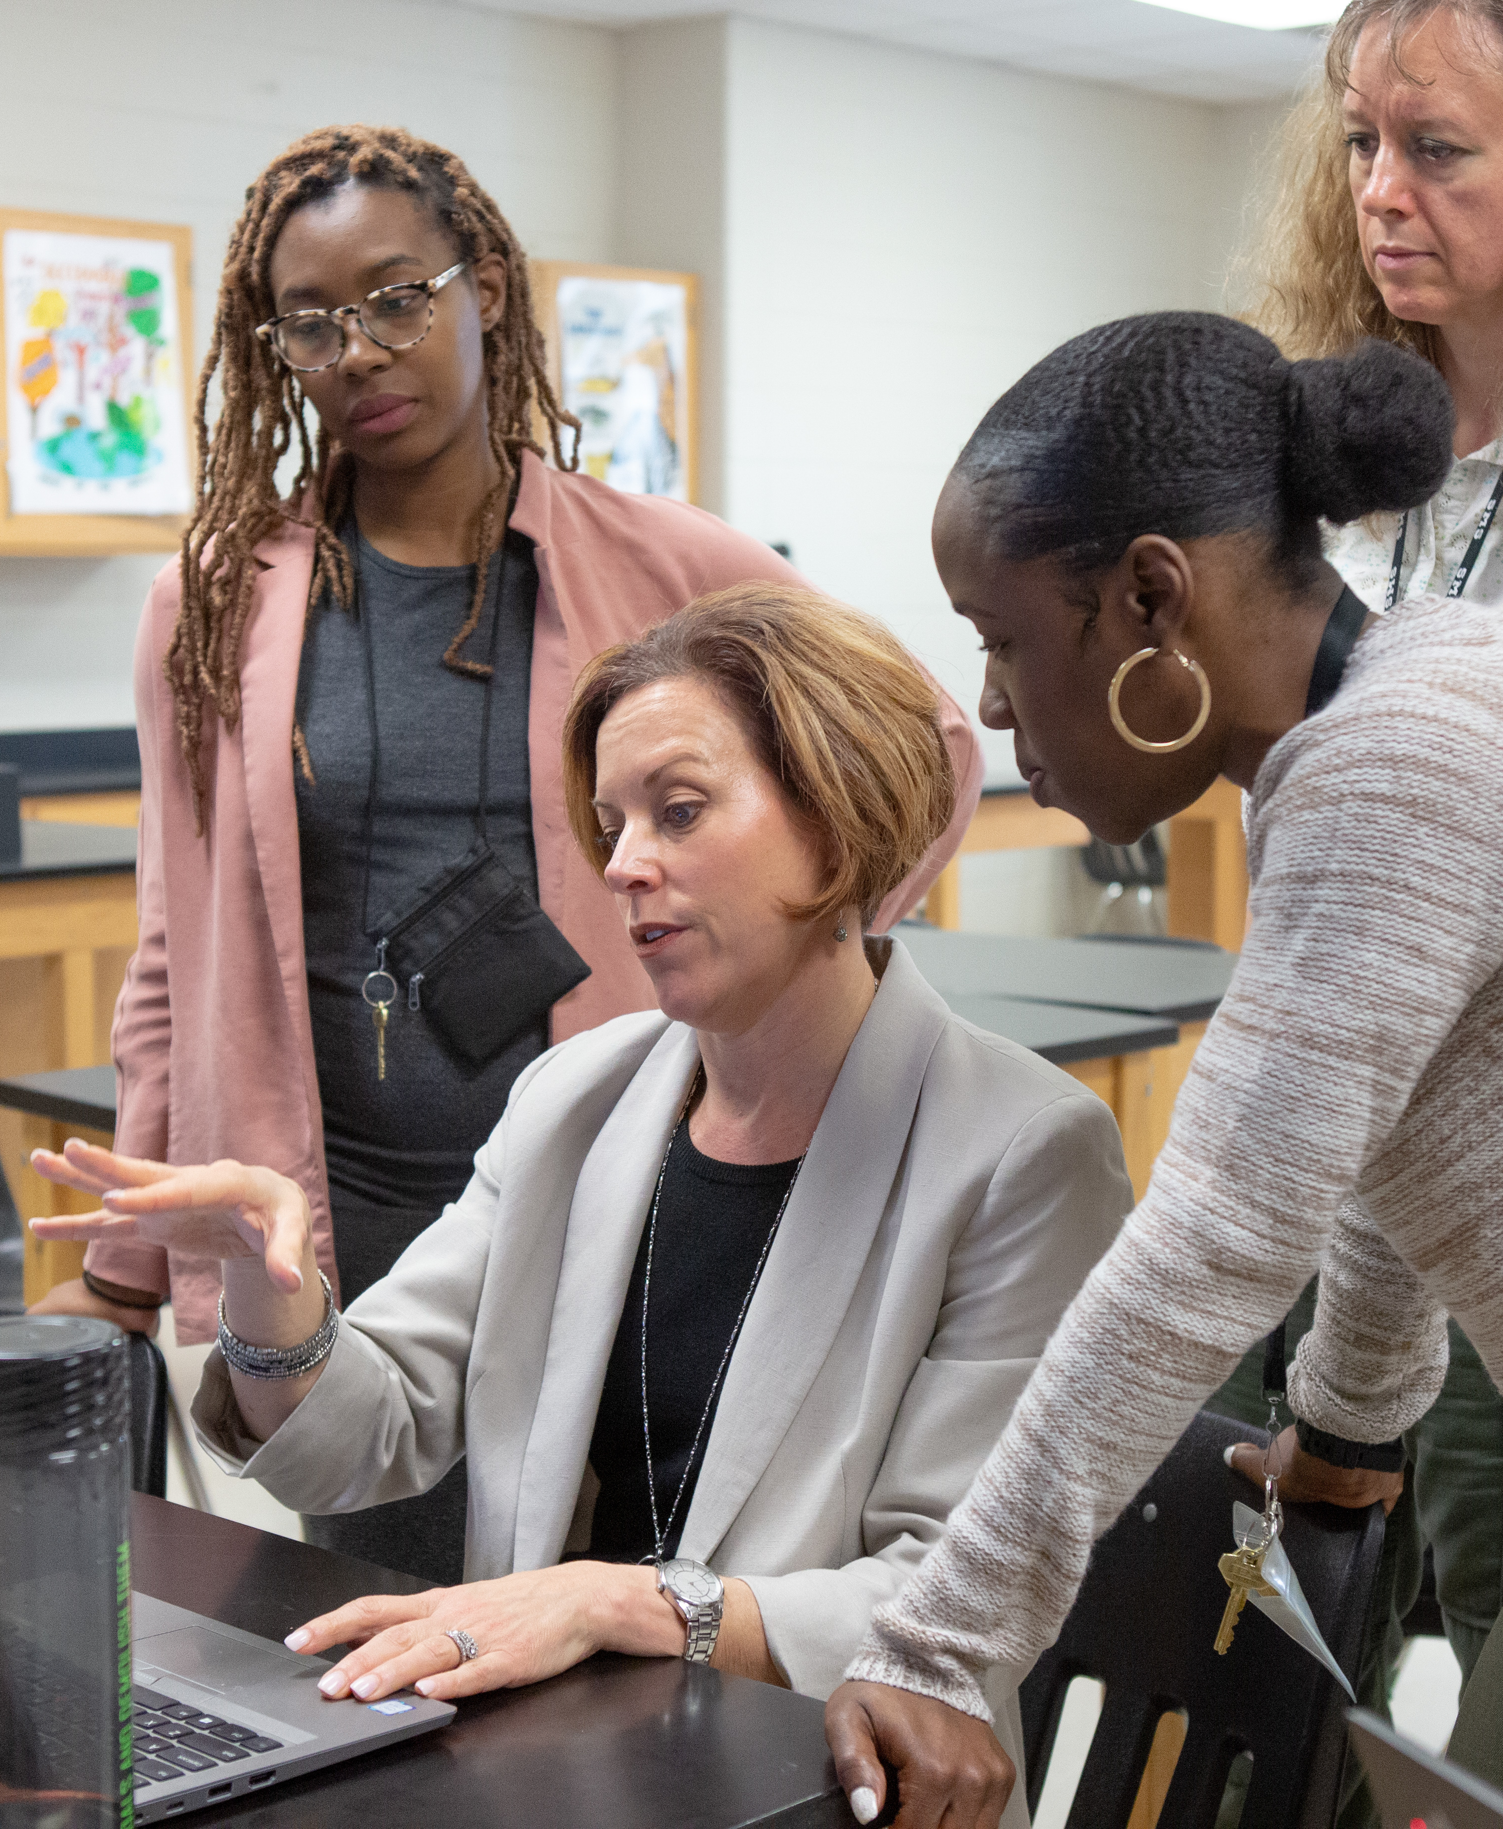
Looking Toward Next Steps
Quick Write
What professional learning opportunities exist for teachers to collaborate and plan for literacy instruction?
What opportunities can you as a leader build to expand and improve these professional learning opportunities?
Notes:
Talking Points
This reflection moves from individual teacher support to systemic professional learning infrastructure. As leaders, you're responsible for creating and improving the systems that support ongoing teacher collaboration and growth.
Existing opportunities might include PLCs, department meetings, faculty meetings, professional development days, or informal collaboration time. The key is evaluating how well these spaces currently support literacy-focused planning and learning.
Expansion and improvement might mean restructuring existing time, advocating for additional resources, or reimagining how collaborative time is used. It could also mean creating new opportunities like literacy-focused learning walks or cross-departmental planning sessions.
Think strategically about sustainability. What professional learning opportunities can you realistically maintain and improve? What new opportunities align with your school's culture and resources?
Facilitator Considerations
This quick write allows for individual reflection toward next steps before moving to session conclusion.
Considerations for interactivity:
Provide 4-5 minutes for individual writing time—this should be genuine reflection, not rushed
Optional sharing: invite 2-3 volunteers to share one insight from their writing
Action planning: encourage participants to identify one specific next step they'll take regarding professional learning opportunities
Connect to earlier discussions: how do these professional learning opportunities support the three practices we've explored?
https://images.all4ed.org/science-teachers-planning

Slide 17
Navigating Oregon’s Adolescent Literacy Framework
SECTION
1
GOAL
Disciplinary literacy is essential for postsecondary success
2
CONDITIONS
High Expectations
Culturally Responsive Practice
Engagement
3
SUPPORTS
Multilingual Learners
Students with Disabilities
4–5
ALL-PURPOSE SKILLS
Reading Skills
Writing Skills
DISCIPLINE-SPECIFIC READING AND WRITING SKILLS
6
LANGUAGE ARTS
MATH
SCIENCE
SOCIAL SCIENCES
CAREER & TECHNICAL EDUCATION
HEALTH & PHYSICAL EDUCATION
Notes:
Talking Points
Oregon's Adolescent Literacy Framework provides the foundation for everything we've explored today. The first three chapters establish why disciplinary literacy matters for students' postsecondary success and how to create the conditions and supports for students to be successful.
Chapter 2's focus on conditions, including high expectations, culturally responsive practice and engagement, directly connects to our discussion about leveraging student background knowledge. When we recognize students' experiences and set high expectations for professional communication, we create the conditions for meaningful learning. The framework shows how these conditions specifically support CTE students in developing career-ready literacy skills.
Chapter 3 addresses supports for multilingual learners and students with disabilities, populations we all serve. The framework provides strategies for making technical texts accessible while maintaining rigor. As you read these chapters, you'll find practical approaches for supporting all students in mastering the complex literacy demands of your field.
Facilitator Considerations
This closing slide encourages continued learning through framework exploration.
Considerations for interactivity:
Consider asking for a commitment: "Who will commit to reading at least one chapter before our next meeting?”
Quick planning: Have participants identify when they'll read the framework chapters (add to calendar).
Buddy system: Encourage participants to find a reading partner for accountability and discussion.
Close with appreciation for their engagement and a reminder that improving disciplinary literacy is ongoing professional work.

Slide 18
Oregon’s Instructional Frameworks: Adolescent Literacy

