Slide 1

Supporting Disciplinary Literacy in Social Science

Slide 2
Opening Reflection:
Disciplinary Literacy Is a Gateway to Career Success
“To succeed, adolescents need excellent instruction combined with a sense of belonging as valued members of the class and school community. This means recognizing the genius and persistence each student brings to their learning and demonstrating the belief that students are capable of learning, achieving and thriving academically.” (Oregon Adolescent Literacy Framework, page 27)
“Disciplinary literacy cultivates adolescents’ ability to think, read, write and communicate like experts in a field of study.” (Oregon Adolescent Literacy Framework, page 14)
“Effective classrooms begin by helping students establish authentic purposes.” (Oregon Adolescent Literacy Framework, page 20)
Reflection: What “genius and persistence” have you seen students bring to your class that might have been overlooked in other disciplines?
Notes:
Talking Points
Ask participants to read the quotes and share out words or ideas that resonate with them.
Reflection prompt: What “genius and persistence” have you seen students bring to your class that might have been overlooked in other disciplines?
Facilitator Considerations
This slide lays the groundwork for the importance of disciplinary literacy to course and career success.

Slide 3
Session Agenda
Opening reflections and discussions:
  The reinforcing nature of disciplinary literacy and content
  Disciplinary literacy in social science
Practice 1: Help students expand discipline-specific vocabulary by connecting to their prior knowledge.
Practice 2: Teach students to effectively navigate diverse texts, sources and data integral to the discipline.
Practice 3: Teach students discipline-specific writing conventions.
Practice 4: Teach students to engage in civic discourse.
Final reflection: Take action.
Notes:
Talking Points
Session purpose: Social science teachers will reflect on their practice and explore disciplinary literacy strategies that help students strengthen their ability to read, write and communicate as professionals in the discipline.
Review the agenda, highlighting that the session begins and ends with reflection. The bulk focuses on four practices teachers can enact to support disciplinary literacy in social science classrooms.
Practice 1 addresses leveraging students' background knowledge to build discipline-specific vocabulary.
Practice 2 presents strategies for comprehending social sciences texts.
Practice 3 supports students by teaching the writing conventions of the discipline.
Practice 4 supports civic discussion and collaboration.
Together, these practices address all literacy modalities—reading, writing, speaking and listening—within authentic social science contexts. Each practice includes a description, classroom example, and potential pitfall to avoid.
Facilitator Considerations
This slide describes the arc of the session and can help participants understand what’s to come.

Slide 4


Reflect and Share
Disciplinary literacy is the ability to read, write, think and communicate using the specific practices and language of a field of study.
Disciplinary content includes the core knowledge, concepts, and skills students need to understand and work within a specific field of study.
How are these two concepts mutually reinforcing?
Notes:
Talking Points
After participants have had a chance to reflect and share, highlight any of the following that did not come out in conversation:
Disciplinary literacy and disciplinary content work together. For example, developing a meaningful understanding of the experience of different groups during a historical period may require reading historical primary sources and understanding period-specific vocabulary and contentions. The disciplinary knowledge and the literacy skills develop hand in hand.
When students learn to read like social scientists, they gain deeper access to content knowledge. A student who can effectively read the Emancipation Proclamation is doing more than just making sense of the words in the speech; they are deepening their understanding of the currents of American history. Literacy skills become the gateway to a more sophisticated understanding.​
This relationship works both ways. As students develop deeper content knowledge, they become better readers and writers in science. They start recognizing patterns in discipline-specific texts, understanding why certain information is emphasized and organized in specific ways, and knowing what details matter most. Their growing expertise helps them navigate complex texts more effectively.​
Facilitator Considerations
This slide introduces key terminology while helping participants see the interconnected nature of literacy and content.
Considerations for interactivity:
Ask participants to turn to a neighbor and share one specific example from their teaching where students' literacy skills directly impacted their ability to master language arts content (2 minutes).
Facilitate a brief whole-group discussion where 3-4 participants share their examples.
If participants seem stuck, prompt with: "Think about a time when a student’s challenges with reading prevented them from learning important content. How did you address both needs?"

Slide 5


The Importance of Disciplinary Literacy in Social Science
The social science curriculum equips students with the essential tools to analyze, create and communicate complex ideas, fostering informed, articulate and adaptable individuals who become contributing members of our democracy.
(Oregon’s Adolescent Literacy Framework, page 139).
Notes:
Talking Points
Disciplinary literacy in social science is about mastering the specific ways professionals in social science communicate, think and solve problems. The discipline emphasizes the use of evidence and field-specific skills and contentions, including skills like critical analysis of primary sources and corroborating evidence in history, interpreting maps and spatial data in geography, and modeling economic trends and analyzing market forces in economics.
Each field in social science includes its own technical language, vocabulary and conventions that practitioners must fluently use.
Facilitator Considerations
This slide establishes the foundational importance of disciplinary literacy in social science.
Considerations for interactivity:
Ask participants to briefly share one example of specialized language from their social science field (30 seconds).
After presenting the framework quote, invite 2-3 participants to share how they've seen disciplinary literacy empower their students.
Consider asking: "How is the literacy in social science different from what students learn in language arts classes?"

Slide 6
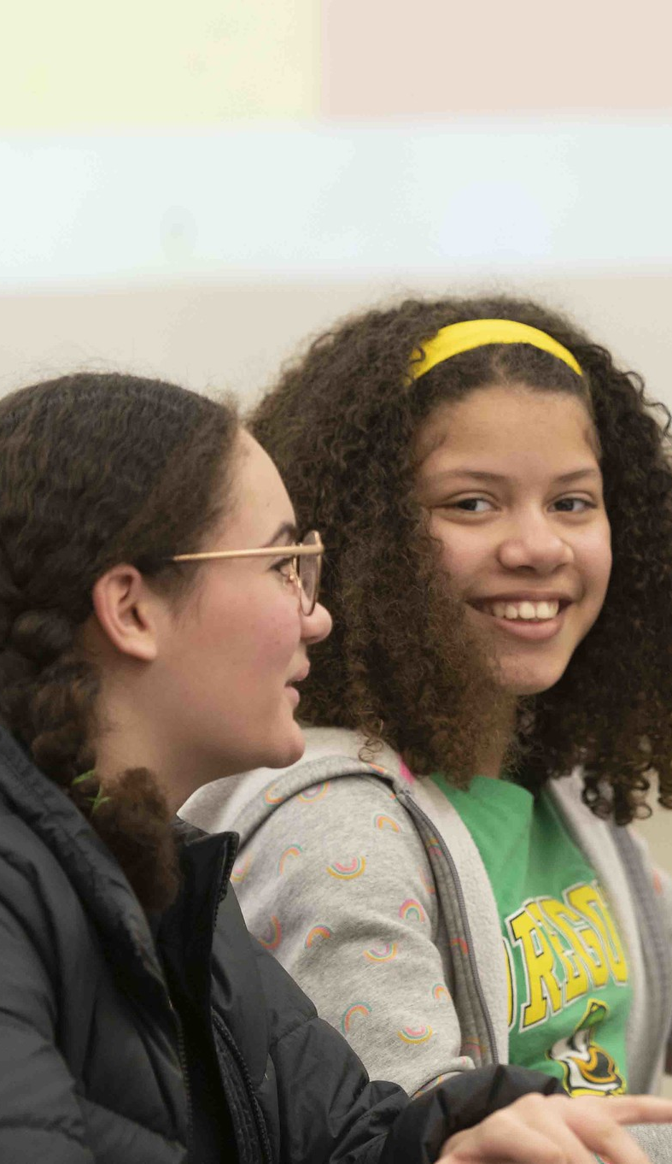
Sample Text Types in Social Science
Primary sources, including texts, art pieces, film and other media
Secondary sources from multiple perspectives
Historical documents
Civics documents
Policy briefs
Opinion editorials
Academic articles and research reports, often incorporating data sets
News articles and popular media
Maps and charts
Artifacts and interviews
Notes:
Talking Points
Students of social science must evaluate, interpret and compare source materials, data and disciplinary concepts in a variety of media
Social science texts are widely varied and have different conventions, vocabularies, structures and styles. Students need support to understand how to use these vastly different text types in the discipline.
Facilitator Considerations
This slide is designed to invite social science educators to begin to think about the specific text types in their field.
Considerations for interactivity:
Invite participants to read the types of text aloud.
Invite participants to share additional text types that are specific to their social science field.
Ask participants to share which text types they find most challenging to use with students and what they have learned about helping students engage deeply with these types of texts.
https://www.flickr.com/photos/portlandpublicschools/52754669012/in/album-72177720306806147

Slide 7
Reflect on Your Practice
Beyond the examples on the previous slide, what specific types of texts do students need to be able to interpret and create to succeed in your field?
What opportunities do your students have to practice reading and writing these types of text?
How do you support students with reading and writing these types of text?
Notes:
Talking Points
We'll start with a reflection so that you can ground the rest of our session in your own practice and get the most out of today.
Facilitator Considerations
This reflection invites participants to examine their current practices around literacy in social science education.
Considerations for interactivity:
Give participants 2-4 minutes of quiet thinking time to jot down responses to these questions.
Use a think-pair-share structure: Have participants discuss their answers with a partner who teaches a different subject or section (3 minutes). If energy is low, do a quick stand-and-find activity where participants find someone across the room and have the conversation while standing.
Bring the group back together and ask for volunteers to share one surprising insight from their partner's field.

Slide 8
Practice 1:
Help students expand discipline-specific vocabulary by connecting to their prior knowledge.
1
Notes:
Talking Points
This is the first of four impactful practices. Each practice includes a description, an example, and a potential pitfall to avoid.
These practices can be incorporated into your instruction to increase student skills in disciplinary literacy.
Facilitator Considerations
This slide transitions from reflection to learning more about the four highlighted practices.

Slide 9
Help students expand discipline-specific vocabulary by connecting to their prior knowledge.
Educators can accelerate student learning of terminology, historical language and conventions for communicating in social science by activating students’ prior knowledge and experiences related to the topic.
Notes:
Talking Points
Every student walks into the classroom with knowledge and experiences that can become bridges to new learning. Social science offers opportunities to connect with the lived experience of students, their families and communities, with current events that students hear about in the media and in discussions, and with learning they may have experienced in other disciplines.
When we connect new technical and historical terminology to what students already know, the learning sticks better and social science can also feel more relevant. A student with parents who run a small business may have heard family conversations that can serve as a foundation for some economics terms, or a student who goes on an annual backcountry backpacking trip may build from their navigation experience to understand vocabulary related to historical maps and geography.
Making these connections explicit helps all students see themselves as capable learners of the social sciences. When you say, "That's exactly right, and in history we call that..." you're validating their knowledge while building their professional vocabulary.
Facilitator Considerations
This slide emphasizes asset-based teaching and the importance of building on student knowledge to increase knowledge of discipline-specific terminology. Word knowledge and world knowledge go hand in hand and are mutually reinforcing.
Considerations for interactivity:
Ask participants to share a brief story about a time when a student's background knowledge surprised them or enhanced a lesson.
Have participants brainstorm in pairs or small groups: What types of background knowledge do your students typically bring? How could you better tap into this? (3 minutes)
If time allows, have participants think about students who might not have obvious connections to science or who are intimidated by science. How can we help them find entry points?

Slide 10
Example of helping students expand discipline-specific vocabulary by connecting to their prior knowledge
During a lesson on how social and political movements affect lawmaking, students first reflect on an issue they care about and consider ways to make an impact. They share strategies and the teacher uses the examples as a bridge to explicit instruction of vocabulary like "advocacy," "lobbying," "civil disobedience,” “grass-roots organizing” and "litigation."
Notes:
Talking Points
In this example, students start with what's familiar and build outward. Most students have exposure to these ideas in their schools, extracurricular activities and communities and they have likely heard about these concepts in the media. Once they recognize that their existing knowledge connects to civics education, suddenly a whole family of technical terms have more tangible meaning to them.
Notice how the instructor lets students lead. Instead of pre-teaching vocabulary, they have students draw on what they know first. This approach builds confidence, agency and conceptual understanding and helps avoid students feeling overwhelmed by abstract technical jargon.
Note that this example aligns to Oregon’s Social Science Standards, I(HS.C.CE.17) and to Essential Disciplinary Practice 10.
Facilitator Considerations
This concrete example helps participants envision how the strategy might work in practice.
Considerations for interactivity:
After presenting the example, ask participants to try it with their own field. "Think of some technical vocabulary and concepts you teach in your class that you have not previously connected with students' prior knowledge. How might you help students make these connections?”

Slide 11
Potential Pitfall:
Introducing new terminology without first exploring what students already know.
Why It Matters
Exploring what students already know offers valuable opportunities to connect new terms to familiar concepts.
This can make new vocabulary feel connected and comprehensible.
Students are more likely to engage with content that feels familiar and from which they can draw relevant knowledge.
Notes:
Talking Points
When we skip the exploration phase, we might spend time over-explaining concepts students already grasp in everyday terms, or worse, we might zoom past their confusion because we didn't realize they lacked foundational understanding.
Students often glean ideas about history, geography, economics, civics and psychology from their experiences in the world, including through the media. When we jump straight to technical language, students might feel like they're learning something completely new, when they're just learning technical names for familiar concepts.
Engagement is so important because when content feels inaccessible or irrelevant, students check out. But when they realize, "Oh, I actually know about this from a story I heard about my grandmother," suddenly they're leaning in, asking questions, making connections. That moment of recognition can transform their relationship with the material.
Facilitator Considerations
This slide addresses a common teaching challenge that many educators will recognize in their own practice.
Considerations for interactivity:
Quick reflection: Have participants write down one technical term they teach that students might have everyday knowledge about (30 seconds).
Partner discussion: Share your term and brainstorm what prior knowledge students might have about this concept (2 minutes).

Slide 12
Practice 2:
Teach students to effectively navigate diverse texts, sources and data integral to the discipline.
Notes:
Talking Points
This is the first of four impactful practices. Each practice includes a description, an example, and a potential pitfall to avoid.
These practices can be incorporated into your instruction to increase student skills in disciplinary literacy.
Facilitator Considerations
This slide transitions from reflection to learning more about the four highlighted practices.

Slide 13

Teach students to effectively navigate diverse texts, sources and data integral to the discipline.
Educators can support students by explicitly teaching students about the conventions and vocabulary in specific text types and by providing opportunities to practice discipline-specific reading strategies, including
Evaluating evidence
Synthesizing information
Analyzing an author’s purpose and perspective
Exploring multiple interpretations and critical perspectives
Notes:
Talking Points
Different text types in social science pose different challenges to readers, and students need background knowledge and support to make sense of the most challenging social science texts. For example, students reading legislative text may need orientation to the contention and structures in the legislation and instruction about new vocabulary.
Using authentic texts is key because when students practice with real historical documents, maps, primary sources, journal articles and other texts, they learn the actual strategies they'll need in social science careers and to be participants in a democratic society. Simplified versions don't prepare them for the complexity and variety of real workplace reading.
Students may think professionals just "know" how to read these texts naturally. By explicitly teaching these strategies, we show them that even experts use specific approaches. This demystification is especially important for students who are striving readers.
This connects to Essential Disciplinary Practice 3 and 9.
Facilitator Considerations
This slide introduces the concept of teaching discipline-specific reading strategies explicitly.
Considerations for interactivity:
If time permits, refer participants to Table 6 SS.2. Teaching General Reading Strategies Used by Social Scientists and Table 6 S.3 Table 6 SS.3. Teaching Discipline-Specific Reading Strategies Used by Social Scientists on page 143 of Oregon's Adolescent Literacy Framework
Think-pair-share: Have participants identify one type of text from their field and one specific strategy professionals use to read it (3 minutes).
Pose this question: "What reading strategies do your students struggle with most when encountering texts in your field?"

Slide 14
Example of teaching students to effectively navigate diverse texts, sources and data integral to the discipline.
In a 10th grade economics class, students analyze a recent article about the Federal Reserve's decision on interest rates. The teacher first models her own process of evaluating the evidence presented, synthesizing information on monetary policies and exploring the author's perspective on the Federal Reserve's role. Students then choose an economic indicator to investigate and make a recommendation about interest rates based on their research.
Notes:
Talking Points
The instructor models with a think-aloud, making the invisible thinking that it takes to interpret scientific research visible. Students see how a professional organizes information from research articles to identify claims and supporting evidence. This modeling step is crucial.
The practice phase helps students learn to distinguish between evidence and interpretation, evaluate data quality and assess whether conclusions are well-supported.
This approach prepares students for authentic scientific discourse. When they learn to identify evidence to support claims about cellular respiration, they're experiencing the foundation of scientific argumentation used in scientific fields.
Note that this example aligns to Oregon’s Social Science Standards, HS.E.MI.6 and HS.E.MI.7
Facilitator Considerations
This detailed example provides a model for explicit strategy instruction in science education contexts.
Considerations for interactivity:
Small group task: Design a similar evidence-identification activity. What scientific text would students evaluate? (3 minutes)
Share out: Each group names their text and explains why evidence evaluation matters in their field.

Slide 15
Potential Pitfall:
Providing real-world and authentic text without the explicit teaching of reading strategies.
Why It Matters
Students benefit from explicit strategies to help them comprehend technical and historical language and the unfamiliar structures and conventions that can appear in authentic social science texts.
This can support engagement and help students effectively interpret what they read.
Notes:
Talking Points
While it can feel as though students should come into the middle or high school science class already possessing the requisite literacy skills to read social science texts, this often is not the case. Authentic social science texts can be complex and can use unfamiliar structures contentions and vocabulary.
Dense technical language, unfamiliar formatting, assumed background knowledge, data sets and source citations in social science can be confusing. In social science careers, professionals constantly encounter new texts that inform their work, including policy documents, research papers, legislation, and legal and historical documents. If students don’t develop discipline-specific reading strategies, pursuing social science careers may feel daunting for them.
Facilitator Considerations
This slide highlights a common challenge that can undermine even the best intentions to use authentic materials.
As a possible extension activity, consider bringing in an authentic text and asking participants to identify what might be challenging for students in reading this text. They can then work together to identify explicit teaching opportunities to make sense of the features and vocabulary of this text type.
Considerations for interactivity:
Small-group discussion: Share a time when students struggled with authentic texts. What happened? What did you learn? (2-3 minutes)
Collect common themes from the groups about where students typically get stuck.
Reflection prompt: "Think about one authentic text you use in your class. What specific strategies would help students read it successfully?"
Acknowledge that finding the balance between authentic materials and appropriate support is an ongoing challenge.

Slide 16
Practice 3:
Teach students discipline-specific writing conventions.
3
Notes:
Talking Points
This is the first of four impactful practices. Each practice includes a description, an example, and a potential pitfall to avoid.
These practices can be incorporated into your instruction to increase student skills in disciplinary literacy.
Facilitator Considerations
This slide transitions from reflection to learning more about the four highlighted practices.

Slide 17
Teach students discipline-specific writing conventions.
Teachers can help students write like social scientists by
Examining model texts
Modeling the research process for a variety of writing purposes
Emphasizing the importance of drafting and revising
Providing opportunities for peer feedback
Fostering the use of technology
Addressing AI in academic writing
Notes:
Talking Points
Social scientists write structured, evidence-based arguments and articulating findings and ideas with clarity and precision. This involves a deep understanding of research methodologies, a critical use of data and the communication of complex ideas to a wide audience. Social science teachers can provide writing opportunities that help students develop these writing skills.
Analyzing authentic model texts makes expert writing strategies used in the social sciences more visible to students. For example, when students examine research articles from journals or read opinion pieces, they see how professionals structure arguments, integrate data representations and connect evidence to conclusions.
Research is an essential skill in social science and students benefit from modeling of the process from formulating questions, collecting data and finding sources, to structuring and revising writing.
Revisions to student writing can help improve not only the writing, but critical thinking about social science topics as well. When students apply revision strategies like strengthening evidence and elaboration in an essay, they can deepen their understanding of the source material and sharpen their understanding of and argument of the topic.
Providing opportunities for peer feedback not only strengthens students’ own writing but also improves their critical analysis of written work.
Finally, students need support to effectively and appropriately use technology, including technology that supports research like digital archives and social science data sets and AI technology. AI is rapidly changing, and teachers can help students by helping them differentiate between AI as a research aid and AI as a substitute for original thinking.
Facilitator Considerations
This slide emphasizes how revision strategies in scientific writing develop both communication skills and scientific reasoning simultaneously.
Considerations for interactivity:
Ask participants to share an example of when student revision led to deeper scientific understanding (2 minutes).
Partner discussion: What specific revision strategies do you teach? How do these improve both writing and thinking? (3 minutes)
Reflection: "How do you help students see revision as thinking rather than just editing?"

Slide 18
Example of teaching students discipline-specific writing conventions
In a high school history class, students read and annotate a collection of primary sources about individual experiences with immigration to the United States during different historical periods, annotating the text for reasons for immigrating. The teacher uses a think-aloud to model the process of using evidence to develop a thesis statement. The teacher then models the process of organizing their evidence into an outline for a comparative analysis essay about causes of immigration in U.S history. Students develop their own thesis statements and outlines and engage in peer feedback and teacher conferences that will inform their final essays.
Notes:
Talking Points
This history example shows the connection between social science reading, writing and communication. The teacher starts students off with authentic primary source texts, leveraging annotation skills they have already practiced. Then the teacher explicitly teaches about developing a thesis statement in history and organizing historical evidence from multiple sources to support an argument.
By providing an authentic audience and purpose, the teacher is not only supporting engagement by making the task relevant to students but also building the skills that professionals use in a wide range of fields that use source material to support conclusions and arguments.
Facilitator Considerations
This example shows how modeling and specific instruction can support students in writing authentic tasks.
Note that this example aligns the Oregon’s Social Science Standards, (HS.US.CE.11) and to Essential Disciplinary Practices 3-8.
Considerations for interactivity:
Small-group activity: Design a similar sequence for your class: What texts might your students analyze? (3 minutes)
Discuss: "How do you help students translate technical information for different audiences?"

Slide 19
Potential Pitfall:
Using inauthentic or artificial writing activities and not supporting students to engage in the writing process.
Why It Matters
Authentic writing tasks or models that reflect the norms of writing in social science help students learn and apply disciplinary writing norms in their own work.
The process of revision helps students understand that even professionals do not write polished products on the first attempt.
Supporting students to revise their writing not only helps them improve their product but also demonstrates the necessity of viewing writing as a process.
Notes:
Talking Points
Generic writing assignments can disconnect some students from their work because it can feel irrelevant. When students write surface-level prompts based on social science topics, instead of, for example, engaging in research papers or letters to their legislators, they miss crucial practice that helps them develop the skills to engage in social science careers and to be full participants in a democratic society. When assignments feel artificial, students may treat them as less authentic school exercises rather than relevant professional skill development.
Facilitator Considerations
This slide addresses a fundamental challenge in creating meaningful writing experiences.
Considerations for interactivity:
Think-pair-share: Identify one current writing assignment that could be more authentic (2 minutes).
Collect examples of artificial versus authentic alternatives on a visible chart.
Group problem-solving: Choose one artificial task and collaboratively redesign it for authenticity.

Slide 20
Practice 4:
Teach students to engage in civic discourse.
4
Notes:
Talking Points
This is the first of four impactful practices. Each practice includes a description, an example, and a potential pitfall to avoid.
These practices can be incorporated into your instruction to increase student skills in disciplinary literacy.
Facilitator Considerations
This slide transitions from reflection to learning more about the four highlighted practices.

Slide 21
Teach students to engage in civic discourse.
Social science teachers strengthen students’ communication skills by teaching them how to engage in discussions, dialogues and debates and allocating time for students to practice active listening, respectful exchanges and use of discipline-specific evidence, through strategies like
Research showcase and symposiums
Deliberations and fishbowl discussions
Developing infographics
Collaborative research and group projects
Notes:
Talking Points
Communication in social science is based on inquiry that can be collaborative and sometimes contentious. Students need instruction and structured opportunities to practice discourse that mirrors the processional dialogue, shared critical thinking and communication in the field. Inquiry-driven conversations deepen understanding of complex concepts because students must articulate their reasoning to peers.
Active listening, respectful deliberation, and purposeful use of evidence must be taught and practiced. These skills are essential for communication in social science classrooms and careers but also contribute to meaningful civic participation in our pluralistic society.
Facilitator Considerations
This slide emphasizes how structured discussions develop both content understanding and professional communication skills.
Considerations for interactivity:
Invite participants to share examples from your practice that develop specific social scientific communication skills.
Ask participants to share their experiences with these strategies and what they have learned.

Slide 22

Example of teaching students to engage in civic discourse
In a 12th grade geography class, students prepare to debate the economic effects of zoning policies on various population groups. The teacher helps students understand the debate structure and provides examples of active listening, effective use of evidence and respectful exchange of viewpoints. Students collaborate with partners to prepare their arguments before participating in the classwide debate.
Notes:
Talking Points
This example demonstrates a teacher providing models and instruction on the norms of processional dialogue on geography. Students learn key skills that will allow them to engage fully in a productive debate.
Partner planning develops essential collaboration skills as students practice using evidence to prepare for argumentation in a debate.
Note that this topic aligns with Oregon’s social science standards, HS.G.HE.9 and HS.G.HE.11.
Facilitator Considerations
This example demonstrates structured preparation leading to meaningful professional dialogue about real-world scientific issues.
Considerations for interactivity:
Before describing what you notice about the example, ask participants to share their noticings and wonderings.
Share scenarios that would generate authentic professional discussions in your field.
Discuss: "What preparation would your students need to handle these conversations professionally using evidence?"
Image source: PowerPoint stock

Slide 23
Potential Pitfall:
Students are asked to participate in discussions without receiving clear models of professional communication.
Why It Matters
Giving students clear models for participation in social science discussions helps them understand what effective communication in social science looks or sounds like.
This helps students shift from vague, informal or off-topic responses that miss the opportunity to share ideas in ways that reflect real-world communication skills.
Without examples to guide them, students may feel unsure or unprepared, limiting both their engagement and their growth.
Notes:
Talking Points
Without models, students may default to casual conversation or misconceptions, using vague language like “everyone agrees” instead of citing research or evidence that supports their argument. Without clear models of professional communication in social science, students miss crucial communication elements: how to use evidence effectively, how to present data and how to describe connections and patterns.
When social science students participate in discussions and debates without understanding professional norms, they may offer opinions rather than evidence-based reasoning, make unsupported claims or may not engage in respectful exchange and disagreement. This leads to missed opportunities for developing the collaboration and communication skills that support knowledge building in careers in social sciences. Students may feel unprepared for college-level social science courses or internships where professional discourse is expected.
Facilitator Considerations
This slide addresses an oversight that undermines communication development in social science education.
Considerations for interactivity:
Quick reflection: What communication models would help your students most? (1 minute)
Table discussion: Share ideas for providing models, such as videos of scientists discussing research, guest professionals demonstrating data presentations or teacher modeling of scientific argumentation.
Discussion: What prevents us from providing good models? What are some possible solutions?

Slide 24
Final Reflection
How can you learn more about the literacy strengths and related background knowledge of your students?
How can you incorporate authentic opportunities for students to build their disciplinary knowledge through speaking, listening, reading and writing?
What text types could your students use more support to read? To write?
What new opportunities for authentic, discipline-specific discourse would you like to try in your class?
Notes:
Talking Points
As we wrap up our exploration of disciplinary literacy in social science, take a moment to consider where you want to focus your efforts. Each of these questions targets a different aspect of what we've discussed today. You might choose the question that addresses your biggest challenge, or perhaps the one where you see the most opportunity for immediate impact in your classroom.
Choose one or two questions that resonate with your current teaching context. Consider what's feasible given your curriculum timeline, available resources and student needs. Remember, small changes can have a significant impact when they're strategically chosen and thoughtfully implemented.
Facilitator Considerations
This reflective closing helps participants synthesize learning and commit to actionable next steps.
Considerations for interactivity:
Provide 2-3 minutes of quiet reflection time for participants to review the questions and select their focus.
Offer participants the choice to reflect individually in writing or discuss with a partner.
If discussing with partners, suggest they share not just which question they chose, but why it feels most relevant.
Remind participants that these questions can guide ongoing professional development throughout the year.

Slide 25
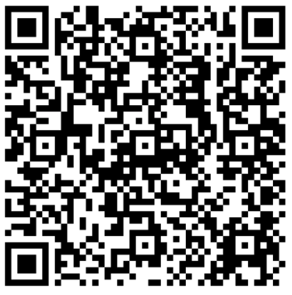
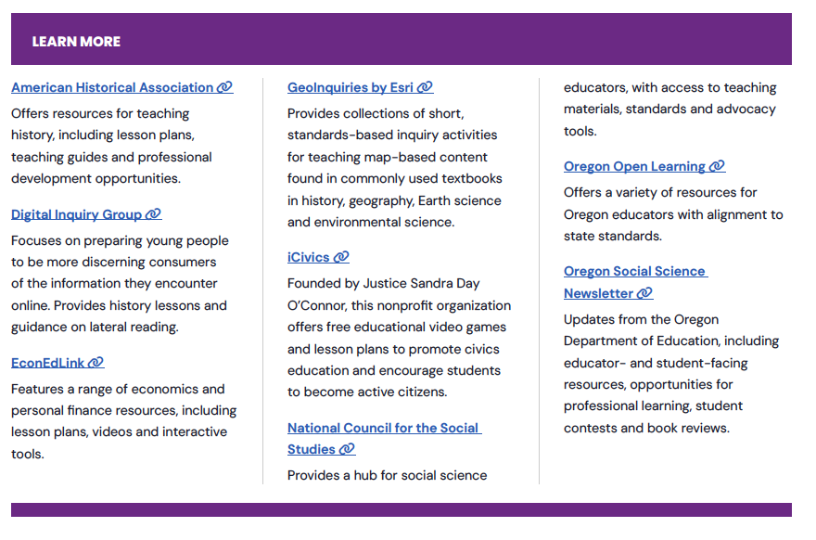
More Resources from Oregon’s Adolescent Literacy Framework
Section 6: Disciplinary Literacy in Social Sciences, Page 148
Notes:
Talking Points
As a reminder and invitation, Oregon's Adolescent Literacy Framework offers a list of resources specifically designed to support science educators in developing disciplinary literacy. The framework recognizes that science education requires unique approaches to reading, writing, and communication, providing targeted guidance for integrating literacy into science instruction.
The QR code will lead you to the framework.
Facilitator Considerations
This slide provides concrete next steps and additional support for implementing disciplinary literacy strategies.
Considerations for interactivity:
Give participants 1-2 minutes to scan the resources and identify one that addresses their reflection focus.
Quick share: Have 2-3 participants name the resource they're most interested in exploring and why.
If time allows, demonstrate navigating to one resource to show ease of access.
Remind participants that these resources can support both immediate changes and long-term professional development.

Slide 26
Navigating Oregon’s Adolescent Literacy Framework
SECTION
1
GOAL
Disciplinary literacy is essential for postsecondary success
2
CONDITIONS
High Expectations
Culturally Responsive Practice
Engagement
3
SUPPORTS
Multilingual Learners
Students with Disabilities
4–5
ALL-PURPOSE SKILLS
Reading Skills
Writing Skills
DISCIPLINE-SPECIFIC READING AND WRITING SKILLS
6
LANGUAGE ARTS
MATH
SCIENCE
SOCIAL SCIENCES
CAREER & TECHNICAL EDUCATION
HEALTH & PHYSICAL EDUCATION
Notes:
Talking Points
Oregon's Adolescent Literacy Framework provides the foundation for everything we've explored today. The first three chapters establish why disciplinary literacy matters for social science students' postsecondary success and how to create the conditions and supports for students to be successful.
Chapter 2's focus on conditions, including high expectations, culturally responsive practice and engagement, directly connects to our discussion about leveraging student background knowledge. When we recognize students' experiences and set high expectations for professional communication, we create the conditions for meaningful learning. The framework shows how these conditions specifically support science students in developing career-ready literacy skills.
Chapter 3 addresses supports for multilingual learners and students with disabilities, populations we all serve. The framework provides strategies for making scientific texts accessible while maintaining rigor. As you read these chapters, you'll find practical approaches for supporting all students in mastering the complex literacy demands of science education.
Chapters 4 and 5 explore gernal strategies to support reading and writing.
And finally, Chapter 6 offers discipline specific guidance for supporting disciplinary literacy, including in the social sciences.
Facilitator Considerations
This closing slide encourages continued learning through framework exploration.
Considerations for interactivity:
Consider asking for a commitment: "Who will commit to reading at least one chapter before our next meeting?"
Quick planning: Have participants identify when they'll read the framework chapters (add to calendar).
Buddy system: Encourage participants to find a reading partner for accountability and discussion.
Close with appreciation for their engagement and reminder that improving disciplinary literacy is ongoing professional work.

Slide 27
Oregon’s Instructional Frameworks: Adolescent Literacy

