Slide 1

Supporting Disciplinary Literacy in Science

Slide 2
Opening Reflection: Disciplinary Literacy Is a Gateway to Career Success
“To succeed, adolescents need excellent instruction combined with a sense of belonging as valued members of the class and school community. This means recognizing the genius and persistence each student brings to their learning and demonstrating the belief that students are capable of learning, achieving and thriving academically.” (Oregon Adolescent Literacy Framework, page 27)
“Disciplinary literacy cultivates adolescents’ ability to think, read, write and communicate like experts in a field of study.” (Oregon Adolescent Literacy Framework, page 14)
“Effective classrooms begin by helping students establish authentic purposes.” (Oregon Adolescent Literacy Framework, page 20)
Reflection: What “genius and persistence” have you seen students bring to your class that might have been overlooked in other disciplines?
Notes:
Talking Points
Ask participants to read the quotes and share out words or ideas that resonate with them.
Reflection prompt: What “genius and persistence” have you seen students bring to your class that might have been overlooked in other disciplines?
Facilitator Considerations
This slide lays the groundwork for the importance of disciplinary literacy to course and career success.

Slide 3
Session Agenda
Opening reflections and discussions:
The reinforcing nature of disciplinary literacy and content
Disciplinary literacy in science
Practice 1: Help students expand scientific vocabulary and conceptual understanding by connecting to their prior knowledge.
Practice 2: Teach comprehension strategies specific to scientific texts.
Practice 3: Teach students to clearly and accurately communicate complex scientific ideas in writing.
Practice 4: Provide structured opportunities for scientific dialogue and discussion.
Final reflection: Taking action
Notes:
Talking Points
Session purpose: Science teachers will reflect on their practice and explore disciplinary literacy strategies that help students strengthen their ability to read, write and communicate in science courses and careers.
Review the agenda, highlighting that the session begins and ends with reflection. The bulk focuses on four practices teachers can enact to support disciplinary literacy in science.
Practice 1 addresses leveraging students' background knowledge to build discipline-specific vocabulary. Practice 2 teaches strategies for comprehending scientific texts. Practice 3 provides authentic opportunities for discipline-specific writing. Practice 4 offers structured discussion and collaboration.
Together, these practices address all literacy modalities—reading, writing, speaking and listening—within authentic science contexts. Each practice includes a description, a classroom example, and a potential pitfall to avoid.
Facilitator Considerations
This slide describes the arc of the session and can help participants understand what’s to come.

Slide 4


Reflect and Share
Disciplinary literacy is the ability to read, write, think and communicate using the specific practices and language of a field of study.
Disciplinary content includes the core knowledge, concepts, and skills students need to understand and work within a specific field of study.
How are these two concepts mutually reinforcing?
Notes:
Talking Points
After participants have had a chance to reflect and share, highlight any of the following that did not come out in conversation:
Disciplinary literacy and disciplinary content work together. For example, you can't analyze climate data without being able to read the research or research interpretation that backs up the data. The knowledge and the literacy skills develop hand in hand.
When students learn to read like scientists, they gain deeper access to content knowledge. A student studying environmental science who can effectively read peer-reviewed research articles isn't just completing an assignment; they're building the foundation for evidence-based environmental stewardship. Literacy skills become the gateway to a more sophisticated understanding.
This relationship works both ways. As students develop deeper content knowledge, they become better readers and writers in science. They start recognizing patterns in discipline-specific texts, understanding why certain information is emphasized and organized in specific ways, and knowing what details matter most. Their growing expertise helps them navigate complex texts more effectively.
Facilitator Considerations
This slide introduces key terminology while helping participants see the interconnected nature of literacy and content.
Considerations for interactivity:
Ask participants to turn to a neighbor and share one specific example from their teaching where students' literacy skills directly impacted their ability to master content (2 minutes). Facilitate a brief whole-group discussion where 3-4 participants share their examples.
If participants seem stuck, prompt with: "Think about a time when a student's reading difficulty prevented them from learning important science content. How did you address both needs?”
Consider how scientists continue learning throughout their careers. They read scientific journals, research studies and new curriculum standards. They write lesson plans, grant proposals and assessment reports. The literacy practices aren't separate from the work; they are the work.
As you reflect on these concepts, take a minute to consider what your current practice of teaching both disciplinary literacy in science and disciplinary content looks like.

Slide 5



The Importance of Disciplinary Literacy in Science
Teaching science-specific disciplinary literacy is essential in helping students become critical thinkers and problem solvers, skills that are pivotal as careers evolve. (Oregon Adolescent Literacy Framework, page 125).
Notes:
Talking Points
Disciplinary literacy in science goes beyond general reading and writing skills. It's also about mastering the specific ways scientists communicate, think and solve problems. Whether students are learning to interpret experimental data, write lab reports or read scientific research articles, they're developing the authentic literacy practices of their potential future careers in STEM fields.
Each science field has its own "language" that includes technical vocabulary, symbols, formulas and conventions that practitioners must fluently use. This specialized language helps ensure accuracy, precision and professionalism in scientific settings.
Facilitator Considerations
This slide establishes the foundational importance of disciplinary literacy in science.
Considerations for interactivity:
Ask participants to briefly share one example of specialized language from their science field (30 seconds).
After presenting the framework quote, invite 2-3 participants to share how they've seen disciplinary literacy empower their students.
Consider asking: "How is the literacy in science different from what students learn in language arts classes?"

Slide 6
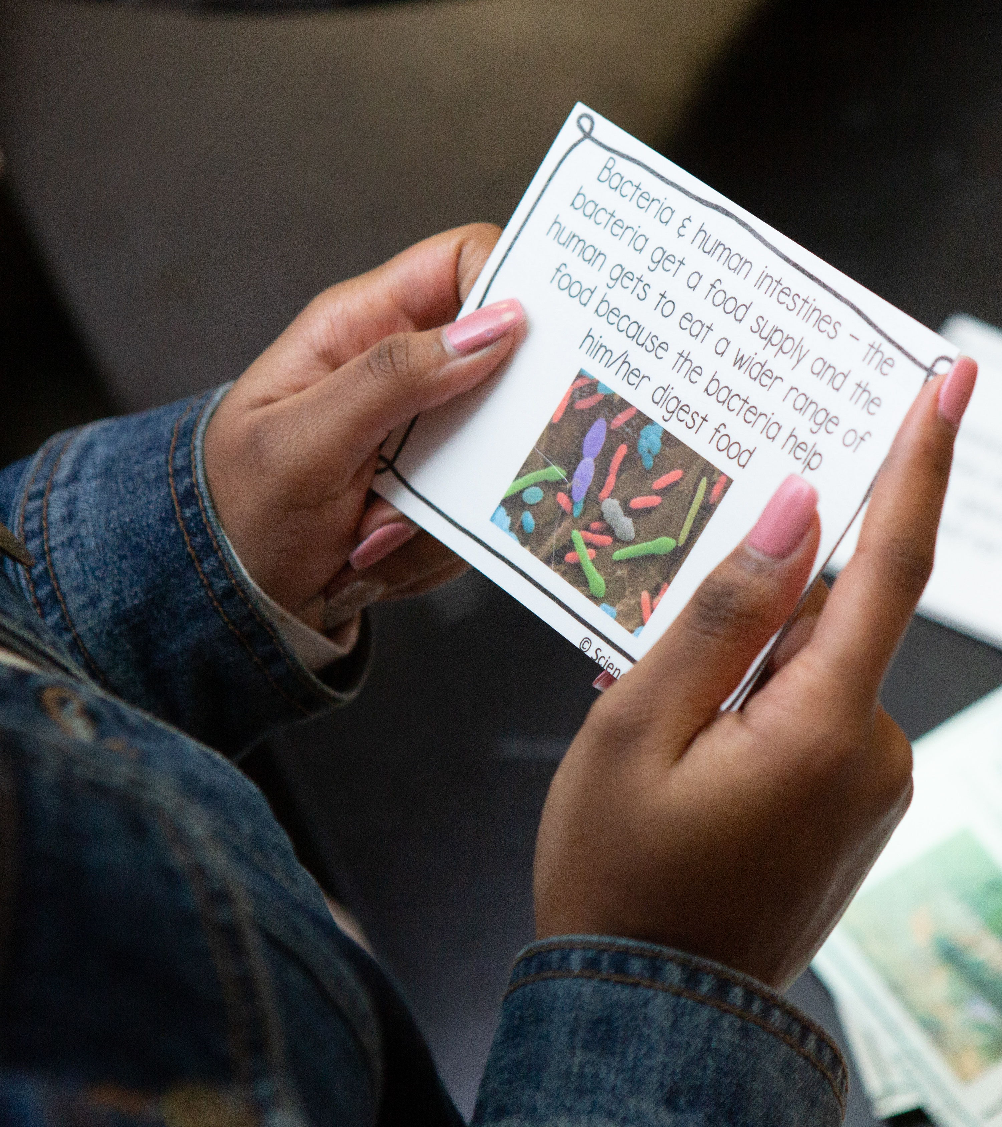
Sample Text Types in Science
Research articles
Lab reports
Technical papers
Instructions and manuals
Data representations and models
Multimodal texts (e.g., infographics, diagrams, videos) that explain scientific phenomena visually and textually
Notes:
Talking Points
Scientific literacy involves engaging with a range of text types that require students to be able to analyze evidence, interpret technical language, evaluate credibility and synthesize information to develop a deep understanding of scientific concepts and practices. Examples of scientific texts include research articles, lab reports, technical papers, field guides, data representations, and models and multimodal texts (e.g., infographics, diagrams, videos) that explain scientific phenomena visually and textually.
Facilitator Considerations
This slide is designed to invite science education educators to begin to think about the industry-specific texts in their field.
Considerations for interactivity:
Invite participants to read the types of text aloud.
Invite participants to share additional text types that are specific to their science field(s).
https://images.all4ed.org/close-up-of-student-with-science-cards

Slide 7
Reflect on Your Practice
Beyond the examples on the previous slide, what specific types of texts do students need to be able to interpret and create to succeed in your field?
What opportunities do your students have to practice reading and writing these types of text?
How do you support students with reading and writing these types of text?
Notes:
Talking Points
We'll start with a reflection so that you can ground the rest of our session in your own practice and get the most out of today.
Facilitator Considerations
This reflection invites participants to examine their current practices around literacy in science education.
Considerations for interactivity:
Give participants 2-4 minutes of quiet thinking time to jot down responses to these questions.
Use a think-pair-share structure: Have participants discuss their answers with a partner who teaches a different subject or section (3 minutes). If energy is low, do a quick stand-and-find activity where participants find someone across the room and have the conversation while standing.
Bring the group back together and ask for volunteers to share one surprising insight from their partner's field.

Slide 8
Practice 1: Help students expand scientific vocabulary and conceptual understanding by connecting to their prior knowledge.
1
How does leveraging students’ prior knowledge support their success?
Notes:
Talking Points
This is the first of four impactful practices. Each practice includes a description, an example and a potential pitfall to avoid.
These practices can be incorporated into your instruction to increase student skills in disciplinary literacy.
Facilitator Considerations
This slide transitions from reflection to learning more about the four highlighted practices.

Slide 9
Help students expand scientific vocabulary and conceptual understanding by connecting to their prior knowledge.
Scientific texts often include a high density of technical terms. Teachers can support students to build a conceptual understanding of a scientific topic by leveraging students’ existing world knowledge and everyday language before introducing specialized vocabulary. Encouraging students to communicate ideas in familiar terms helps them make meaningful connections, allowing for a smoother transition to using the technical terminology used in scientific texts.
Notes:
Talking Points
Every student walks into the classroom with knowledge and experiences that can become bridges to new learning. Some students have family members in STEM careers, while others have experiences with technology, animals or other activities that have ready connections to science. This prior knowledge is valuable when it comes to teaching specialized vocabulary and concepts.
When we connect new technical terms to what students already know, the learning sticks better. A student who's observed weather patterns understands meteorological concepts, even if they don't know the formal terminology yet. A student who's helped with home repairs grasps engineering principles and force calculations, providing a foundation for physics terms.
Making these connections explicit helps all students see themselves as capable learners in science education. When you say, "That's exactly right, and in science we call that..." you're validating their knowledge while building their professional vocabulary.
Facilitator Considerations
This slide emphasizes asset-based teaching and the importance of building on student knowledge to increase knowledge of discipline-specific terminology. Word knowledge and world knowledge go hand in hand and are mutually reinforcing.
Considerations for interactivity:
Ask participants to share a brief story about a time when a student's background knowledge surprised them or enhanced a lesson.
Have participants brainstorm in pairs or small groups: What types of background knowledge do your students typically bring? How could you better tap into this? (3 minutes)
If time allows, have participants think about students who might not have obvious connections to science or who are intimidated by science. How can we help them find entry points?

Slide 10
Example of helping students expand scientific vocabulary and conceptual understanding by connecting to their prior knowledge
After completing a lab experiment where fat and sodium hydroxide react to create soap, 8th grade students use everyday language to share their observations of the reaction. The teacher then introduces key technical terms, such as chemical reaction, reactants, products and compounds, deliberately connecting the students’ everyday language with the scientific terminology. The teacher facilitates a discussion on how these terms can be used to more accurately describe students’ observations and students revise their lab reports to ensure accurate use of important vocabulary.
Notes:
Talking Points
In this example, students start with what's familiar and build outward. Most students have observed chemical reactions in everyday life (e.g., cooking, metal rusting). Once they recognize that their existing knowledge connects to formal chemistry, suddenly a whole family of technical terms opens up: reactants, products, chemical bonds, molecular interactions. The unfamiliar becomes familiar.
Notice how the instructor lets students lead. Instead of pre-teaching vocabulary, they have students observe and describe the reaction first. This approach builds confidence, agency and conceptual understanding and helps avoid students feeling overwhelmed by technical jargon.
Studying parts of words, or morphology, works across all science fields. For example, in biology, students who know "photo" can use that knowledge to help remember the meaning of photosynthesis, phototropism and photoperiodism. In chemistry, knowing "hydro" means water unlocks hydrolysis and hydration.
Facilitator Considerations
This concrete example helps participants envision how the strategy might work in practice.
Considerations for interactivity:
After presenting the example, ask participants to try it with their own field. "Think of a common word from everyday life that connects to technical terms in your science field.”
Have participants create a quick word web on paper: everyday word, root, prefix or suffix in the center, technical terms branching out (2 minutes).

Slide 11
Potential Pitfall: Introducing new terminology without first exploring what students already know.
Why It Matters
When teachers include the step of exploring what students already know, they leverage valuable opportunities to connect new terms to familiar concepts.
Connecting new terms to familiar concepts can make new vocabulary feel more relevant and easier to understand.
Students are more likely to engage with content that feels familiar and accessible, especially when they have relevant knowledge to draw from.
Notes:
Talking Points
When we skip the exploration phase, we might spend time over-explaining concepts students already grasp in everyday terms, or worse, we might zoom past their confusion because we didn't realize they lacked foundational understanding. A student might know all about why ice floats on water but not recognize the term "density differences."
Students often inherit scientific conceptual knowledge from their experiences in the world. When we jump straight to technical language, students might feel like they're learning something completely new, when they're just learning technical names for familiar concepts.
Engagement is so important because when content feels inaccessible or irrelevant, students check out. But when they realize, "Oh, I actually know about this from watching the night sky with my family," suddenly they're leaning in, asking questions, making connections. That moment of recognition can transform their relationship with the material.
Facilitator Considerations
This slide addresses a common teaching challenge that many educators will recognize in their own practice.
Considerations for interactivity:
Quick reflection: Have participants write down one technical term they teach that students might have everyday knowledge about (30 seconds).
Partner discussion: Share your term and brainstorm what prior knowledge students might have about this concept (2 minutes).

Slide 12
Practice 2: Teach comprehension strategies specific to scientific texts.
How does using reading strategies foster student success?
Notes:
Talking Points
This is the second of four impactful practices. Each practice includes a description, an example and a potential pitfall to avoid.
This practice, like the others, can be incorporated into your instruction to increase student skills in disciplinary literacy.
Facilitator Considerations
This slide transitions from practice 1 to practice 2.

Slide 13
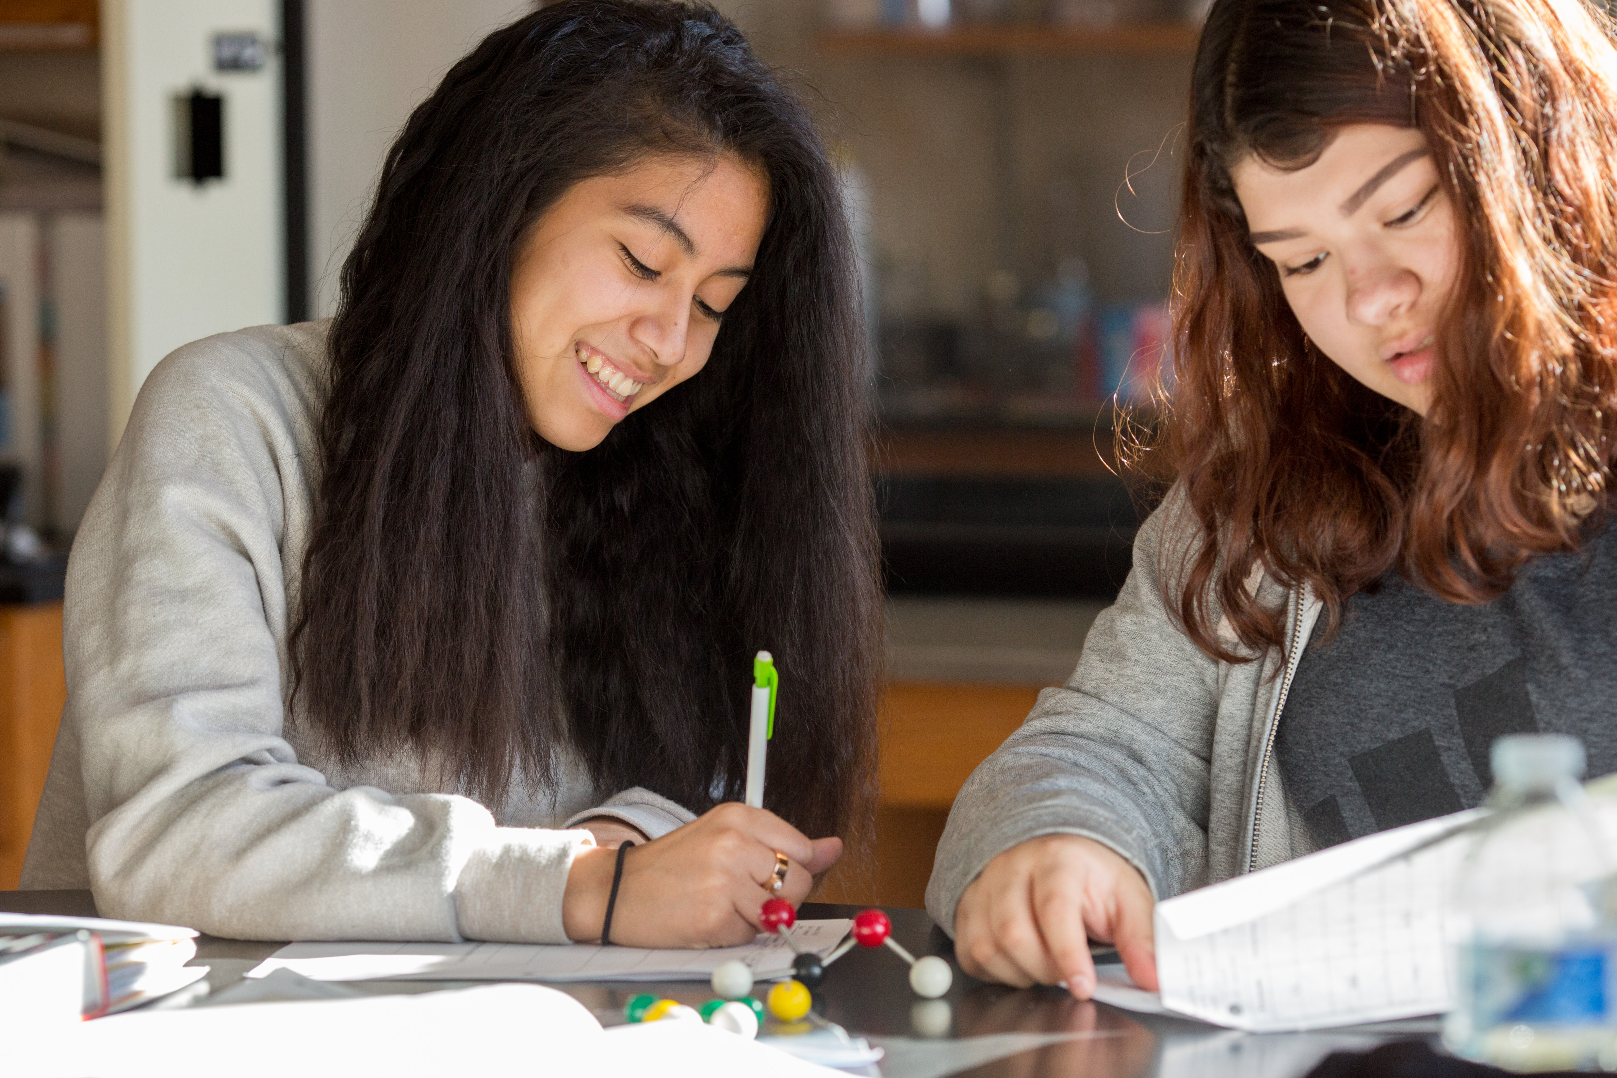
Teach comprehension strategies specific to scientific texts.
Students benefit when teachers clarify purposes for reading, how to break down conceptually dense text and how to interpret data sets and structures for presenting arguments and findings. Practicing discipline-specific comprehension strategies, like annotation and interpreting charts and graphs, supports students to engage deeply with scientific texts.
Notes:
Talking Points
Scientists develop specific ways of reading technical texts that are dependent upon the text's purpose. A marine biologist reading a species identification guide to identify a type of porpoise in the field uses different strategies than when interpreting a graph to understand trend data about porpoises in an area over time. A physics teacher scanning an equipment manual to troubleshoot a problem reads differently than when studying educational research about conceptual understanding. We can make these professional reading strategies visible and teachable. Without explicit instruction, these strategies are often invisible to students.
Using authentic texts is key because when students practice with real scientific publications, field studies, laboratory reports, or engineering specifications, they learn the actual strategies they'll need in STEM careers. Simplified versions don't prepare them for the complexity and variety of real workplace reading.
Students may think professionals just "know" how to read these texts naturally. By explicitly teaching these strategies, we show them that even experts use specific approaches. This demystification is especially important for students who are striving readers.
Facilitator Considerations
This slide introduces the concept of teaching discipline-specific reading strategies explicitly.
Considerations for interactivity:
Time permitting, refer participants to Table 6 S.2 General Reading Strategies Used by Scientists and Table 6 S.3 Discipline-Specific Reading Strategies Used by Scientists on page 131 of Oregon's Adolescent Literacy Framework
Think-pair-share: Have participants identify one type of text from their field and one specific strategy professionals use to read it (3 minutes).
Pose this question: "What reading strategies do your students struggle with most when encountering scientific texts?“
https://images.all4ed.org/girls-in-chemistry-class-2

Slide 14
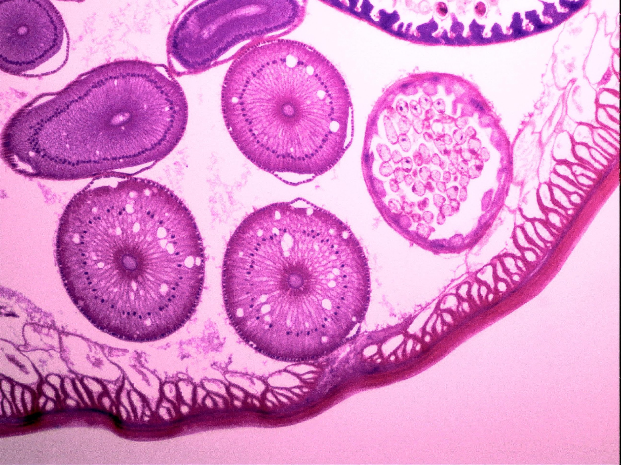
Example of teaching comprehension strategies specific to scientific texts.
To prepare for an investigation about cellular respiration, a science teacher models how to identify information that can be used as evidence to support a specific claim in a research article on cellular respiration. Students then review another text on their own to identify evidence to support a claim about cellular respiration.
Notes:
Talking Points
The instructor models with a think-aloud, making the invisible thinking that it takes to interpret scientific research visible. Students see how a professional organizes information from research articles to identify claims and supporting evidence. This modeling step is crucial.
The practice phase helps students learn to distinguish between evidence and interpretation, evaluate data quality and assess whether conclusions are well-supported.
This approach prepares students for authentic scientific discourse. When they learn to identify evidence to support claims about cellular respiration, they're experiencing the foundation of scientific argumentation used in scientific fields.
Facilitator Considerations
This detailed example provides a model for explicit strategy instruction in science education contexts.
Considerations for interactivity:
Small-group task: Design a similar evidence-identification activity. What scientific text would students evaluate? (3 minutes)
Share-out: Each group names their text and explains why evidence evaluation matters in their field.

Slide 15
Potential Pitfall: Providing real-world and authentic text without the explicit teaching of reading strategies.
Why It Matters
Providing reading support can make it easier for students to read authentic materials, as they may benefit from support to comprehend the long, dense sentences that often appear in scientific texts.
Supported, appropriately scaffolded instruction can nurture connection and engagement with texts and mathematical content, helping students be successful in the course.
Notes:
Talking Points
Providing students a scientific research article or laboratory protocol without teaching them how to read it is sort of like giving them lab equipment without showing them proper procedures. We wouldn't expect most students to use complex microscopes or telescopes without instruction. Professional texts require the same kind of explicit teaching. While it can feel as though students should come into the middle or high school science class already possessing the requisite literacy skills to read scientific texts, this often is not the case. Many students need explicit instruction to be able to interpret science texts.
Dense technical language, unfamiliar formatting, assumed background knowledge and scientific abbreviations can be challenging. In STEM careers, professionals constantly encounter new texts: updated research findings, safety protocols, technical specifications, continuing education materials. If students don’t develop discipline-specific reading strategies, they may be less likely to pursue STEM fields in college or career.
Facilitator Considerations
This slide highlights a common challenge that can undermine even the best intentions to use authentic materials.
Considerations for interactivity:
Small-group discussion: Share a time when students struggled with authentic texts. What happened? What did you learn? (2-3 minutes)
Collect common themes from the groups about where students typically get stuck.
Reflection prompt: "Think about one authentic text you use in your class. What specific strategies would help students read it successfully?"
Acknowledge that finding the balance between authentic materials and appropriate support is an ongoing challenge.

Slide 16
Practice 3: Teach students to clearly and accurately communicate complex scientific ideas in writing.
3
How does knowing how to use writing strategies lead to student success?
Notes:
Talking Points
This is the third of four impactful practices. Each practice includes a description, an example and a potential pitfall to avoid.
This practice, like the others, can be incorporated into your instruction to increase student skills in disciplinary literacy.
Facilitator Considerations
This slide transitions from practice 2 to practice 3.

Slide 17
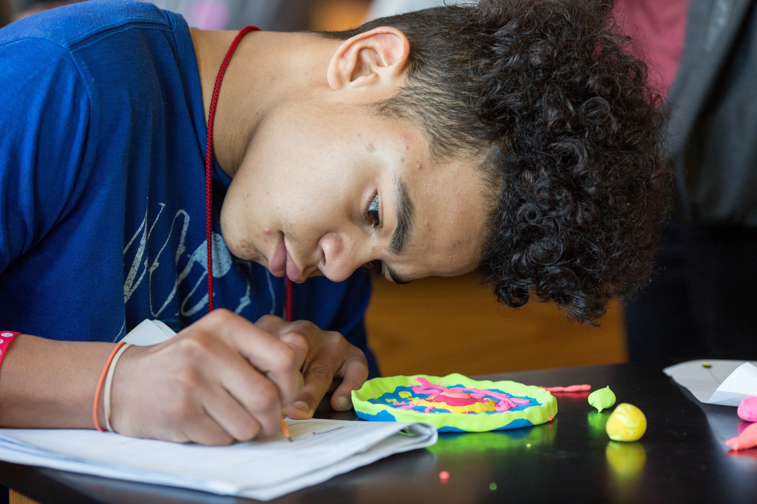
Teach students to clearly and accurately communicate complex scientific ideas in writing.
By analyzing authentic model texts and applying revision strategies to their own writing, such as refining word choice, restructuring sections for coherence and enhancing data representations, students refine their scientific reasoning, clarify their ideas and strengthen the connection between evidence and conclusions.
Notes:
Talking Points
Analyzing authentic model texts makes expert scientific writing strategies visible to students. For example, when students examine research articles from journals or field reports, they see how professionals structure arguments, integrate data representations and connect evidence to conclusions.
Revisions to student writing can help improve scientific reasoning itself. When students apply revision strategies like refining word choice, they move from vague descriptions ("the water was not good for salmon") to precise scientific language ("dissolved oxygen levels decreased to 4.2 mg/L, below the threshold for salmon survival"). This precision strengthens their understanding of scientific concepts.
Enhancing data representations is one place where writing and scientific thinking merge. When chemistry students revise their reaction rate experiments by creating clearer graphs or improving data tables, they're clarifying their scientific ideas and strengthening connections between evidence and conclusions. The revision process builds the same iterative thinking that drives scientific discovery.
Facilitator Considerations
This slide emphasizes how revision strategies in scientific writing develop both communication skills and scientific reasoning simultaneously.
Considerations for interactivity:
Ask participants to share an example of when student revision led to deeper scientific understanding (2 minutes).
Partner discussion: What specific revision strategies do you teach? How do these improve both writing and scientific thinking? (3 minutes)
Reflection: "How do you help students see revision as scientific thinking rather than just editing?"
https://images.all4ed.org/boy-writing-in-science-class

Slide 18

Example of teaching students to clearly and accurately communicate complex scientific ideas in writing
To prepare for writing lab reports in a physics class, students analyze model lab reports. They use a peer-review rubric to assess the clarity and accuracy of explanations of an egg drop experiment and provide targeted feedback on precision, ensuring that explanations of velocity, acceleration and force calculations are logically structured, supported by evidence and scientifically accurate. The teacher then leads the class through a collaborative revision of one of the model lab reports.
Notes:
Talking Points
This physics example demonstrates how reading and writing work together. The teacher starts students off with authentic texts. By analyzing model lab reports, students can more easily see writing strategies that good scientific writers use, as well as those used by less effective writers.
The explicit teaching of lab report analysis bridges the gap between reading and writing. Students learn which data matters most, how to identify precise language and why certain organizational structures help communicate scientific findings effectively across different physics concepts.
Using peer review for egg drop experiments transforms learning into collaborative scientific practice. Students apply their analysis skills to provide meaningful feedback on explanations of velocity, acceleration and force. They must consider scientific accuracy while helping peers communicate complex physics concepts clearly and logically.
Facilitator Considerations
This example shows how analyzing authentic model texts can support students in understanding the structure and features of disciplinary texts.
For this routine to work best, the teacher should use a variety of model lab reports, some that are very high quality and others that are less so.
Considerations for interactivity:
Small-group activity: Design a similar sequence for your class: What texts might your students analyze? (3 minutes)
Discuss: "How do you help students translate technical information for different audiences?"
Image source: PowerPoint stock

Slide 19
Potential Pitfall: Using inauthentic or artificial writing models and not supporting students to engage in multi-draft writing.
Why It Matters
When students are given writing tasks that reflect scientific norms and purposes, they can often clearly see the purpose and value in their work.
With a clear connection to authentic and relevant practices, motivation and engagement can quickly increase.
Meaningful context also provides valuable practice for students to develop the skills they need to succeed in course and in future endeavors that involve science.
Notes:
Talking Points
Generic writing assignments can disconnect some students from their work because it can feel irrelevant. When science students write traditional essays about scientific topics instead of, for example, actual lab reports or environmental impact statements, they miss crucial practice that helps them develop scientific understanding, but also a better understanding of what a professional scientist does. When assignments feel artificial, students may treat them as less authentic school exercises rather than relevant professional skill development.
Facilitator Considerations
This slide addresses a fundamental challenge in creating meaningful writing experiences.
Considerations for interactivity:
Think-pair-share: Identify one current writing assignment that could be more authentic (2 minutes).
Collect examples of artificial versus authentic alternatives on a visible chart.
Group problem-solving: Choose one artificial task and collaboratively redesign it for authenticity.
Possible extension activity
Ask educators to think about the use of their high-quality instructional materials and find an engaging writing task. Teachers could do this in small groups and then share out.

Slide 20
Practice 4: Provide structured opportunities for scientific dialogue and discussion.
4
How do engagement strategies foster student success?
Notes:
Talking Points
This is the final of the impactful practices in the session today. Each practice includes a description, an example and a potential pitfall to avoid.
This practice, like the others, can be incorporated into your instruction to increase student skills in disciplinary literacy.
Facilitator Considerations
This slide transitions from practice 3 to practice 4.

Slide 21
Support structured opportunities for discussion and collaboration.
Authentic discussions enable students to critically analyze scientific texts, evaluate evidence, question assumptions and engage in inquiry-driven conversations that deepen their understanding of complex concepts. Educators support students by modeling how to engage in productive scientific discussions and structuring opportunities for collaborative investigations of real-world phenomena, where students formulate questions, use evidence to support explanations and arguments and communicate findings.
Notes:
Talking Points
Collaborative discussions in science education go far beyond casual conversation. They're structured opportunities for students to engage in the same critical thinking that drives scientific discovery. When students critically analyze scientific texts together, they learn to question assumptions, evaluate evidence quality and challenge each other's interpretations
Inquiry-driven conversations deepen understanding of complex concepts because students must articulate their reasoning to peers.
Modeling productive scientific discussions is essential because students need to see what professional scientific communication looks like. Teachers can demonstrate how scientists ask probing questions ("What evidence supports this claim?"), challenge assumptions respectfully ("Have we considered alternative explanations?"), and build on each other's ideas using precise terminology. This modeling shows students that scientific discussion follows specific protocols and purposes.
Structuring collaborative investigations of real-world phenomena, such as analyzing water quality data from the Columbia River or studying biodiversity changes in Oregon's old-growth forests, gives students authentic reasons to formulate questions, support explanations with evidence and communicate findings. These structured opportunities transform classroom discussions into genuine scientific practice where students learn to think and talk like scientists.
Facilitator Considerations
This slide emphasizes how structured scientific discussions develop both content understanding and professional communication skills.
Considerations for interactivity:
Quick brainstorm: What real-world phenomena could generate authentic scientific discussions in your classroom? (1 minute)
Partner activity: Design one collaborative investigation that would require students to use evidence-based reasoning. (3 minutes)
Share examples that develop specific scientific communication skills.

Slide 22

Example of supporting structured opportunities for discussion and collaboration
In an Earth sciences unit, students read texts in their adopted curriculum about climate change, including shifts in Earth’s carbon reservoirs, short- and long-term carbon cycles, temperature and atmospheric gas data and human activities. The teacher facilitates a group discussion of the pros and cons of one strategy to combat climate change, then students talk in partners about different strategies. They use scientific terminology and details from the text to support recommendations that evidence suggests will be most effective.
Notes:
Talking Points
The structured preparation phase is an important part of this lesson. Using texts from the adopted curriculum as the foundation for analysis teaches students to ground their communication in scientific evidence. They learn to cite specific data about carbon reservoirs, reference temperature trends and explain climate solutions using precise terminology. This approach builds credibility and demonstrates the connection between technical knowledge and effective communication.
Partner discussions develop essential collaboration skills as students learn to articulate complex relationships between human activities and natural systems, using evidence from texts to support their recommendations. When they debate strategies to combat climate change, they're experiencing the same evidence-based reasoning used in most science fields.
The progression from whole-group to partner discussions scaffolds students' confidence while building their ability to engage in professional scientific discourse. Students move from listening to expert modeling to independently using scientific terminology and evidence to support their own recommendations about climate strategies.
Facilitator Considerations
This example demonstrates structured preparation leading to meaningful professional dialogue about real-world scientific issues.
Considerations for interactivity:
Ask participants to identify similar text-based analysis opportunities in their science fields.
Share scenarios that would generate authentic professional discussions in biology, chemistry or physics.
Discuss: "What preparation would students need to handle these conversations professionally using scientific evidence?"
Image source: PowerPoint stock

Slide 23
Potential Pitfall: Students are asked to participate in discussions without receiving clear models of professional communication.
Why It Matters
When students are asked to participate in scientific discussions with clear models, they are more likely to understand and practice what effective communication looks and sounds like in this setting.
Modeling for students helps them engage in precise, formal and appropriate responses that allow the opportunity to build communication skills along with the ability to explain and reason scientifically.
With examples to guide them, students may feel surer and more prepared, promoting both their engagement and their growth in the discipline.
Notes:
Talking Points
Without models, students may default to casual conversation or misconceptions, using vague language like "the experiment worked" instead of describing specific data patterns and evidence, or struggling to explain scientific phenomena if they've never heard professionals do it. A student might say "the plants grew better" rather than "increased nitrogen availability resulted in 23% greater biomass production compared to the control group."
Without clear models of professional scientific communication, students miss crucial communication elements: how to present data objectively, when to use technical versus accessible language and how to construct evidence-based arguments. They risk not developing the verbal cues that signal scientific competence, such as confident use of scientific terminology, precise data citations and logical reasoning, which mark professional communication in STEM fields.
When students participate in scientific discussions without understanding professional norms, they may offer opinions rather than evidence-based reasoning, make unsupported claims or fail to engage with data critically. This leads to missed opportunities for developing the collaborative scientific thinking essential for careers in research, environmental science, healthcare and engineering. Students may feel unprepared for college-level science courses or STEM internships where professional scientific discourse is expected.
Facilitator Considerations
This slide addresses an oversight that undermines communication development in science education.
Considerations for interactivity:
Quick reflection: What communication model(s) would help your students most? (1 minute)
Table discussion: Share ideas for providing models, such as videos of scientists discussing research, guest professionals demonstrating data presentations or teacher modeling of scientific argumentation.
Discussion: What prevents us from providing good models? What are some possible solutions?

Slide 24
Final Reflection
How can you learn more about the literacy strengths and related background knowledge of your students?
How can you incorporate authentic opportunities for students to build their disciplinary knowledge through speaking, listening, reading and writing?
What text types could your students use more support to read? To write?
What new opportunities for authentic, discipline-specific discourse would you like to try in your class?
Notes:
Talking Points
As we wrap up our exploration of disciplinary literacy in science, take a moment to consider where you want to focus your efforts. Each of these questions targets a different aspect of what we've discussed today. You might choose the question that addresses your biggest challenge, or perhaps the one where you see the most opportunity for immediate impact in your classroom.
Choose one or two questions that resonate with your current teaching context. Consider what's feasible given your curriculum timeline, available resources and student needs. Remember, small changes can have a significant impact when they're strategically chosen and thoughtfully implemented.
Facilitator Considerations
This reflective closing helps participants synthesize learning and commit to actionable next steps.
Considerations for interactivity:
Provide 2-3 minutes of quiet reflection time for participants to review the questions and select their focus.
Offer participants the choice to reflect individually in writing or discuss with a partner.
If discussing with partners, suggest they share not just which question they chose, but why it feels most relevant.
Remind participants these questions can guide ongoing professional development throughout the year.

Slide 25

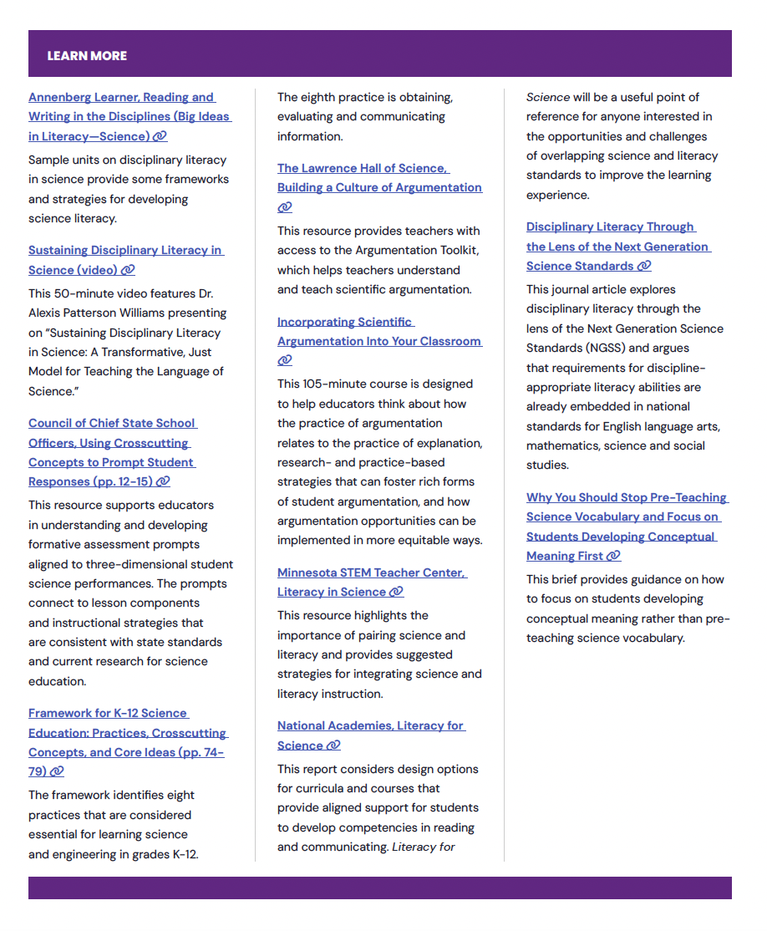
More Resources from Oregon’s Adolescent Literacy Framework
Section 6: Disciplinary Literacy in Science, Page 137
Notes:
Talking Points
As a reminder and invitation, Oregon's Adolescent Literacy Framework offers a list of resources specifically designed to support science educators in developing disciplinary literacy. The framework recognizes that science education requires unique approaches to reading, writing and communication, providing targeted guidance for integrating literacy into science instruction.
The QR code will lead you to the framework.
Facilitator Considerations
This slide provides concrete next steps and additional support for implementing disciplinary literacy strategies.
Considerations for interactivity:
Give participants 1-2 minutes to scan the resources and identify one that addresses their reflection focus.
Quick share: Have 2-3 participants name the resource they're most interested in exploring and why.
If time allows, demonstrate navigating to one resource to show ease of access.
Remind participants that these resources can support both immediate changes and long-term professional development.

Slide 26
Navigating Oregon’s Adolescent Literacy Framework
SECTION
1
GOAL
Disciplinary literacy is essential for postsecondary success
2
CONDITIONS
High Expectations
Culturally Responsive Practice
Engagement
3
SUPPORTS
Multilingual Learners
Students with Disabilities
4–5
ALL-PURPOSE SKILLS
Reading Skills
Writing Skills
DISCIPLINE-SPECIFIC READING AND WRITING SKILLS
6
LANGUAGE ARTS
MATH
SCIENCE
SOCIAL SCIENCES
CAREER & TECHNICAL EDUCATION
HEALTH & PHYSICAL EDUCATION
Notes:
Talking Points
Oregon's Adolescent Literacy Framework provides the foundation for everything we've explored today. The first three chapters establish why disciplinary literacy matters for science students' postsecondary success and how to create the conditions and supports for students to be successful.
Chapter 2's focus on conditions, including high expectations, culturally responsive practice and engagement, directly connects to our discussion about leveraging student background knowledge. When we recognize students' experiences and set high expectations for professional communication, we create the conditions for meaningful learning. The framework shows how these conditions specifically support science students in developing career-ready literacy skills.
Chapter 3 addresses supports for multilingual learners and students with disabilities, populations we all serve. The framework provides strategies for making scientific texts accessible while maintaining rigor. As you read these chapters, you'll find practical approaches for supporting all students in mastering the complex literacy demands of science education.
Facilitator Considerations
This closing slide encourages continued learning through framework exploration.
Considerations for interactivity:
Consider asking for a commitment: "Who will commit to reading at least one chapter before our next meeting?"
Quick planning: Have participants identify when they'll read the framework chapters (add to calendar).
Buddy system: Encourage participants to find a reading partner for accountability and discussion.
Close with appreciation for their engagement and a reminder that improving disciplinary literacy is ongoing professional work.

Slide 27
Oregon’s Instructional Frameworks: Adolescent Literacy

