Slide 1

Supporting Disciplinary Literacy in Mathematics

Slide 2
Opening Reflection:
Disciplinary Literacy Is a Gateway to Career Success
“To succeed, adolescents need excellent instruction combined with a sense of belonging as valued members of the class and school community. This means recognizing the genius and persistence each student brings to their learning and demonstrating the belief that students are capable of learning, achieving and thriving academically.” (Oregon Adolescent Literacy Framework, page 27)
“Disciplinary literacy cultivates adolescents’ ability to think, read, write and communicate like experts in a field of study.” (Oregon Adolescent Literacy Framework, page 14)
“Effective classrooms begin by helping students establish authentic purposes.” (Oregon Adolescent Literacy Framework, page 20)
Reflection: What “genius and persistence” have you seen students bring to your class that might have been overlooked in other disciplines?
Notes:
Talking Points
Ask participants to read the quotes and share out words or ideas that resonate with them.
Reflection prompt: What “genius and persistence” have you seen students bring to your class that might have been overlooked in other disciplines?
Facilitator Considerations
This slide lays the groundwork for the importance of disciplinary literacy to course and career success.

Slide 3
Session Agenda
Opening reflections and discussions:
  The reinforcing nature of disciplinary literacy and content
  Disciplinary literacy in mathematics
Practice 1: Teach students to understand and use the language of mathematics by making connections to their understanding of the world.
Practice 2: Teach students strategies to read complex mathematical texts.
Practice 3: Teach students to write like mathematicians.
Practice 4: Support structured opportunities for mathematical dialogue.
Final reflection: Taking action
Notes:
Talking Points
Session purpose: Mathematics teachers will reflect on their practice and explore disciplinary literacy strategies that help students strengthen their ability to read, write and communicate in mathematics courses and careers.
Review the agenda, highlighting that the session begins and ends with reflection. The bulk focuses on four practices teachers can enact to support disciplinary literacy in science.
Practice 1 addresses leveraging students' background knowledge to build discipline-specific vocabulary. Practice 2 teaches strategies for comprehending scientific texts. Practice 3 provides authentic opportunities for discipline-specific writing. Practice 4 offers structured discussion and collaboration.
Together, these practices address all literacy modalities—reading, writing, speaking, and listening—within authentic mathematics contexts. Each practice includes a description, a classroom example and a potential pitfall to avoid.
Facilitator Considerations
This slide describes the arc of the session and can help participants understand what’s to come.

Slide 4


Reflect and Share
Disciplinary literacy is the ability to read, write, think and communicate, using the specific practices and language of a field of study.
Disciplinary content includes the core knowledge, concepts and skills students need to understand and work within a specific field of study.
How are these two concepts mutually reinforcing?
Notes:
Talking Points
After participants have had a chance to reflect and share, highlight any of the following that did not come out in conversation:
Disciplinary literacy and disciplinary content work together. For example, you can't analyze statistical data embedded within a research report without being able to read that report. You can't develop engineering solutions without interpreting technical specifications. The knowledge and the literacy skills develop hand in hand.
When students learn to read like mathematicians, they gain deeper access to content knowledge. A student studying statistics who can effectively read peer-reviewed research articles isn't just completing an assignment; they're building the foundation for evidence-based data analysis. The literacy skills become the gateway to more sophisticated understanding.
This relationship works both ways. As students develop deeper content knowledge, they become better readers and writers of math-related texts. They start recognizing patterns in discipline-specific texts, understanding why certain information is emphasized and organized in specific ways, and knowing what details matter most. Their growing expertise helps them navigate complex documents more effectively.
Facilitator Considerations
This slide introduces key terminology while helping participants see the interconnected nature of literacy and content.
Considerations for interactivity:
Ask participants to turn to a neighbor and share one specific example from their teaching where students' literacy skills directly impacted their ability to master content (2 minutes). Facilitate a brief whole-group discussion where 3-4 participants share their examples.
If participants seem stuck, prompt with: "Think about a time when a student's reading difficulty prevented them from learning important content. How did you address both needs?"
Consider how mathematicians continue learning throughout their careers. They read mathematical journals, research studies and new curriculum standards. They write lesson plans, grant proposals and assessment reports. The literacy practices aren't separate from the work; they are the work. As you reflect on these concepts, take a minute to consider what your current practice of both looks like.

Slide 5



The Importance of Disciplinary Literacy in Mathematics
At its core, disciplinary literacy in math is about the process of fluently translating between written and spoken language and the language of mathematics. Developing these skills opens opportunities for individuals to gain new knowledge through problem-solving and logical reasoning (Oregon’s Adolescent Literacy Framework, page 115).
Notes:
Talking Points
Disciplinary literacy in mathematics goes beyond general reading and writing skills. It's also about mastering the specific ways mathematicians communicate, think and solve problems. Whether students are learning to interpret statistical data, write mathematical proofs using logical reasoning or interpret mathematical research articles, they're developing the authentic literacy practices of potential future careers in STEM fields.
Each mathematics field has its own "language" that includes technical vocabulary, symbols, formulas and conventions that practitioners must fluently use. This specialized language helps ensure accuracy, precision and professionalism in mathematical settings.
Facilitator Considerations
This slide establishes the foundational concept of disciplinary literacy in mathematics education contexts.
Considerations for interactivity:
Ask participants to briefly share one example of specialized language from their mathematics field (30 seconds).
After presenting the framework quote, invite 2-3 participants to share how they've seen disciplinary literacy empower their students.
Consider asking: "How is the literacy in math different from what students learn in language arts classes?"

Slide 6

Sample Text Types in Math
Example text types that integrate graphs, pictures, diagrams and symbolic representations:
Math textbooks
Worksheets
Word problems
Notes:
Talking Points
Texts in mathematics can be complex and abstract with symbols, formulas, notations and descriptions of concepts and procedures. These texts include math textbooks, worksheets and word problems, which may integrate graphs, pictures, diagrams and symbolic representations. Additionally, mathematical arguments include proofs and theorems, mathematical theories and solutions.
Facilitator Considerations
This slide is designed to invite mathematics education educators to begin to think about the industry-specific texts in their field.
Considerations for interactivity:
Invite a participant to read the text aloud.
After you read the text, invite participants to share additional text types that are specific to their mathematics field.

Slide 7
Reflect on Your Practice
Beyond the examples on the previous slide, what specific types of texts do students need to be able to interpret and create to succeed in your field?
What opportunities do your students have to practice reading and writing these types of text?
How do you support students with reading and writing these types of text?
Notes:
Talking Points
We'll start with a reflection so that you can ground the rest of our session in your own practice and get the most out of today.
Facilitator Considerations
This reflection invites participants to examine their current practices around literacy in mathematics education.
Considerations for interactivity:
Give participants 2-4 minutes of quiet thinking time to jot down responses to these questions.
Use a think-pair-share structure: Have participants discuss their answers with a partner (3 minutes).
Bring the group back together and ask for volunteers to share one insight from their partner discussion.
If energy is low, do a quick stand-and-find activity where participants find someone who teaches a different grade, subject or section to compare the types of texts their students encounter.

Slide 8
Practice 1:
Teach students to understand and use the language of mathematics by making connections to their understanding of the world.
1
How does leveraging student’s prior knowledge support their success?
Notes:
Talking Points
This is the first of four impactful practices. Each practice includes a description, an example, and a potential pitfall to avoid.
These practices can be incorporated into your instruction to increase student skills in disciplinary literacy.
Facilitator Considerations
This slide transitions from reflection to learning more about the four highlighted practices.

Slide 9
Teach students to understand and use the language of mathematics by making connections to their understanding of the world.
Teachers can support students' understanding and proficiency in mathematics first by helping them connect their knowledge of the world around them with mathematical concepts; then, teachers can help students apply specialized mathematical vocabulary used to convey these concepts, including through equations, graphs and geometric representations.
Notes:
Talking Points
Every student walks into the classroom with knowledge and experiences that can become bridges to new learning. Since mathematics is all around us, students bring a wealth of knowledge about the world and the way it works into the mathematics classroom.
When we connect new technical terms to what students already know, the learning sticks better. A student who's observed patterns in games understands probability concepts, even if they don't know the formal terminology yet. A student who's helped with budgeting or worked in retail grasps proportional reasoning and percentage calculations, providing a foundation for algebra terms.
Making these connections explicit helps all students see themselves as capable learners in mathematics education. When you say, "That's exactly right, and in math we call that..." you're validating their knowledge while building their professional vocabulary.
Facilitator Considerations
This slide emphasizes asset-based teaching and the importance of building on student knowledge to increase knowledge of discipline-specific terminology. Word knowledge and world knowledge go hand in hand and are mutually reinforcing.
Considerations for interactivity:
Ask participants to share a brief story about a time when a student's background knowledge surprised them or enhanced a lesson.
Have participants brainstorm in pairs or small groups: What types of background knowledge do your students typically bring? How could you better tap into this? (3 minutes)
If time allows, have participants think about students who might not have obvious connections to mathematics or who feel intimidated by it. How can we help them find entry points?

Slide 10
Example of teaching students to understand and use the language of mathematics by making connections to their understanding of the world
An 8th grade math teacher guides students through a project to help plan their school’s new community garden. The school seeks to maximize space for garden plots and make room for composting bins. The teacher asks students to make predictions based on their practical experiences with volume, encouraging them to form conjectures about how much space plants need to grow. The teacher then helps students connect their knowledge to mathematical concepts related to volume and surface area and use precise mathematical vocabulary to describe these concepts as a rationale in a garden design proposal.
Notes:
Talking Points
In this example, students start with what's familiar and build outward. Most students have observed spatial relationships in everyday life (e.g., arranging furniture, packing boxes, parking a car). Once they recognize that their existing knowledge about space usage connects to formal geometry, a family of technical terms opens up: volume, surface area, optimization, geometric constraints. The unfamiliar becomes familiar.
Notice how the instructor asks students to lead their own learning. Instead of pre-teaching vocabulary, they have students observe and describe the spatial relationships first. This approach builds confidence and agency and helps avoid students feeling overwhelmed by technical jargon.
Studying parts of words, or morphology, works across all mathematics fields. For example, in geometry, students who know "poly" can understand polygon, polyhedron, and polynomial. In algebra, knowing "bi" means two provides clues to the meaning of binomial, bisect and bivariate.
Facilitator Considerations
This concrete example helps participants envision how the strategy works in practice.
Considerations for interactivity:
After presenting the example, ask participants to try it with their own field. "Think of a common word from everyday life that connects to technical terms in your mathematics field."
Have participants create a quick word web on paper: everyday root, prefix or suffix in the center with technical terms branching out (2 minutes).
Participants discuss how word webs could support students in authentic discussions and mathematics writing assignments.

Slide 11
Potential Pitfall:
Introducing new terminology without first exploring what students already know.
Why It Matters
When teachers include the step of exploring what students already know, they leverage valuable opportunities to connect new terms to familiar concepts.
Connecting new terms to familiar concepts can make new vocabulary feel more relevant and easier to understand.
Students are more likely to engage with content that feels familiar and accessible, especially when they have relevant knowledge to draw from.
Notes:
Talking Points
When we skip the exploration phase, we might spend time over-explaining concepts students already grasp in everyday terms, or worse, we might zoom past their confusion because we didn't realize they lacked foundational understanding. A student might know all about "splitting things equally" but not recognize the term "division" or "quotient."
When we jump straight to technical language, students might feel like they're learning something completely new, when they're just learning discipline-specific names for familiar concepts.
Engagement is so important because when content feels inaccessible, students check out. But when they realize, "Oh, I actually know about this from sharing pizza with my family," suddenly they're leaning in, asking questions, making connections. That moment of recognition can transform their relationship with the material.
Facilitator Considerations
This slide addresses a common teaching challenge that many educators will recognize in their own practice.
Considerations for interactivity:
Quick reflection: Have participants write down one technical term they teach that students might have everyday knowledge about (30 seconds). Partner discussion: Share your term and brainstorm what prior knowledge students might have about this concept (2 minutes).

Slide 12
Practice 2:
Teach students strategies to read complex mathematical texts.
How does using reading strategies foster student success?
Notes:
Talking Points
This is the second of four impactful practices. Each practice includes a description, an example and a potential pitfall to avoid.
This practice, like the others, can be incorporated into your instruction to increase student skills in disciplinary literacy.
Facilitator Considerations
This slide transitions from practice 1 to practice 2.

Slide 13

Teach students strategies to read complex mathematical texts.
Explicit instruction in mathematics-specific reading strategies—such as math talks, using evidence to support claims, annotating texts and rephrasing or summarizing—helps students develop a deeper understanding of mathematical concepts.
Notes:
Talking Points
Mathematicians develop specific ways of reading their technical texts that are dependent upon the text's purpose. A statistician analyzing data across multiple studies uses different strategies than when reading a paper on a complex mathematical theory. A mathematics teacher scanning a curriculum guide reads differently than when studying educational research about conceptual understanding. We can make these professional reading strategies visible and teachable. Without explicit instruction, these strategies can be invisible to students.
Using authentic texts is key because when students practice with real math publications, research studies, textbook proofs or problem-solving guides, they learn the actual strategies they'll need in STEM careers. Simplified or basic worksheet versions don't prepare them for the complexity and variety of real workplace reading.
Students may think professionals just "know" how to read these texts naturally. By explicitly teaching these strategies, we show them that even experts use specific approaches. This demystification is especially important for students who are striving readers.
Facilitator Considerations
This slide introduces the concept of teaching profession-specific reading strategies explicitly.
Considerations for interactivity:
Time permitting, refer participants to Table 6 M.2 General Reading Strategies Used by Mathematicians and Table 6 M.3 Discipline-Specific Reading Strategies Used by Mathematicians on pages 119 of Oregon's Adolescent Literacy Framework.
Think-pair-share: Have participants identify one type of text from their field and one specific strategy professionals use to read it (3 minutes).
Pose this question: "What reading strategies do your students struggle with most when encountering professional texts?"

Slide 14

Example of teaching students strategies to read complex mathematical texts
A high school math teacher leads her students through writing mathematical arguments about a choice of car for a family of five to take on a long-distance road trip, considering fuel efficiency and interior capacity. Then, students carefully read and critique each other’s arguments for mathematical soundness, articulating to each other what about the arguments is clear and convincing and where the arguments could be improved. The teacher supports students’ critiques by providing sentence starters.
Notes:
Talking Points
This instruction and practice example uses real-world problem solving, where students learn to distinguish between assumptions and conclusions, evaluate logical soundness and assess whether arguments are well-supported.
This approach prepares students for authentic mathematical discourse. When they learn to identify logical arguments about optimization problems, they're experiencing the foundation of mathematical reasoning used in engineering, economics and data science.
Most students benefit from support when learning how to explain their mathematical ideas to someone, including explaining how the math behind those ideas works. Notice how the instructor provides sentence starters to support her students in having these conversations.
Facilitator Considerations
This detailed example provides a model for explicit strategy instruction in mathematics education contexts.
Considerations for interactivity:
Small group task: Design a similar argument-analysis activity. What mathematics text would you use? What claim would students evaluate? (3 minutes) Share out: Each group names their text and explains why logical evaluation matters in their field.

Slide 15
Potential Pitfall:
Providing authentic mathematics texts without the explicit teaching of reading strategies.
Why It Matters
Providing reading support can make it easier for students to read authentic materials, as they may benefit from support to comprehend mathematical language.
Supported, appropriately scaffolded instruction can nurture connection and engagement with texts and mathematical content, helping students be successful in the course.
Notes:
Talking Points
Providing students a mathematical research article or complex proof without teaching them how to read it is sort of like giving them advanced calculators without showing them proper procedures. We wouldn't expect most students to use complex statistical software or graphing tools without instruction. Mathematics texts require the same kind of explicit teaching. While it can feel as though students should come into the middle or high school math class already possessing the requisite literacy skills to read math texts, this often is not the case. Many students need explicit instruction to be able to interpret math texts.
Dense technical language, unfamiliar formatting, assumed background knowledge and mathematical notation can be challenging. This pitfall has potentially long-term consequences. In STEM careers, professionals constantly encounter new texts: updated research findings, technical specifications, algorithm documentation, continuing education materials. Students need to learn reading strategies as much as they need computational skills to become proficient.
Facilitator Considerations
This slide highlights a common challenge that can undermine even the best intentions to use authentic materials.
Considerations for interactivity:
Ask something like: "How many of you have seen students shut down when faced with complex technical texts?"
Small-group discussion: Share a time when students struggled with an authentic math text. What happened? What did you learn? (2-3 minutes)
Collect common themes from the groups about where students typically get stuck.
Reflection prompt: "Think about one authentic text you use in your class. What specific strategies would help students read it successfully?"
Acknowledge that finding the balance between authentic materials and appropriate support is an ongoing challenge.

Slide 16
Practice 3:
Teach students to write like mathematicians.
3
How does knowing how to use writing strategies lead to student success?
Notes:
Talking Points
This is the third of four impactful practices. Each practice includes a description, an example and a potential pitfall to avoid.
This practice, like the others, can be incorporated into your instruction to increase student skills in disciplinary literacy.
Facilitator Considerations
This slide transitions from practice 2 to practice 3.

Slide 17
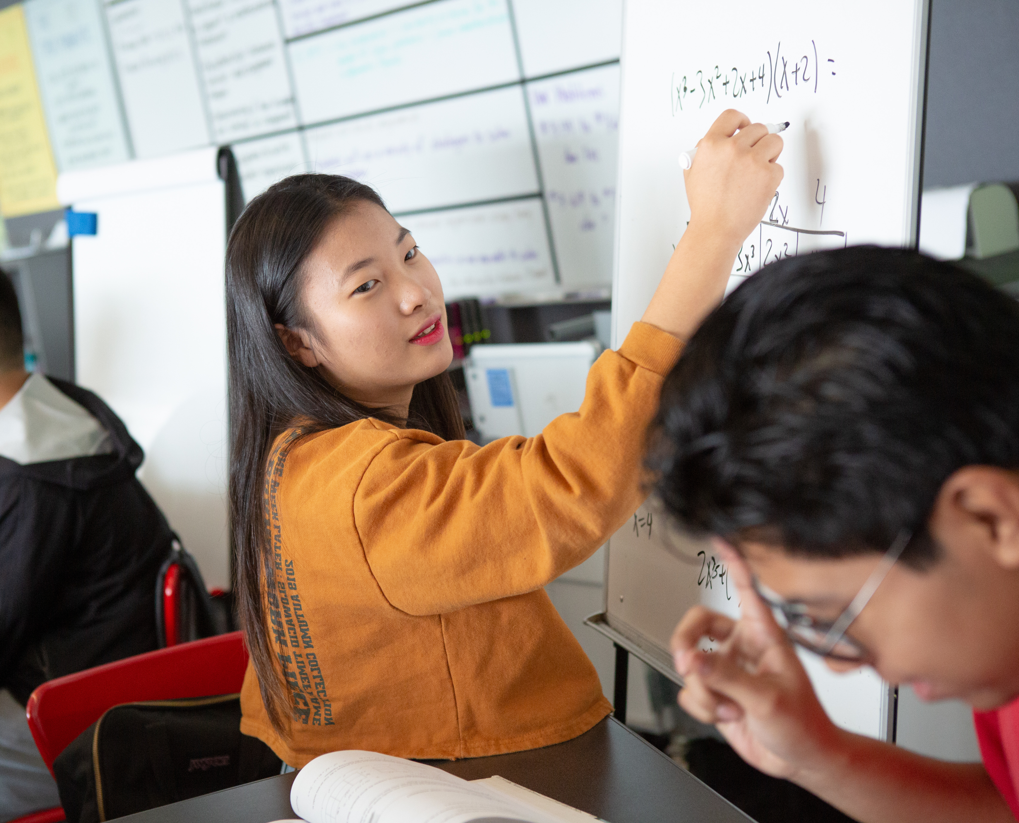
Teach students to write like mathematicians.
Writing in mathematics supports student thinking and exploration of ideas; teachers can support their students by providing explicit instruction of mathematical writing, including writing clear, precise and detailed descriptions and using visual and symbolic representations.
Notes:
Talking Points
Students need practice with various genres because each serves a distinct purpose.
Every mathematics field has writing tasks. Mathematics teachers write lesson plans, assessments and instructional sequences. Applied mathematicians produce technical reports, algorithm documentation and research proposals. Statistics educators create data visualization guides, analysis reports and educational materials. Each document follows conventions that students must master for professional success.
Understanding audience and purpose helps students write appropriately. A research abstract for mathematicians requires technical precision, while a public data literacy guide emphasizes accessibility and engagement. When students write for authentic purposes, they are more likely to invest in quality because the writing is relevant.
Facilitator Considerations
This slide shifts focus to writing in mathematics education contexts.
Considerations for interactivity:
Quick brainstorm: List three types of writing in your mathematics field (1 minute). Create a T-chart showing Writing Type and Audience. Partner discussion: Which writing tasks challenge students most? (2 minutes)
Image source: PowerPoint stock
https://images.all4ed.org/high-school-girl-and-boy-collaborate-on-math

Slide 18
Example of teaching students to write like mathematicians
In an 8th grade mathematics class, the teacher provides data showing phone storage space in gigabytes (x-axis) and the average number of apps that can be stored. Students find a line of best fit to model the relationship between storage space and the average number of apps. Using this linear model, they predict the average number of apps for storage space amounts not in the original data. The teacher then guides students in collaboratively writing an explanation of their process for finding the model and making predictions, using appropriate mathematical language and reasoning.
Notes:
Talking Points
The collaborative development of a mathematical explanation bridges the gap between reading and writing using their work from a previous lesson as the basis for analysis.
Facilitator Considerations
This example shows how using previous work to write texts, along with collaborative writing, can support students to understand the structure and features of disciplinary texts.
Considerations for interactivity:
Ask participants to identify parallel examples in their fields where a previous assignment could be used to launch into a writing task.
Small-group activity: Design a similar sequence for one of your subjects (3 minutes).

Slide 19
Potential Pitfall:
Using inauthentic or artificial writing tasks that do not reflect discipline practices and standards.
Why It Matters
When students are given writing tasks that reflect mathematics norms and purposes, they can often clearly see the purpose and value in their work.
With a clear connection to authentic and relevant practices, motivation and engagement can quickly increase.
Meaningful context also provides valuable practice for students to develop the skills they need to succeed in the course and in future endeavors that involve mathematics.
Notes:
Talking Points
Generic writing assignments disconnect students from relevance. When mathematics students write traditional essays about mathematical topics instead of, for example, logical arguments or data analysis reports, they miss crucial industry practice.
Students can recognize when writing tasks don't match field or industry reality, or don’t connect with something that is relevant to them. When assignments feel artificial, students may treat them as less authentic school exercises rather than relevant skill development.
Facilitator Considerations
This slide addresses a fundamental challenge in creating meaningful writing experiences.
Considerations for interactivity:
Think-pair-share: Identify one current writing assignment that could be more authentic (2 minutes). Collect examples of artificial versus authentic alternatives on a visible chart. Group problem-solving: Choose one artificial task and collaboratively redesign it for authenticity.

Slide 20
Practice 4:
Support structured opportunities for mathematical dialogue.
4
How do engagement strategies foster student success?
Notes:
Talking Points
This is the final of the impactful practices in the session today. Each practice includes a description, an example and a potential pitfall to avoid.
This practice, like the others, can be incorporated into your instruction to increase student skills in disciplinary literacy.
Facilitator Considerations
This slide transitions from practice 3 to practice 4.

Slide 21
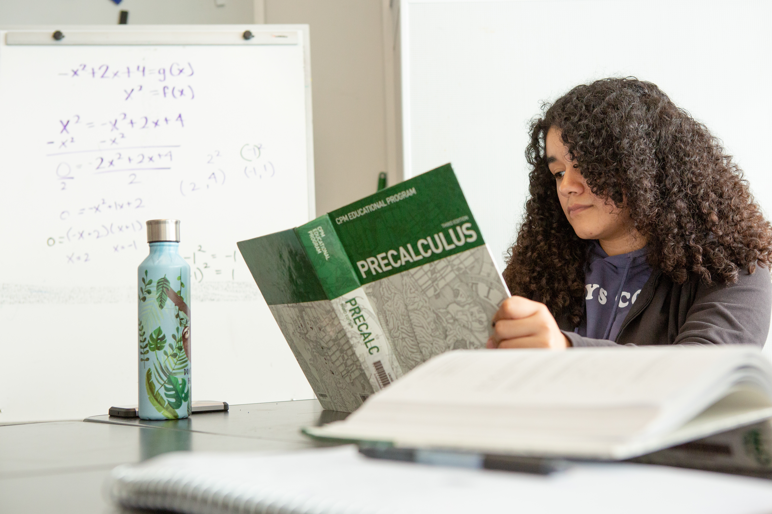
Support structured opportunities for mathematical dialogue.
All students of mathematics should be supported in developing logical reasoning, collaborative problem-solving, critical evaluation of mathematical claims and the ability to refine their thinking through evidence-based feedback.
Notes:
Talking Points
Structured discussions mirror the collaborative reality of mathematics education careers, where clear communication using precise terminology prevents misconceptions and ensures accurate understanding.
Facilitator Considerations
This slide emphasizes verbal communication as a technical skill.
Considerations for interactivity:
Quick brainstorm: Types of professional discussions in your mathematics field (1 minute).
Partner activity: Design one discussion activity that mirrors industry practice (2 minutes). Share examples that develop specific communication skills.
https://images.all4ed.org/high-school-girl-reading-precalculus-book

Slide 22
Example of supporting structured opportunities for mathematical dialogue
A high school math teacher presents an authentic scenario about population growth in a nearby town. Students must determine whether the growth can be modeled with a linear function, an exponential function or neither. Students work in groups to analyze the scenario, construct logical arguments and present their reasoning. The teacher then facilitates a class discussion in which students compare and critique each other's arguments, drawing on features of the scenario and their proposed models, and collaboratively draw conclusions about the most appropriate model.
Notes:
Talking Points
The group preparation phase is an important part of this lesson. Using real-world scenarios as the foundation for analysis teaches students to ground their communication in observable evidence. They learn to cite evidence, reference mathematical features and explain model choices using precise terminology. This approach builds credibility and demonstrates the connection between technical knowledge and effective communication.
Facilitator Considerations
This example demonstrates structured preparation leading to meaningful mathematical dialogue.
Considerations for interactivity:
Ask participants to identify similar analysis opportunities in their fields.
Share scenarios that would generate authentic professional discussions.
Discuss: "What preparation would students need to handle these conversations professionally?"

Slide 23
Potential Pitfall:
Students are asked to participate in discussions without receiving clear models of professional communication.
Why It Matters
When students are asked to participate in mathematics-focused discussions with clear models, they are more likely to understand and practice what effective communication looks and sounds like in this setting.
Modeling for students helps them engage in precise, formal and appropriate responses that allow the opportunity to build communication skills along with conceptual knowledge of mathematics.
With examples to guide them, students may feel surer and more prepared, promoting both their engagement and their growth in the discipline.
Notes:
Talking Points
Structured conversations, including modeling and guidance, help prepare students to engage in discussions about math appropriately. Students can learn to cite specific formulas, reference mathematical principles and explain.
Facilitator Considerations
This slide communicates the common pitfall of not preparing students to engage in structured discussions about mathematics.
Considerations for interactivity:
Ask participants to identify scenarios that would generate authentic professional discussions. Discuss: "What preparation would students need to participate in these conversations appropriately?"

Slide 24
Final Reflection
How can you learn more about the literacy strengths and related background knowledge of your students?
How can you incorporate authentic opportunities for students to build their disciplinary knowledge through speaking, listening, reading and writing?
What text types could your students use more support to read? To write?
What new opportunities for authentic, discipline-specific discourse would you like to try in your class?
Notes:
Talking Points
As we wrap up our exploration of disciplinary literacy in mathematics, take a moment to consider where you want to focus your efforts. Each of these questions targets a different aspect of what we've discussed today. You might choose the question that addresses your biggest challenge, or perhaps the one where you see the most opportunity for immediate impact in your classroom.
Choose one or two questions that resonate with your current teaching context. Consider what's feasible given your curriculum timeline, available resources and student needs. Remember, small changes can have a significant impact when they're strategically chosen and thoughtfully implemented.
Facilitator Considerations
This reflective closing helps participants synthesize learning and commit to actionable next steps.
Considerations for interactivity:
Provide 2-3 minutes of quiet reflection time for participants to review the questions and select their focus.
Offer participants the choice to reflect individually in writing or discuss with a partner.
If discussing with partners, suggest they share not just which question they chose, but why it feels most relevant.
Remind participants that these questions can guide ongoing professional development throughout the year.

Slide 25


More Resources from Oregon’s Adolescent Literacy Framework
Section 6: Disciplinary Literacy in Mathematics, page 124
Notes:
Talking Points
As a reminder and invitation, Oregon's Adolescent Literacy Framework offers a list of resources specifically designed to support mathematics educators in helping their students develop disciplinary literacy. The framework recognizes that literacy in math requires unique approaches to reading, writing and communication, providing targeted guidance for integrating literacy into math instruction.
The QR code will lead you to the framework.
Facilitator Considerations
This slide provides concrete next steps and additional support for implementing disciplinary literacy strategies.
Considerations for interactivity:
Give participants 1-2 minutes to scan the resources and identify one that addresses their reflection focus.
Quick share: Have 2-3 participants name the resource they're most interested in exploring and why.
If time allows, demonstrate navigating to one resource to show ease of access.
Remind participants that these resources can support both immediate changes and long-term professional development.

Slide 26
Navigating Oregon’s Adolescent Literacy Framework
SECTION
1
GOAL
Disciplinary literacy is essential for postsecondary success
2
CONDITIONS
High Expectations
Culturally Responsive Practice
Engagement
3
SUPPORTS
Multilingual Learners
Students with Disabilities
4–5
ALL-PURPOSE SKILLS
Reading Skills
Writing Skills
DISCIPLINE-SPECIFIC READING AND WRITING SKILLS
6
LANGUAGE ARTS
MATH
SCIENCE
SOCIAL SCIENCES
CAREER & TECHNICAL EDUCATION
HEALTH & PHYSICAL EDUCATION
Notes:
Talking Points
Oregon's Adolescent Literacy Framework provides the foundation for everything we've explored today. The first three chapters establish why disciplinary literacy matters for math students’ school and postsecondary success and how to create the conditions and supports for students to be successful.
Chapter 2's focus on conditions, including high expectations, culturally responsive practice and engagement, directly connects to our discussion about leveraging student background knowledge. When we recognize students' experiences and set high expectations for professional communication, we create the conditions for meaningful learning. The framework shows how these conditions specifically support mathematics students in developing career-ready literacy skills.
Chapter 3 addresses supports for multilingual learners and students with disabilities, populations we all serve. The framework provides strategies for making mathematical texts accessible while maintaining rigor. As you read these chapters, you'll find practical approaches for supporting all students in mastering the complex literacy demands of mathematics education.
Facilitator Considerations
This closing slide encourages continued learning through framework exploration.
Considerations for interactivity:
Consider asking for a commitment: "Who will commit to reading at least one chapter before our next meeting?"
Quick planning: Have participants identify when they'll read the framework chapters (add to calendar).
Buddy system: Encourage participants to find a reading partner for accountability and discussion.
Close with appreciation for their engagement and a reminder that improving disciplinary literacy is ongoing professional work.

Slide 27
Oregon’s Instructional Frameworks: Adolescent Literacy

