Slide 1

Introducing Oregon’s 2024
Social Science Standards
Oregon’s Vision for Social Science

Slide 2
Key Changes
Oregon’s 2024 revised Social Science Standards
  Prioritize critical analysis, cultural awareness and engaging in a diverse democracy and an interconnected world.
  Include the contributions, perspectives and histories of individuals and groups previously underrepresented.
  Address legislated requirements, including civics, ethnic studies, the Holocaust and other genocides.
2

Slide 3




Content Domains and Concepts
Civics
Georgraphy
Economics
History
Political Institutions
Identity, Roles, Responsibilities
Democratic Principles
Civic Engagement
Geographic Reasoning
Migration and Movement
Human Interaction and Interconnections
Human Environmental Interaction
Earning, Saving, and Spending
Micro and Macro Economics
Incentives, Choice, and Consumer Behavior
Specialization, Trade, Interdependence
Continuity and Change
Conflict and Cooperation
Cause and Effect
Communities and Pluralism
3

Slide 4
Essential Disciplinary Practices
The 2024 Social Science Standards integrate ten Essential Disciplinary Practices with grade-level content standards.
These Essential Disciplinary Practices support students to
  Strengthen chronological reasoning
  Incorporate diverse perspectives
  Combat digital misinformation
  Build empathy across identities and groups
  Become informed and empowered agents of change
4

Slide 5
Ten Disciplinary Practices
Develop questions for social science inquiry.
Use chronological thinking skills, connecting the past with the present to recognize continuity and change in human history.
Collect, interpret, evaluate, and apply information from primary and secondary sources to better understand and create historical narratives distinguishing between fact and opinion.
Seek and analyze diverse perspectives to develop a more complete understanding of past and current events.
Evaluate and assess how discrimination, racism, and inequality shape historical narratives, individual perspectives, intersecting identities, and diverse understandings of the past and present.
Construct well-reasoned and logically coherent explanations, arguments, and solutions related to complex societal issues.
Cultivate global awareness and cultural understanding to effectively engage with the interconnected world, diverse cultures, and perspectives.
Demonstrate empathy to understand how identities shape actions of resistance and resilience among individuals and communities.
Develop the necessary skills to critically analyze and evaluate digital and social media content, identify reliable sources, and become more informed and responsible digital citizens.
Apply the practices and knowledge of social science to determine the most effective ways to take informed civic action.
5

Slide 6
Let’s Take a Moment to Reflect
Which Essential Disciplinary Practices are you curious about?
Which Essential Disciplinary Practices are currently utilized in your classroom?
Which are areas for growth?
6

Slide 7
Oregon’s Vision for Social Science

Slide 8
Oregon’s Integrated Approach (1)
The 2024 standards utilize an integrated approach that weaves diverse perspectives, experiences and contributions across K–12. This approach allows students to
  Develop a deeper understanding of the individuals and groups shaping our world
  Examine the complexity of social structures and their impact on history and society
  Build critical thinking skills and cultural awareness
  Become more informed and engaged citizens
  See their histories and identities reflected in the curriculum while developing empathy and understanding across cultural differences
8

Slide 9

Oregon’s Integrated Approach (2)
The revised standards include the integration of
  Ethnic studies
  The Holocaust
  Genocide
  Tribal History/Shared History

Slide 10

Legislative Requirements
The 2024 standards reflect a commitment to telling a more complete story of our state, nation and world, shaped by input from Oregon voters. These standards incorporate often underrepresented histories, contributions and perspectives, aligning with voter-supported changes.
Legislative requirements include
  Civics education
  Ethnic studies
  Holocaust and genocide studies

Slide 11
Ethnic Studies
Oregon House Bills 2845, 2023 and 2905 legislate that ethnic studies be integrated into instruction for the state's K-12 public school students. Ethnic studies in instruction includes the histories and perspectives of these traditionally underrepresented groups:
  Native Americans
  Americans of African, Asian, Pacific Island, Chicano, Latino, Jewish, or Middle Eastern descent
  Women
  People with disabilities
  Immigrants
  Refugees
  Individuals who are lesbian, gay, bisexual or transgender
11

Slide 12
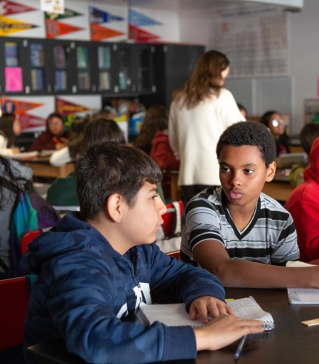
The Holocaust
Oregon Senate Bill 664 legislates specific instruction on the Holocaust and other genocides for public school students.
  The Holocaust during World War II was the systematic, state-sponsored persecution and murder of approximately six million Jews by the Nazi regime and its collaborators.
  Antisemitism, the hatred of or prejudice against Jews, was at the foundation of the Holocaust and a basic tenet of Nazi ideology.

Slide 13
Genocide
Oregon Senate Bill 664 legislates specific instruction on the Holocaust and other genocides for public school students.
  The United Nations Convention on the Prevention and Punishment of the Crime of Genocide (1948), Article II defines genocide as “the intentional destruction, in whole or in part, of a national, ethnic, racial or religious group.” The acts that constitute genocide fall into the following five categories:
    Killing members of the group
    Causing serious bodily or mental harm to members of the group
    Deliberately inflicting on the group conditions of life calculated to bring about its physical destruction, in whole or in part
    Imposing measures intended to prevent births within the group
    Forcibly transferring children of the group to another group
13

Slide 14

Tribal History/Shared History
Oregon Senate Bill 13 legislates the creation of K-12 Native American lesson plan for Oregon public schools and professional learning for educators. Tribal History/Shared History includes
The development of place-based curricula on the history and culture of the nine federally recognized tribes in Oregon
Opportunities for professional learning centered on the nine Essential Understandings

Slide 15
Connecting to the Standards (1)
The 2024 Social Science Standards foster
Diverse Perspectives and Experiences: Actively seek and include diverse perspective to ensure students see themselves reflected in the social sciences.
Civic Engagement: Prepare students to become informed and engaged citizens in a diverse, democratic society.
Critical Thinking: Encourage students to ask questions, think critically, develop digital literacy and explore multiple perspectives.
Global and Historical Context: Provide opportunities for understanding the global context of historical and current events to help students appreciate the interconnectedness of today’s world.
15

Slide 16
Connecting to the Standards (2)
Understand Inequality: Help students understand how systems of power, discrimination and inequality shape individual and collective experiences.
Educator Preparation: Equip educators with the knowledge and skills to deliver effective, culturally responsive and inclusive social science instruction.
Community Engagement: Engage families and communities in social science learning.
Equity and Justice: Foster empathy to empower students to advocate for equity, challenge systemic biases and support a more just society.
16

Slide 17
Questions for Consideration
What additional supports do teachers need to integrate ethnic studies, the Holocaust, genocide and Tribal History/Shared History in their classrooms?
How can schools engage their families and communities in the adoption of the 2024 standards and integration of ethnic studies, the Holocaust, genocide and Tribal History/Shared History?
17

Slide 18
Let’s Look at Our Standards
Read the content standards that align with the integrated topics for your grade level and mark
  one standard you have firmly in place in your teaching,
  one standard you need additional materials or resources to teach and
  one standard you have a question about.
Then, discuss with a partner.
18

Slide 19
Read more about the Oregon Social Science Standards.

Slide 20
Oregon’s Instructional Frameworks: Social Sciences

