Slide 1

Genocide, Including the Holocaust: Grades 5–12
Oregon’s 2024 Social Science Standards

Slide 2
How to Use These Slides
These slides are intended to be used by educators, educational leaders and those providing professional learning to educators to build understanding and application of teaching about the Holocaust and genocide in grades 5–12.
These slides may be used as is or adapted to meet the needs of educators in your local district.
Facilitator notes are included to provide suggestions for how those leading professional learning can facilitate others’ learning and processing of new information.
2
Notes:
Facilitator Notes:
Review the content on the slide that outlines the intention, purpose and use behind this slide deck.

Slide 3
Making Connections
Notes:
Facilitator Notes:
Transition the group to engage in reflection exercises before diving into the content.

Slide 4
Reflect on Your Experience
Consider one or more of the following questions:
How were you first introduced to the topic of genocide (school, books, media, personal connections, etc.)?
How were you first introduced to the topic of the Holocaust?
What personal or professional experiences have deepened your understanding of genocide (visiting a memorial or museum, meeting a survivor, traveling to historical sites, etc.)?
What personal or professional experiences have deepened your understanding of the Holocaust?
4
Notes:
Facilitator Notes:
Have participants reflect on their own experience with the topic of genocide and the Holocaust.
You may encourage folks to reflect in a physical or digital format.
After reflecting independently, you may invite participants to engage in a whole-group discussion. If online, it could be possible to post ideas in the chat.

Slide 5
Reflect on Your Classroom
Consider one or more of the following questions:
How do you create a safe and respectful learning environment for students when discussing topics like genocide and the Holocaust?
What resources, including texts, primary sources, media, or community knowledge, do you currently use to teach about genocide and the Holocaust?
What issues might arise for your students as they learn about genocides, including the Holocaust?
5
Notes:
Facilitator Notes:
Have participants reflect on their own experience with the topic of genocide and the Holocaust.
You may encourage participants to reflect in a physical or digital format.
After reflecting independently, you may invite participants to engage in a whole-group discussion. If online, it could be possible to post ideas in the chat.

Slide 6
Key Terms
Notes:
Facilitator Notes:
Transition the group to review key terms of this topic before diving into reviewing the content.

Slide 7
Key Terms: What is genocide and the Holocaust? (1)
Genocide: As defined by the UN Genocide Convention, genocide is any of the following acts committed with intent to destroy, in whole or in part, a national, ethnical, racial or religious group, as such:
  Killing members of the group;
  Causing serious bodily or mental harm to members of the group;
  Deliberately inflicting on the group conditions of life calculated to bring about its physical destruction in whole or in part;
  Imposing measures intended to prevent births within the group;
  Forcibly transferring children of the group to another group.
7
Notes:
Facilitator Notes:
Review the key terms on the slide.

Slide 8
Key Terms: What is genocide and the Holocaust? (2)
The Holocaust: The systematic, state-sponsored persecution and murder of approximately 6 million Jews by the Nazi regime and its collaborators. Antisemitism was at the foundation of the Holocaust and a basic tenet of Nazi ideology. This prejudice was widespread throughout Europe and continues to target Jews in Europe and the United States today.
Antisemitism: Prejudice, discrimination, or hostility against Jews based on their religion, ethnicity or perceived race. This can manifest in various forms, from stereotypes and exclusion to violence and persecution.
8
Notes:
Facilitator Notes:
Review the key terms on the slide.

Slide 9
Reflection
What emotions or reactions may these terms evoke? How might a deeper understanding of one term enhance the understanding of the others?
Genocide
The Holocaust
Antisemitism
9
Notes:
Facilitator Notes:
Have participants reflect on their experience with the shared key terms.
You may encourage participants to reflect in writing or digital format.
After reflecting independently, you may invite participants to engage in a whole-group discussion. If online, it could be possible to post ideas in the chat.

Slide 10
What does learning about genocide and the Holocaust look like in grades 5–12?
Notes:
Facilitator Notes:
Transition the group to learning about genocide and the Holocaust in grades K-12.

Slide 11
Genocide and the Holocaust in Grades 5–12
In Oregon’s 2024 Social Science Standards, the topic of genocide and the Holocaust is developed across multiple grade levels.
Grade 5: The topic of genocide is introduced in the fifth grade with a focus on the cultural and physical genocide of Indigenous peoples in what became the United States.
Grades 6–8: Students learn about resistance and reconciliation in response to genocide, including the cultural and physical genocide faced by Indigenous tribes. Students are introduced to anti-Judaism and antisemitism as root causes of the Holocaust.
Grades 9–12: Students engage in a deeper study of the causes and conditions of and responses to 20th-century genocides, including the perspectives and experiences of survivors.
11
Notes:
Facilitator Notes:
Review the content on the slide regarding the specific grade-level revisions for genocide and the Holocaust across grades K-12.

Slide 12
Why is it important to teach about the Holocaust and genocide? (1)
Teaching about the Holocaust and other genocides is critical in education.
​​​The Holocaust represents a pivotal historical event that demonstrates how a modern, industrialized society systematically targeted and murdered millions, reshaping international law, human rights frameworks and global politics.
Understanding how propaganda and gradual normalization of extremism enabled the Holocaust helps students recognize warning signs of persecution, the fragility of democratic institutions and the dangers of unchecked authoritarianism, scapegoating of minority groups and collective indifference to the suffering of others.
12
Notes:
Facilitator Notes:
Review the content on the slide.

Slide 13
Why is it important to teach about the Holocaust and genocide? (2)
​Examining genocide across cultures and time periods develops students' capacity for cross-cultural understanding and empathy while revealing how prejudice can manifest in various societal contexts.
Examining both the Holocaust and other genocides provides students with a framework to analyze historical patterns across different societies and time periods. Students analyze the conditions and actions that led to genocide, identify universal human rights principles that emerged in response to these events and evaluate how various communities responded to extremism.
13
Notes:
Facilitator Notes:
Review the content on the slide.

Slide 14
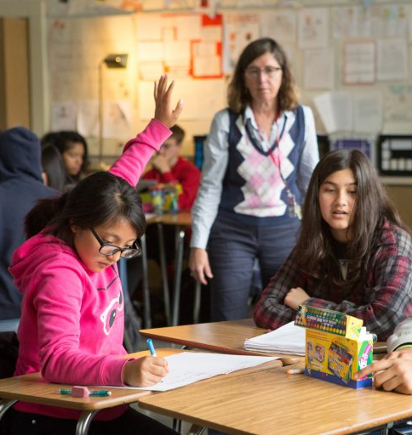
Why is it important to teach about the Holocaust and genocide? (3)
Engaging with primary sources and survivor testimony fosters understanding of why individuals adopt the roles of perpetrators, collaborators, bystanders, resisters and rescuers, and how the actions of individuals change based on a variety of situations.
When students engage with survivor testimony and compare case studies of genocide throughout history, they understand the complex human choices involved in these events.
Notes:
Facilitator Notes:
Review the content on the slide.

Slide 15
Teaching About Genocide and the Holocaust in Practice
Notes:
Facilitator Notes:
Transition the group to looking at two examples of teaching about genocide and the Holocaust in practice.
Frame the activity for participants:
Two examples of how genocide and the Holocaust may look in a classroom lesson will be presented.
After each example is presented, participants will reflect in pairs or small groups on the following three components of the example:
(1) What Essential Disciplinary Practice is present?
(2) What content standards are present?
(3) How does the example illustrate student agency and engagement?
Depending on your context, you may have participants physically annotate an example using the Teaching About the Holocaust and Genocide in Grades 9-12 Snapshot document.​
You are encouraged to provide participants with a copy of the standards, the essential disciplinary practices, and copies of the examples to follow along as they engage in this reflection activity.

Slide 16

Ten Essential Disciplinary Practices
Develop questions for social science inquiry
Use chronological thinking skills
Collect, interpret, evaluate, and apply information from primary and secondary sources
Seek and analyze diverse perspectives
Evaluate and assess how discrimination, racism, and inequality shape historical narratives and diverse perspectives
Construct well-reasoned and logically coherent explanations, arguments, and solutions
Cultivate global awareness and cultural understanding
Demonstrate empathy
Develop skills to critically analyze and evaluate digital and social media content
Apply the practices and knowledge of social science to take informed civic action
https://www.oregon.gov/ode/educator-resources/standards/socialsciences/Documents/2024%20Oregon%20Social%20Studies%20Standards%20EDP.pdf
16
Notes:
Facilitator Notes:
Review the ten Essential Disciplinary Practices in the standards before analyzing the following two examples.
Provide framing for participants as they read through the examples; they should consider which Essential Disciplinary Practice appears.

Slide 17
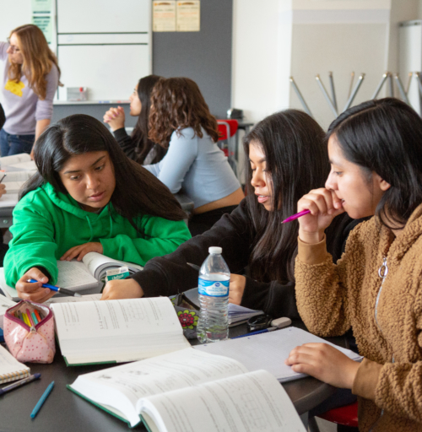
Example 1: Genocide and the Holocaust
A tenth grade world history class examines how different countries remember and teach the Holocaust. In small groups, they analyze cultural and historical influences on memorialization and compare global perspectives to Holocaust education in the United States. Small groups choose specific topics to focus on, visit websites to learn about their topics and present their learnings to the whole class.
17
Notes:
Facilitator Notes:
Review the content on the slide.
One example of teaching genocide and the Holocaust in the classroom might look like: [Read the slide.]

Slide 18
Reflection Activity (1)
Reflect on the example we just read. With a partner, discuss the following questions:
Which Essential Disciplinary Practices did you notice in the example?
Which grade level content standards relate to the example?
How does this example demonstrate student engagement and agency in the classroom?
18
Notes:
Facilitator Notes:
After providing time for participants to talk in small groups. You may encourage participants to reflect in a physical or digital format and suggest that as they review the example, they look at the Essential Disciplinary Practices and go back through the Social Science Standards.
After providing time for groups to reflect in pairs, invite participants to share out in the whole group.
Essential Disciplinary Practices: Cultivate global awareness and cultural understanding to effectively engage with the interconnected world, diverse cultures and perspectives.
Possible content from standards:
HS.WR.CP.15 - Explain the significant events, public policies, and experiences of the Holocaust.
HS.WR.CP.17 - Evaluate the international community’s responses to the persecution of Jews and other identity groups during the Holocaust.
HS.WR.CP.19 - Analyze efforts among nation-states and in the international community to hold perpetrators responsible for their involvement in the Holocaust and other acts of genocide.
Student engagement/agency possible responses:
Working in small groups fosters discussion, perspective-taking, and peer learning, making students active participants rather than passive recipients.
By analyzing global perspectives, students can bring in their own insights and experiences, making the learning process more relevant and meaningful to them.
Depending on how the activity is structured, students may have some autonomy in selecting countries to research or the aspects of memorialization they want to focus on, enhancing their sense of ownership over the learning process.

Slide 19
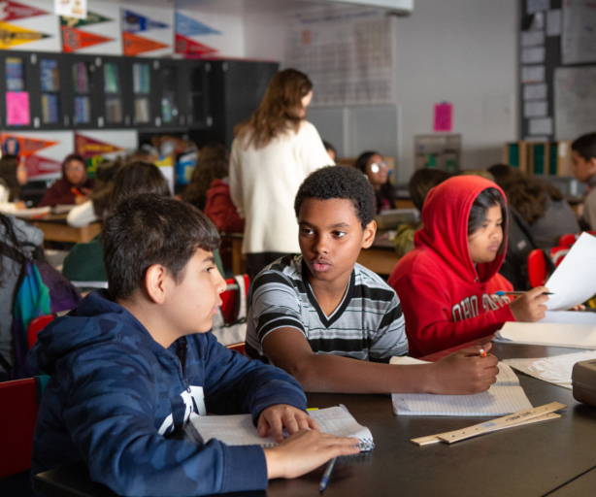
Example 2: Genocide and the Holocaust
After reading about the experiences of Syrian refugees, a seventh grade class recreates a timeline of major events in the Syrian civil war using photographs, maps and news articles. The class discusses why families flee their countries and the challenges they face when seeking safety.
19
Notes:
Facilitator Notes:
Review the content on the slide.
One example of teaching genocide and the Holocaust in the classroom might look like: [Read the slide.]

Slide 20
Reflection Activity (2)
Reflect on the example we just read. With a partner, discuss the following questions:
Which Essential Disciplinary Practices did you notice in the example?
Which grade level content standards relate to the example?
How does this example demonstrate student engagement and agency in the classroom?
20
Notes:
Facilitator Notes:
After providing time for participants to talk in small groups. You may encourage participants to reflect in a physical or digital format and suggest that as they review the example, they look at the Essential Disciplinary Practices and go back through the Social Science Standards.
After providing time for groups to reflect in pairs, invite participants to share out in the whole group.
Essential Disciplinary Practices: Collect, interpret, evaluate, and apply information from primary and secondary sources to better understand and create historical narratives, distinguishing between fact and opinion.
Possible content from standards that may be mentioned:
6/7.G.MM.8 Analyze and explain how push and pull factors contribute to human migration and settlement patterns over time, including displacement due to conflict.
6/7.H.CE.12 Investigate the causes and effects of significant conflicts and movements in different regions, such as civil wars and forced migrations.
6/7.H.CP.14 Use primary and secondary sources to examine characteristics of civilizations in the Middle East and North Africa and their historical and contemporary relevance
6/7.C.CE.5 Examine how individuals and groups respond to global challenges, such as humanitarian crises, and advocate for change
Student engagement and agency possible responses:
Students are not just receiving information but actively constructing a timeline using photographs, maps and news articles. This hands-on approach encourages critical thinking, analysis and interpretation of historical events.
The process of creating a timeline and discussing the causes and effects of displacement involves working together, sharing perspectives and constructing knowledge collectively.
By examining a current and ongoing humanitarian crisis, students engage in learning that is relevant and meaningful.
Depending on how the activity is structured, students may have the autonomy to choose sources, select key events and contribute their interpretations, empowering them to take control of their learning process.
Using visuals (photographs, maps), textual sources (news articles), and discussion provides multiple avenues for students to engage with the material, allowing for different learning styles and strengths to be utilized.

Slide 21
Reflecting on Our Practice
Notes:
Facilitator Notes:
Transition the group to reflecting on their own practices in their classrooms.

Slide 22
Pair-share
Select one question to discuss with a partner:
What are additional ways to incorporate more primary sources, oral traditions and survivor testimonies in your teaching?
How does your instruction support students in exploring their identities and examining how identity shapes historical narratives and responses to injustice?
In what ways can you support students in recognizing their own agency—and the agency of historical actors—when learning about injustice, resistance and efforts toward justice over time?
What is one question you still have about teaching about genocide and the Holocaust?
22
Notes:
Facilitator Notes:
Have participants reflect on the questions on the slide with a partner.
You may encourage folks to reflect in a written or digital format.
After reflecting independently, you may invite participants to engage in a whole-group discussion. If online, it could be possible to post ideas in the chat.

Slide 23
Learn More: Additional Resources
Online module: Genocide, Including the Holocaust 5–12
Website: Social Science Standards Resource
Collaborative Learning Guide: Genocide, Including the Holocaust 5–12
Oregon Jewish Museum and Center for Holocaust Education’s Speakers’ Bureau
Oregon Department of Education: Holocaust & Genocide SB664
Oregon’s 2024 Social Science Standards: Genocide Factsheet
23
Notes:
Facilitator Notes:
Provide an overview of additional resources for participants to learn more about genocide and the Holocaust in grades K-12.

Slide 24
Learn More: Additional Resources for Grade 5
The Walter Pick Holocaust and Genocide Book Box Fund
Lesson Plan: The Whispering Town
Lesson Plan: Hold On to Your Music
24
Notes:
Facilitator Notes:
Provide an overview of additional resources for participants to learn more about genocide and the Holocaust in grades K-12.

Slide 25
Learn More: Additional Resources for Grades 6–12
Lesson Plan: Critically Analyzing Propaganda
Lesson Plan: Racial “Science” and Law
Lesson Plan: Refugees and the Obligation to Protect
Echoes and Reflections: Teaching About Genocide
United States Holocaust Memorial Museum: Resources
United States Holocaust Memorial Museum: Professional development
25
Notes:
Facilitator Notes:
Provide an overview of additional resources for participants to learn more about genocide and the Holocaust in grades K-12.

Slide 26
Next Steps
This slide can be adapted for the next steps at your site.
26

Slide 27

Thank you!

