Slide 1
Oregon Social Science Resources: A Guided Tour

Slide 2

New Standards
The Oregon State Board of Education adopted new social science standards in June 2024, which introduced significant changes, including
New content
Integrated Essential Disciplinary Practices
Expanded narratives, including more underrepresented groups
Schools across Oregon must implement these K–12 standards no later than the 2026–2027 academic year.
This presentation is a guided tour of all the resources available to educators to support their implementation.

Slide 3
New Resources

Slide 4
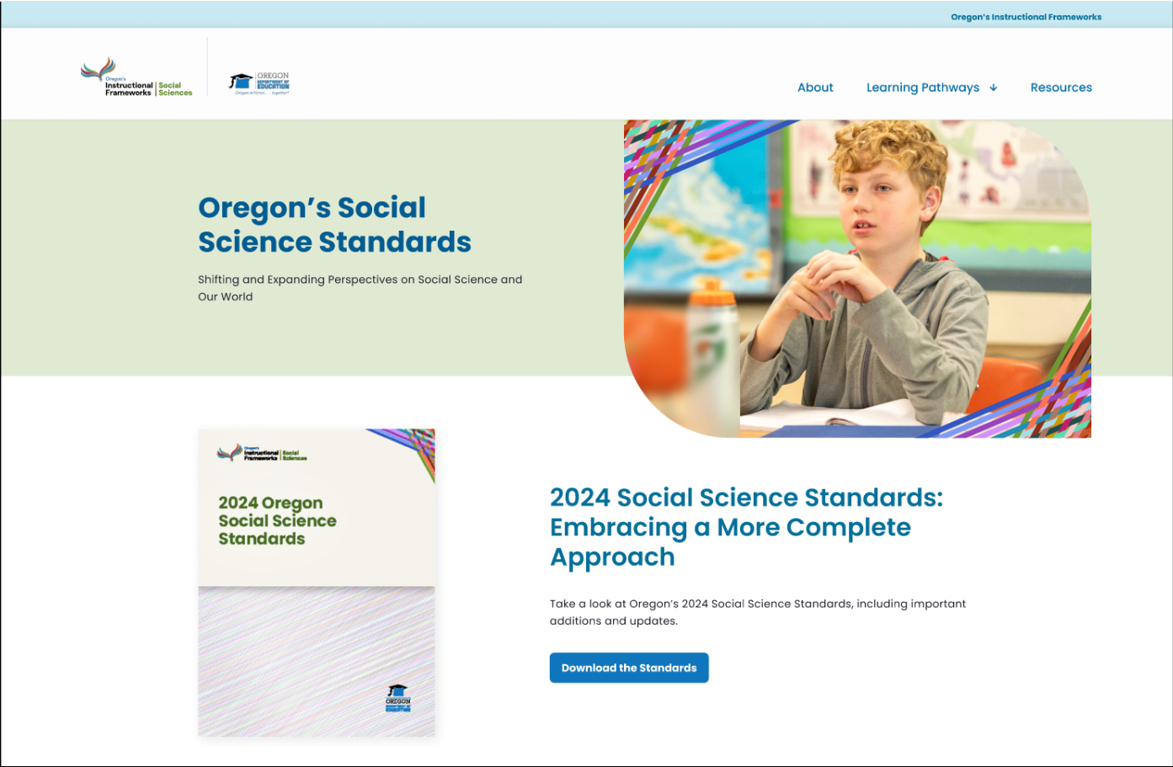
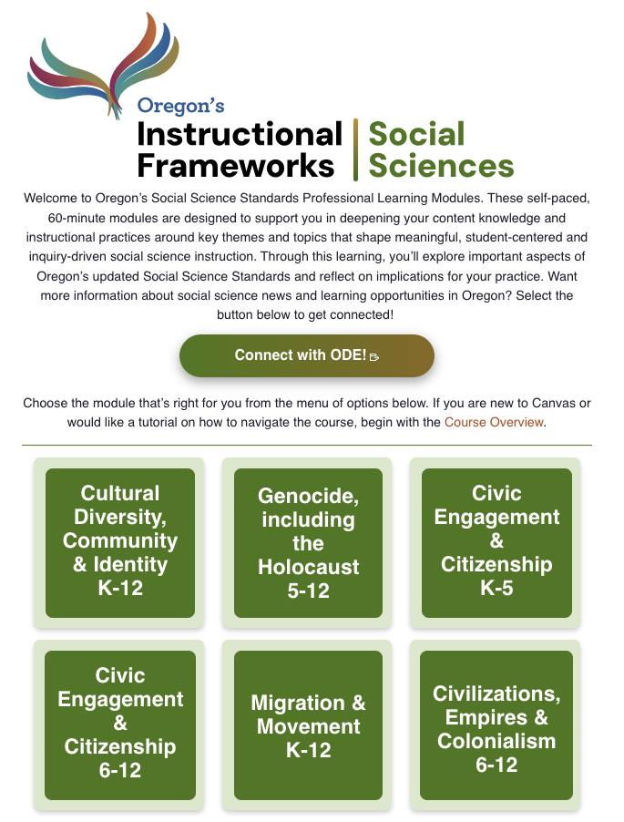
New Resources (1)
ODE gathered, vetted and created professional learning resources to support educators.
Notes:
Oregon Instructional Frameworks Website: https://oregoninstructionalframeworks.org/

Slide 5
New Resources (2)
ODE gathered, vetted and created professional learning tools to support educators.
Self-paced, online courses to help you integrate standards-aligned social science content and effective practices in your classroom
Notes:
Social Sciences Canvas Courses: https://oregoninstructionalframeworks.org/eZAiN6tT

Slide 6
New Resources (3)
ODE gathered, vetted and created professional learning tools to support educators.
Self-paced, online courses to help you integrate standards-aligned social science content and effective practices in your classroom
Activities and professional learning resources to help plan and deliver powerful instruction
Notes:
Resource Library: https://oregoninstructionalframeworks.org/social-science-standards/resources/

Slide 7
New Resources (4)
ODE has gathered, vetted and created professional learning tools to support educators.
Self-paced, online courses to help you integrate standards-aligned social science content and effective practices in your classroom
Activities and professional learning resources to help plan and deliver powerful instruction
Overviews and high-level summaries of what’s new in the standards
Notes:
Fact Sheets: https://oregoninstructionalframeworks.org/LmJDRhIa
Information Sheets and Slide Decks: https://oregoninstructionalframeworks.org/UEglPivB

Slide 8
Self-paced, Online Courses to Learn More About a Specific Topic

Slide 9
Self-paced, Online Courses to Learn More About a Specific Topic (1)
Canvas-based digital learning modules help teachers explore ways to integrate standards-aligned social science content and effective practices in their classrooms.
Course topics:
Cultural Diversity, Community and Identity, K–12
Genocide, including the Holocaust, 5–12
Civic Engagement and Citizenship, K–5, 6–12
Migration and Movement, K–12
Civilizations, Empires and Colonialism, 6–12
  Use case
  A principal wants to provide her teachers with professional learning about integrating diverse narratives into instruction. She shares the link to the Cultural Diversity, Community and Identity course with her staff.
Notes:
Social Sciences Canvas Courses: https://oregoninstructionalframeworks.org/eZAiN6tT

Slide 10
Activities and Professional Learning Resources to Help Plan and Deliver Powerful Instruction

Slide 11
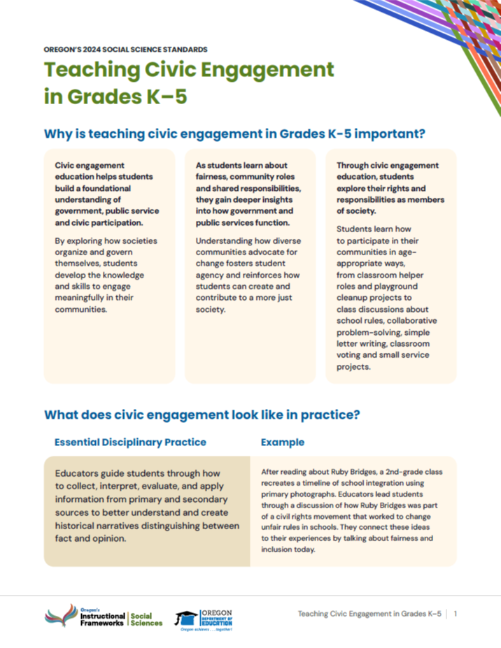
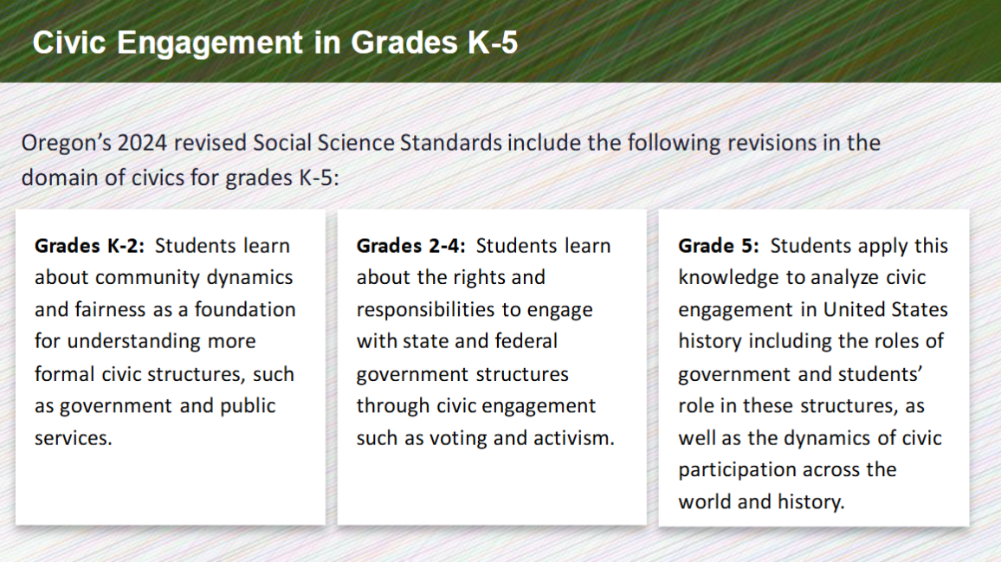
Activities and Professional Learning Resources to Help Plan and Deliver Powerful Instruction (1)
These professional learning resources can help leaders support groups of teachers learning together.
Spotlights and slide decks illustrate the Essential Disciplinary Practices in action
  Use case
  An instructional coach wants to provide professional learning for a group of teachers on civic engagement. He presents the civic engagement slide deck in a 45-minute teacher meeting and prints copies of the spotlight as handouts for the group.
Notes:
Spotlights and Slide Decks: https://oregoninstructionalframeworks.org/NxfWMXtd

Slide 12
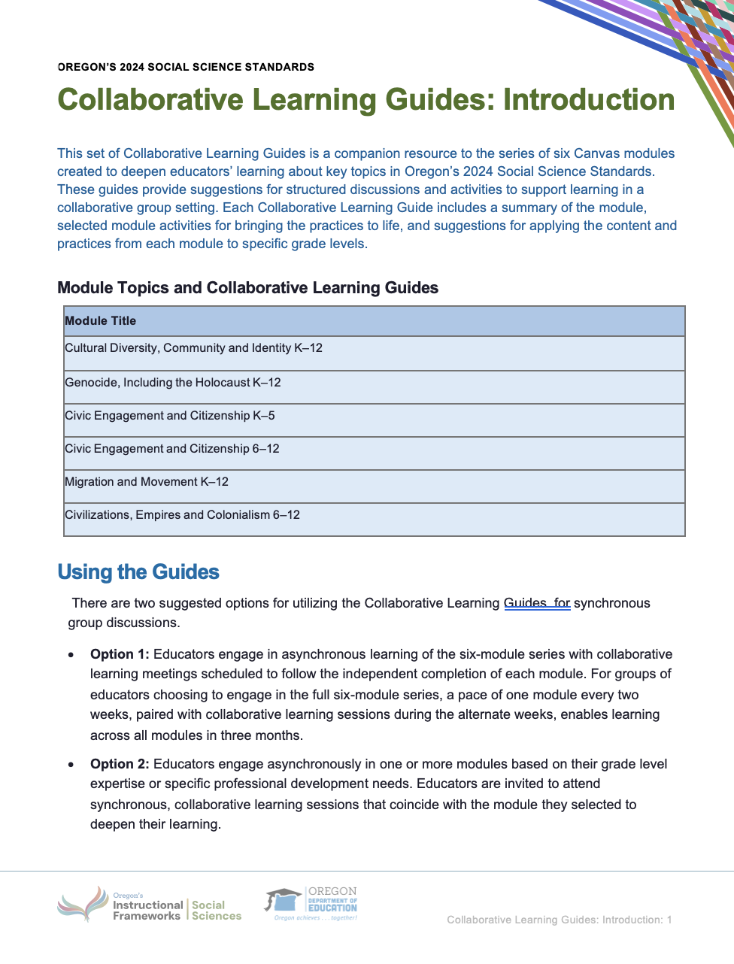
Activities and Professional Learning Resources to Help Plan and Deliver Powerful Instruction (2)
These professional learning resources can help leaders support groups of teachers learning together.
Collaborative learning guide placeholder
Collaborative learning guides provide activities to help teachers apply their learning from the online courses
  Use case
  A principal uses the guide to host an interactive professional learning session to follow up with a group of teachers who took one of the online courses.
Notes:
Collaborative Learning Guides: https://oregoninstructionalframeworks.org/qQ2JEykH

Slide 13
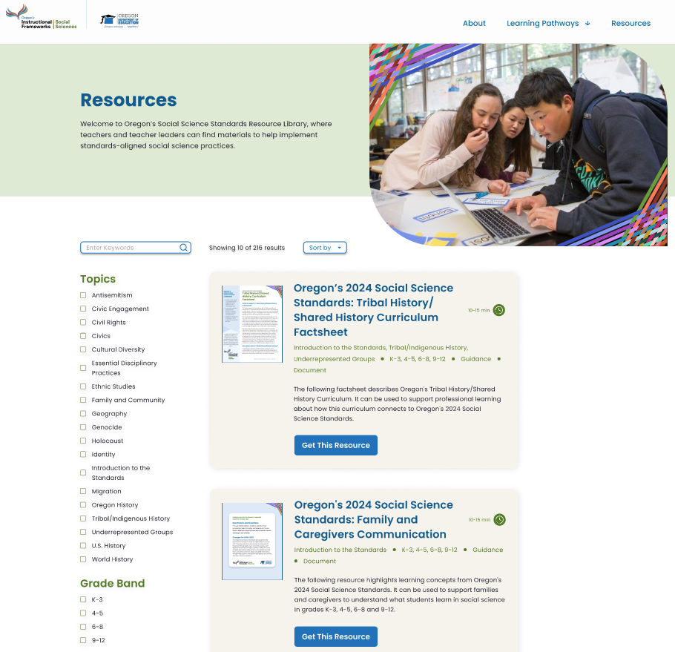
Activities and Professional Learning Resources to Help Plan and Deliver Powerful Instruction (3)
These professional learning resources can help leaders support groups of teachers learning together.
A resource library of curated lesson plans, professional learning guides and instructional materials
  Use case
  A fourth grade teacher is looking for help to plan a lesson on immigration in Oregon and she searches the online resource library for ideas.
Notes:
Oregon Instructional Frameworks Website Resource Library: https://oregoninstructionalframeworks.org/social-science-standards/resources/

Slide 14
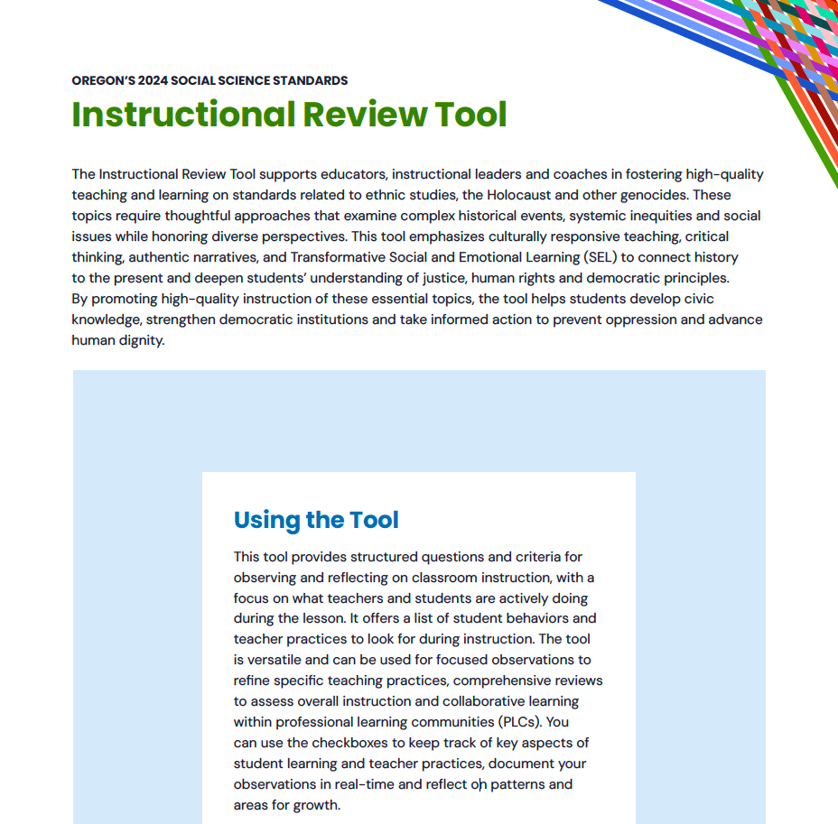
Activities and Professional Learning Resources to Help Plan and Deliver Powerful Instruction (4)
These professional learning resources can help leaders support groups of teachers learning together.
A curriculum analysis framework and instructional review tool for making decisions about high-quality instruction
  Use case
  A site-based team is reviewing their social science materials for the year and wants to make sure they reflect the 2024 Social Science Standards.
Notes:
Curriculum Analysis Framework: https://oregoninstructionalframeworks.org/F1T2tZK8
Instructional Review Tool: https://oregoninstructionalframeworks.org/E7sLD3RZ

Slide 15
Overviews and High-level Summaries

Slide 16
Overviews and High-level Summaries (1)
These resources provide high-level overviews of key revisions to the social science standards.
Factsheets with information about teaching ethnic studies, genocide and the Holocaust, Tribal history and traditionally underrepresented groups
  Use case
  A coach needs help understanding how these standards differ from the 2018 standards.
Notes:
Fact Sheets: https://oregoninstructionalframeworks.org/LmJDRhIa

Slide 17
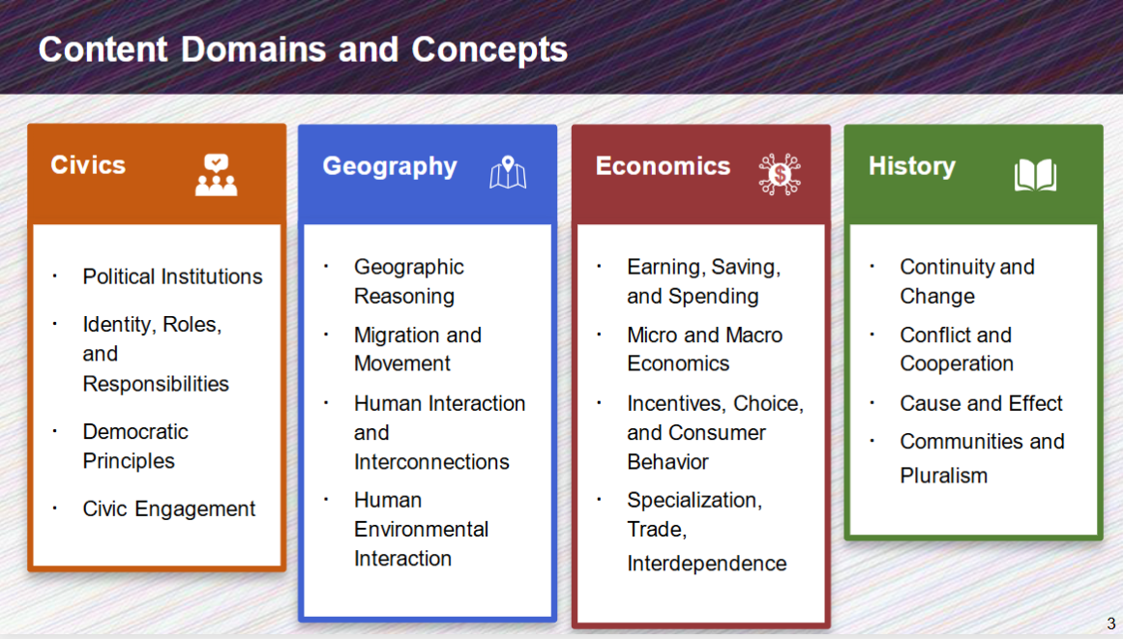
Overviews and High-level Summaries (2)
These resources provide high-level overviews of key revisions to the social science standards.
Information sheets and slide decks with key revisions to the standards for each grade span
  Use case
  A teacher needs information about how the standards have been revised for her students.
Notes:
Information Sheets and Slide Decks: https://oregoninstructionalframeworks.org/UEglPivB

Slide 18
Overviews and High-level Summaries (3)
These resources provide high-level overviews of key revisions to the social science standards.
FAQ with answers to common questions about the standards
  Use case
  A community member is curious about how the standards were created.
Notes:
FAQ: https://oregoninstructionalframeworks.org/vxT3yisS

Slide 19
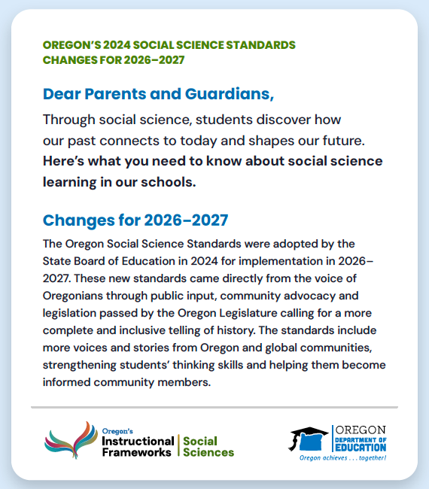
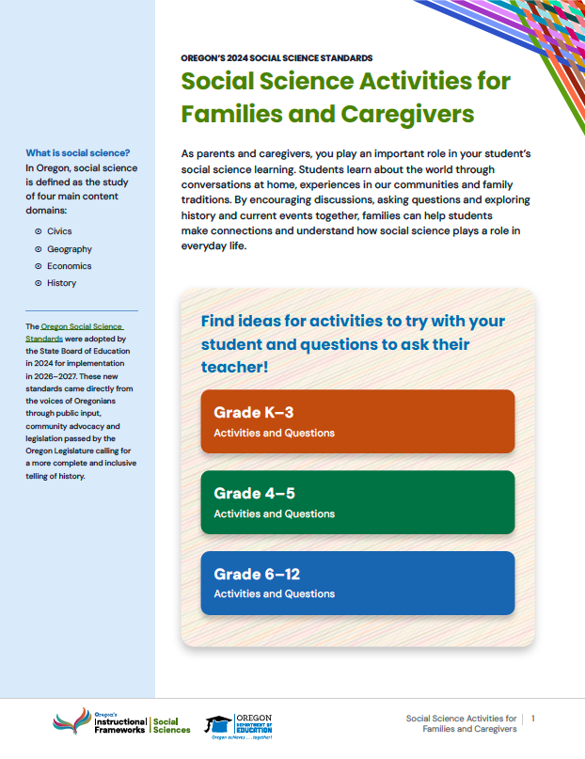
Overviews and High-level Summaries (4)
These resources provide high-level overviews of key revisions to the social science standards.
Family and community resources orient caregivers to the standards
  Use case
  A parent wants to know what their student will be learning about in social science, and how to support
  their learning at home.
Notes:
Family and Caregivers Communication: https://oregoninstructionalframeworks.org/NUr3LrhH
Activities for Families and Caregivers: https://oregoninstructionalframeworks.org/6UiZEZmj

Slide 20

Get Started Today!
Explore these resources to support your professional learning and classroom implementation of the 2024 Oregon Social Science Standards.
Visit ODE’s website to access the materials and courses.
Notes:
Oregon Instructional Frameworks Website: https://oregoninstructionalframeworks.org/social-science-standards/

Slide 21
Oregon’s Instructional Frameworks: Social Sciences

