Slide 1


Student Belonging
Oregon’s Early Literacy Framework
Notes:
Talking P=points
Welcome to our learning session.
Our focus today is about the guidance that Oregon’s Early Literacy Framework provides about student belonging and the role of student belonging in literacy education.
This will be an interactive experience. While I will be sharing some key information, I will also be inviting your insights, expertise and experience.
Facilitator considerations
Consider also inserting a slide about collaborative norms that you and your community can use or have used in the past to engage with one another.
In-person considerations:
If possible, set seating so that participants can easily talk with a partner.
Online considerations:
If possible, enable breakout rooms for conversations between participants.

Slide 2
Oregon’s Early Literacy Framework—Student belonging
Oregon's vision
Children have access to consistent, culturally responsive and research-aligned literacy instruction that guarantees reading and writing proficiency in at least one language.
Parents and caregivers are supported as full partners in their children’s literacy development.
Teachers are prepared and supported to identify individual student strengths and needs, and to teach reading and writing in research-aligned ways.
Notes:
Talking points
Oregon’s Early Literacy Framework offers a vision for children, families/caregivers and teachers.
[Read slide text.]
The time today will focus specifically on how we can leverage student belonging to support this literacy vision.
While the framework includes parents and caregivers, the work today is focused on classroom practice.
Facilitator considerations
This slide is designed to situate student belonging and Oregon’s Early Literacy Framework in the greater vision for statewide literacy.
Considerations for interactivity:
Invite participants to read a section aloud.
After you read the text, invite participants to share words or phrases aloud that resonate with them.

Slide 3

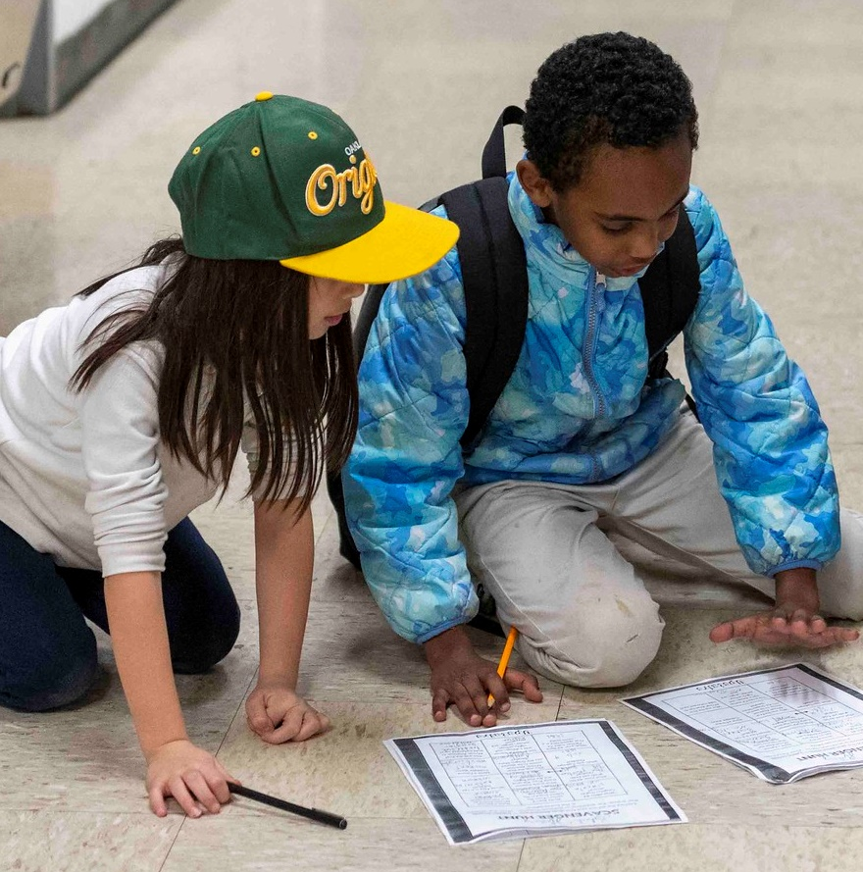

Making connections
Notes:
20240229_2024_02_29 Boise EH Literacy Night_06
https://www.flickr.com/photos/portlandpublicschools/53561904601/in/album-72177720315166782/

Slide 4
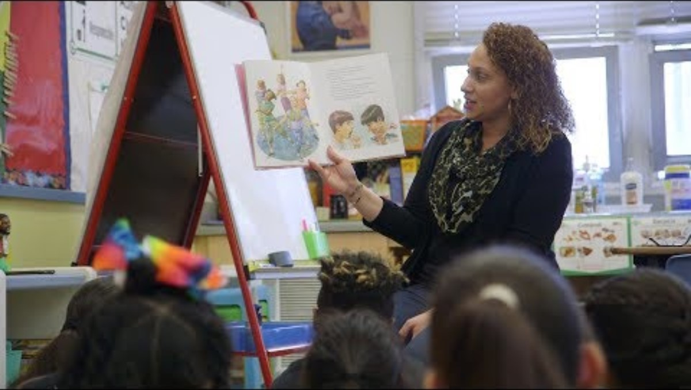
Making connections
As you watch the video, consider the following question:
How do educators foster a sense of student belonging in literacy education?
Notes:
Talking points
Let's begin our learning about student belonging in literacy by peering into an elementary grade classroom.
[Read slide text. Play the video.]
Facilitator considerations
Please turn on closed captions before playing the video.
Provide time for individuals to either turn and speak with a colleague or share out a few responses as a whole group.

Slide 5

Reflect on your experience
Consider one or more of the following questions:
When have you felt a sense of belonging in school or elsewhere?
What did people do or how did they treat you to create that sense of belonging?
What else in the environment helped contribute to that sense of belonging?
Notes:
Talking points
We are going to start by making connections and activating our own prior knowledge. It is important to connect our literacy vision to our own experiences. Consider one of the questions individually before turning to a partner to share your response.
Facilitator considerations
Begin with this slide as an opening activity for presenters and participants who do not have access to video and audio.
The purpose of this slide is to activate background knowledge in the room and make a personal connection to oral language.
Considerations for interactivity:
Invite participants to consider the question individually and then share with each other to build community and foster engagement.

Slide 6
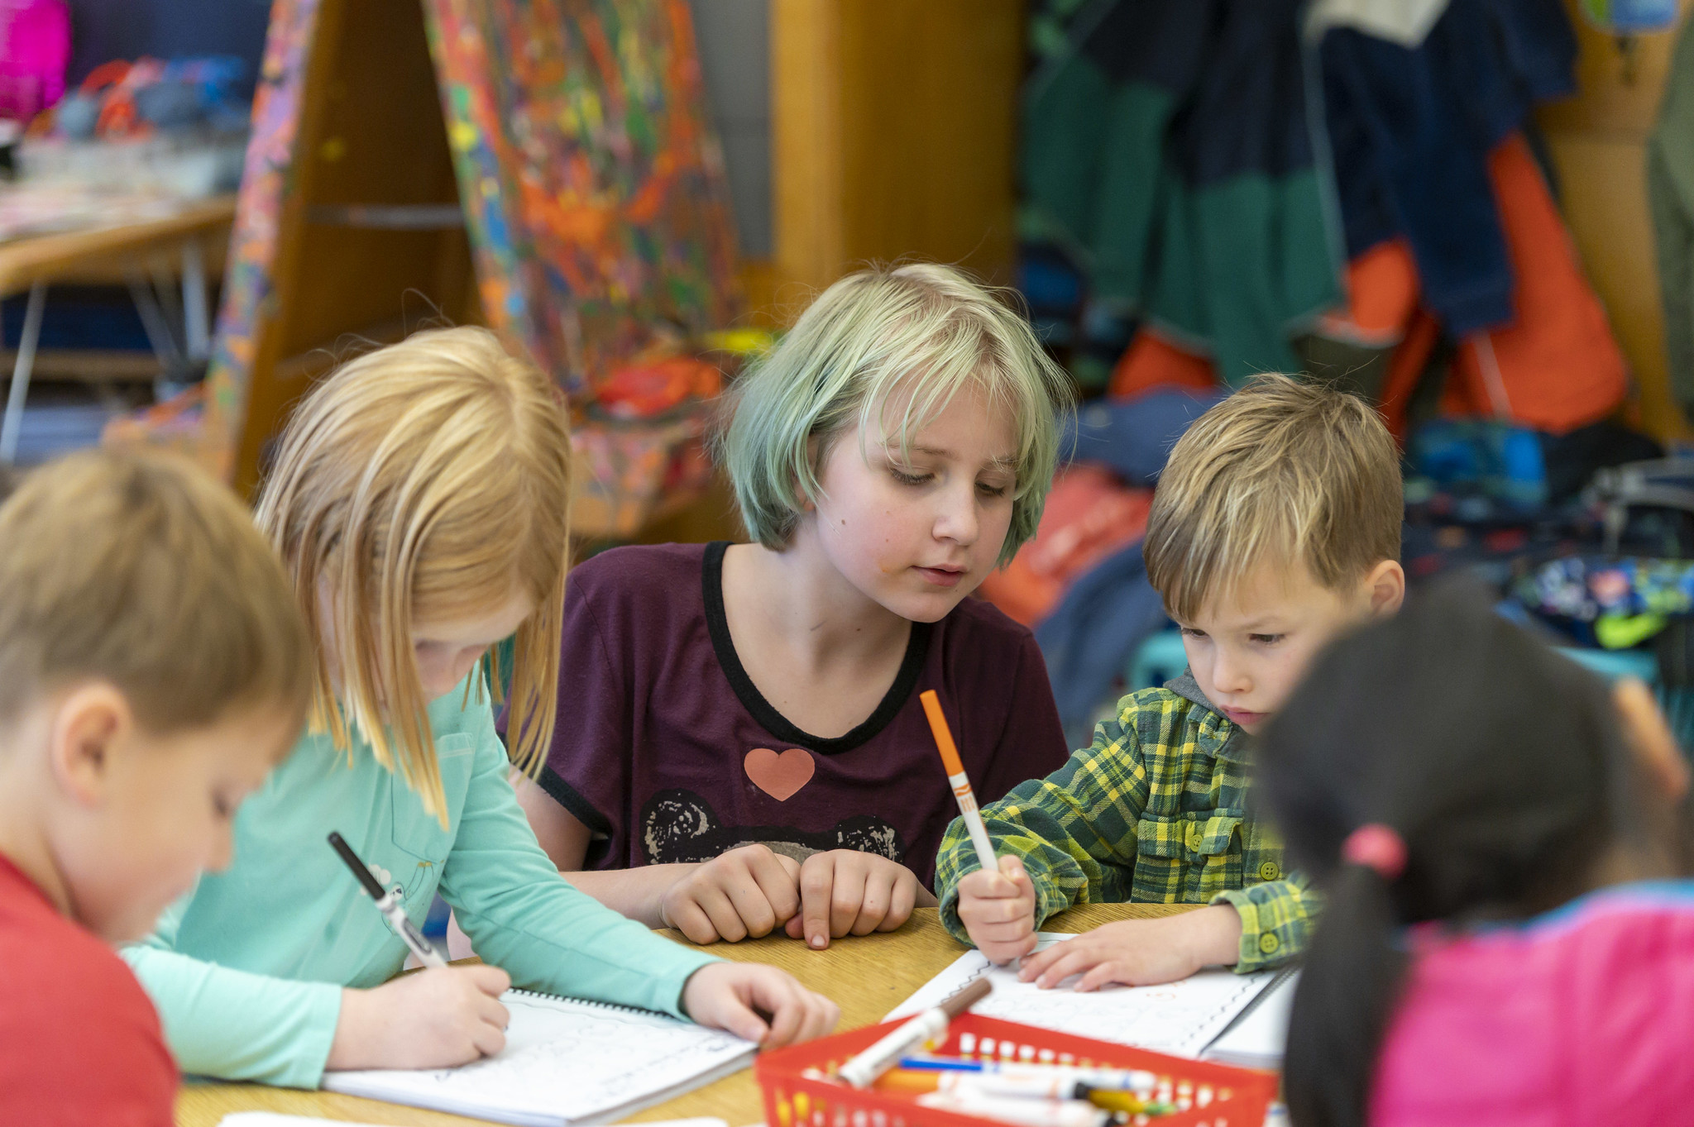
What is student belonging?
Notes:
20191114_BethConyers_Bridlemile Elementary_91
https://www.flickr.com/photos/portlandpublicschools/49066467578/in/album-72157711785430207/

Slide 7
What is student belonging? (2)
Which of these ideas feel like strengths at your school?
Which feel like growth areas?
Fostering student belonging includes paying attention to the conditions for literacy learning as well as the content and approach.
Culturally responsive practices support students to see themselves as a part of literacy learning and foster student belonging.
Building students’ social–emotional skills and paying attention to their well-being can also foster student belonging.
Notes:
Talking points
Let’s start by beginning to answer the question: What is student belonging?
As I share information on the slide, think about which ideas pique your interest and why.
[Read slide text.]
Facilitator considerations
This slide helps build a common understanding of student belonging for literacy learning.
Considerations for interactivity:
If time permits, think about asking for participants to share their own definitions and ideas about student belonging before introducing the bulleted points.
Invite participants to turn and talk, based on the discussion prompt.
Invite a few whole group responses.
Invite participants to jot down their ideas for a later discussion.

Slide 8
Reflect on a student
Now think about what you know about the students in your classroom.
What do you know about their racial, cultural
or linguistic backgrounds?
How does your classroom represent these backgrounds?
What feedback or data do you have about whether students feel like they belong?
Notes:
Talking points
You have now had a moment to think about your own early experiences with student belonging. Now let’s shift to thinking about the role of student belonging in our classrooms.
Now think about what you know about the students in your classroom and consider the questions.
[Read the questions.]
As we continue learning about the role of student belonging in literacy education, I invite you to keep the students in your classroom in mind.
Facilitator considerations
This slide continues to make connections.
Considerations for interactivity:
Provide 30 seconds for participants to consider these questions individually. Then invite participants to share with one another to build community and foster engagement.

Slide 9
Why is student belonging important to literacy development?
Why is student belonging particularly important to foster in literacy instruction?
Students need to feel that they belong in the classroom to take academic risks for learning.
Students are more likely to see the relevance of reading and writing in their lives when literacy instruction affirms their identities and fosters cross-cultural understanding.
Teaching social–emotional skills, such as collaboration, self-expression and a growth mindset, during literacy education can provide a rich context and condition for student engagement.
Notes:
Talking points
After building a shared definition of oral language, now let’s start to think about why student belonging is so important to literacy development.
This is not a definitive list. As I share these reasons, think about additional reasons why student belonging is important to literacy development.
[Read slide text.]
Facilitator considerations
The purpose of this slide is to share information on why fostering student belonging matters for literacy education.
Considerations for interactivity:
Consider asking for volunteers to help read the slide.
After reading the slide, invite participants to turn and talk, based on the discussion prompt.
Invite a few whole group responses.
Invite participants to jot down their ideas for a later discussion.

Slide 10
Three effective instructional practices
Which of these are part of your current practice?
Which practices might be growth areas for you?
Reflect on how your identity, preferences and lived experiences shape your literacy instruction and classroom climate.
Explore multicultural perspectives and disrupt negative stereotypes of communities, using diverse texts and multimedia.
Support students to exercise their opinion, curiosity and collaborative problem-solving while learning new literacy skills and content.
Notes:
Talking points
Now we are going to explore three effective instructional practices related to fostering student belonging in literacy education.
​​After thinking about the “what” and the “why,” we will move toward the “how” by focusing on three effective instructional practices for fostering student belonging in literacy education. We will go into them one by one, to get a little deeper and share some examples and potential pitfalls to look out for when implementing these practices in the classroom.
This is an overview of the three potential practices. [Read slide text.]
Facilitator considerations
As you frame the instructional practices, it is important to recognize that many teachers are already doing some of these.
As a facilitator, you will want to build on the strengths in the room and model a stance of curiosity toward how we can always grow our teaching practice.

Slide 11
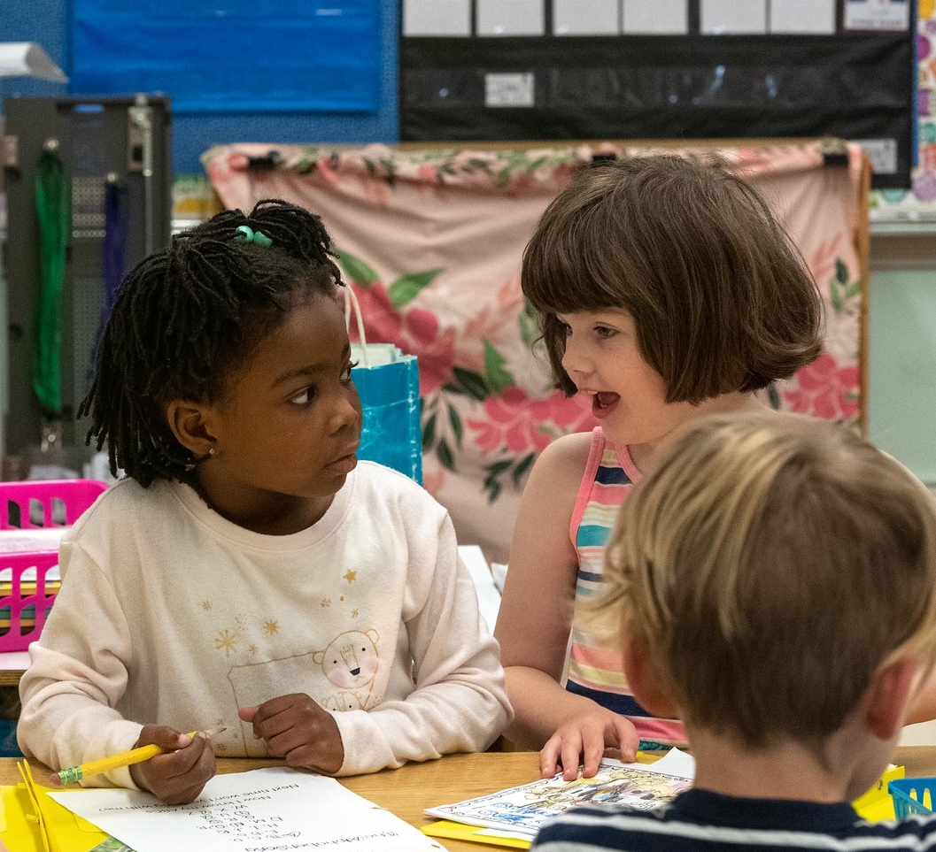
Three practice examples
Notes:
https://www.flickr.com/photos/portlandpublicschools/44377812940/
20181205_BethConyers_Vernon Elementary_58

Slide 12
1. Reflect on how your identity, preferences and lived experiences shape your literacy instruction and classroom climate.
Example
A first-grade teacher begins the year by sharing his own identity with students and creating an inventory to get to know the identities and preferences of the students in his classroom, which guides his instruction throughout the year.
Potential pitfall
Educators see their classroom environment and instruction as culturally neutral and say that they don’t see race or ethnicity when engaging with students and families.
Notes:
Talking points
The first practice is: [Read the slide.]
For each detailed example, we will also review a potential pitfall to spur dialogue about how complex it can be to implement these practices in the classroom with students.
One example of this practice might look like: [Read the slide.]
We have also provided a potential pitfall: [Read the slide.]
Facilitator considerations
Examples and non-examples can be a helpful tool for understanding a new concept.
Frame the potential pitfall as an opportunity to look closely at the practice and notice how it does and does not support oral language.
Be aware that some teachers might see themselves in the non-example. It will be important to frame these as shifts that teachers can make in their practice.
Considerations for interactivity:
Invite participants to turn and talk about the example and the pitfall.
Invite participants to share other examples.
Invite a whole group conversation on the differences between the example and the potential pitfall.

Slide 13
1. Reflect on how your identity, preferences and lived experiences shape your literacy instruction and classroom climate. (2)
Why this matters
Knowing your own identity well and sharing this identity with students encourages them to do the same. Furthermore, all classroom norms and demonstrations of learning are cultural. Incorporating students’ ways of knowing and preferences into instruction fosters student belonging and creates a safe environment for taking academic risks.
Notes:
Talking points
Let’s go into a little more detail about why this practice matters.
[Read slide text.]
Facilitator considerations
This slide is intended to provide rationale about why the practice matters.
Considerations for interactivity:
Instead of reading the slide aloud, invite participants to read it to themselves.
If time permits, consider asking participants to share other reasons for why this practice matters.

Slide 14
2. Explore multicultural perspectives and disrupt negative stereotypes of communities, using diverse texts and multimedia.
Example
A fourth-grade teacher selects texts by racially diverse authors about a relevant topic, such as immigration, and prompts students to use evidence from the texts to argue against stereotypes about immigrants.
Potential pitfall
Educators choose texts, multimedia, or topics that they think are culturally responsive and relevant for students without asking students’ opinions about whether they connect with the materials.
Notes:
Talking points
The second practice is: [Read the slide.]
This might look like: [Read the slide.]
We have also provided a potential pitfall: [Read the slide.]
Again, we are putting these two practices next to each other to help build a more nuanced understanding.
Facilitator considerations
When reviewing the second practice and sharing the potential pitfall, notice teachers’ responses. It is possible that teachers will see themselves in both the example and the pitfall.
Considerations for interactivity:
Invite participants to turn and talk about the example and the pitfall.
Invite participants to share other examples.
Invite a whole group conversation on the differences between the example and the potential pitfall.

Slide 15
2. Explore multicultural perspectives and disrupt negative stereotypes of communities, using diverse texts and multimedia. (2)
Why this matters
While culture does include celebrations and food, culture is also hopes, dreams, values and ways of looking at the world. Curating and analyzing texts and multimedia with cross-cultural perspectives helps students discuss ideas across these perspectives and potentially negative stereotypes that students hear about one another or about themselves.
Notes:
Talking points
Let’s go into a little more detail about why this practice matters.
[Read slide text.]
Facilitator considerations
This slide is intended to provide a rationale for why the second effective practice matters.
Considerations for interactivity:
Instead of reading the slide aloud, invite participants to read it to themselves.

Slide 16
3. Support students to exercise their opinion, curiosity and collaborative problem-solving while learning new literacy skills and content.
Example
Fifth-grade students practice literacy skills in a collaborative research project about the impact of media on self-image. Students read nonfiction articles by diverse authors, write an explanatory paper that uses text evidence, and present their findings to staff of the local newspaper.
Potential pitfall
Educators plan for students to engage in a rigorous project without providing academic supports, including help with the vocabulary, collaboration skills or models of high-quality work required for students to meaningfully participate.
Notes:
Talking points
The third practice is: [Read the slide.]
One example of this is: [Read the slide.]
We have also provided a potential pitfall: [Read the slide.]
Facilitator considerations
The purpose of this slide is for educators to better understand how the practice is implemented and potential pitfalls during implementation. This particular practice may feel lofty to some participants. Consider asking participants to share examples of how they have used this practice or similar practices in their classrooms.
Considerations for interactivity:
Invite participants to turn and talk about how they have implemented practices similar to the practice shared in the example and, if applicable, how they would extend their implementation in the future.
Invite a whole group conversation on the differences between the example and the potential pitfall.
Consider asking participants to share about the supports they have used to help students engage in meaningful projects.

Slide 17
3. Support students to exercise their opinion, curiosity and collaborative problem-solving while learning new literacy skills and content. (2)
Why this matters
Students often use social skills when applying literacy skills to the real world. For example, speaking, presenting and collaborating with peers requires practice, feedback and coaching. A growth mindset supports students to build their literacy skills in these real-world contexts.
Notes:
Talking points
Let’s go into a little more detail about why this practice matters.
[Read slide text.]
Facilitator considerations
This slide is intended to provide a rationale for why this practice matters.
Considerations for interactivity:
Instead of reading the slide aloud, invite participants to read it to themselves.

Slide 18
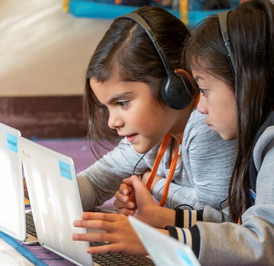
Reflecting on our practice
Notes:
20191114_BethConyers_Bridlemile Elementary_9
https://www.flickr.com/photos/portlandpublicschools/49066475768/in/album-72157711785430207/

Slide 19
Pair-share
Select one question to discuss with a partner:
What type of self-reflection must happen before a teacher is ready to implement culturally responsive and social–emotional practices into their literacy instruction?
What additional ideas have you gained about culturally responsive and social–emotional practices in literacy instruction?
Notes:
Talking points
Now that we have reviewed the definition of student belonging, why it matters for literacy, and how it can be implemented, let’s take a moment to reflect on our discussions and shared learning.
[Read slide text.]
Facilitator considerations
This marks a shift from learning about practices to beginning to think about teacher practices in the classroom.
Considerations for interactivity:
Turn and talk.
Offer time for participants to jot their own thoughts before sharing with a partner.
If online, it could be possible to post ideas in the chat.

Slide 20
Integrating student belonging into literacy instruction
Return to the classroom community you thought about
in the beginning of this session.
How can you learn more about the cultures and languages of your students and their families?
How are these cultures and languages reflected in your literacy instruction?
What types of opportunities do students have to practice social–emotional skills while developing literacy?
Notes:
Talking points
As we come to the end of this session, let’s recall the classroom and students who you brought to mind at the beginning of the session.
As you have that classroom in mind, think about these specific questions.
[Read the questions.]
After the discussion, consider sharing out a few action steps that participants will take back to their contexts.
Facilitator considerations
To conclude the session, invite participants to think back to the classroom and students they brought to mind in the beginning of the time together. This might help them to begin thinking about classroom practice.
Considerations for interactivity:
Invite participants to think, journal or discuss.

Slide 21



Learn more
Oregon’s Early Literacy Framework
Oregon’s Early Literacy Framework website
https://oregoninstructionalframeworks.org/
https://oregoninstructionalframeworks.org/wp-content/uploads/2024/04/Literacy-Framework_2023.pdf

Slide 22
Next steps
This slide can be adapted for the next steps at your site.
Notes:
Talking points
As a community, our next steps are . . .
Thank you for your participation today.
Facilitator considerations
Personalize this slide for your school/site community.
Integrate closing routines as helpful.

