Slide 1
Oral Language
Oregon’s Early Literacy Framework
Notes:
Talking Points:
Welcome to our learning session.
This will be an interactive experience. While I will be sharing some key information, I will also be inviting your insight, expertise and experience.
Our focus today on Oregon’s Early Literacy Framework (OELF) and Oral Language.
Facilitator Considerations
Consider also inserting a slide about collaborative norms that you and your community can use or have used in the past to engage with one another.
In person considerations:
If possible, set seating so that participants can easily talk with a partner.
Online considerations:
If possible, enable breakout rooms for conversations between participants.

Slide 2
Oregon Early Literacy Framework – Oral Language
Oregon's Vision
Children have access to consistent, culturally responsive, and research-aligned literacy instruction that guarantees reading and writing proficiency in at least one language.
Parents and caregivers are supported as full partners in their children’s literacy development.
Teachers are prepared and supported to identify individual student strengths and needs, and to teach reading and writing in research-aligned ways.
Notes:
Talking Points
Oregon’s Early Literacy Framework offers a vision for children, families/caregivers, and teachers.
Read slide text
The time today will focus specifically on how we can leverage oral language to support this literacy vision.
While the framework includes families and caregivers – the work today is focused on classroom practice.
Facilitator Considerations
This slide is designed to situate oral language and the Oregon Early Literacy Framework in the greater vision.
Considerations for interactivity:
Invite participants to read a section aloud.
After you read the text, invite participants to share words or phrases aloud that resonate.

Slide 3
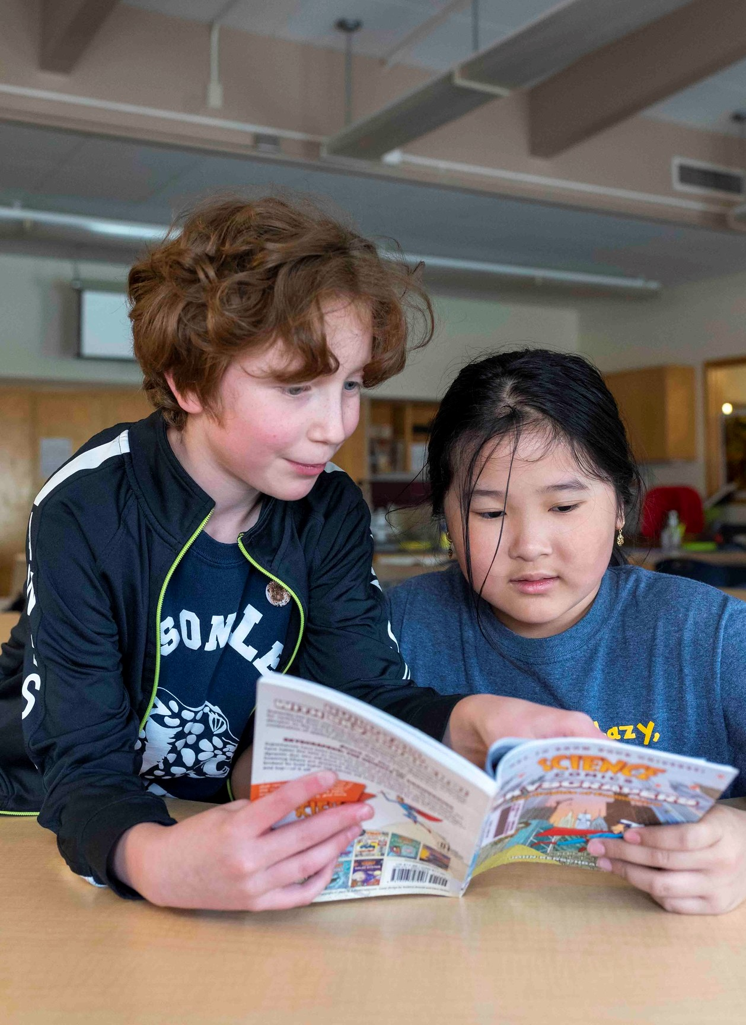
Making Connections
Notes:
20230519_BethConyers_2023_05_19 Jason Lee_32
https://www.flickr.com/photos/portlandpublicschools/52916430322/in/album-72177720308469830/

Slide 4
Reflect on your experience
Think back to when you were a child.
What were the first voices you remember?
What language or languages were spoken in your home?
How did you use language to connect with the people around you?
Notes:
Talking Points
We are going to start by making connections and activating our own prior knowledge. It is important to connect our literacy vision to our own experiences and students.
Read slide
Facilitator Considerations
The purpose of this slide is to activate background knowledge in the room and make a personal connection to oral language.
Considerations for interactivity:
Invite participants share with each other to build community and foster engagement.

Slide 5
Reflect on a student
Now think about a current or former student. Picture that child in your classroom.
What do you know about their cultural or linguistic background?
What strengths are they bringing to their learning?
What needs do they have as they grow their literacy skills?
Notes:
Talking Points
You have now had a moment to think about your own early experiences with oral language. Now let’s shift to thinking about a current or former student.
Read slide
I invite you to keep this student in your mind throughout our time together today.
Facilitator Considerations
This slide continues to make connections.
Considerations for interactivity:
Invite participants share with each other to build community and foster engagement.

Slide 6
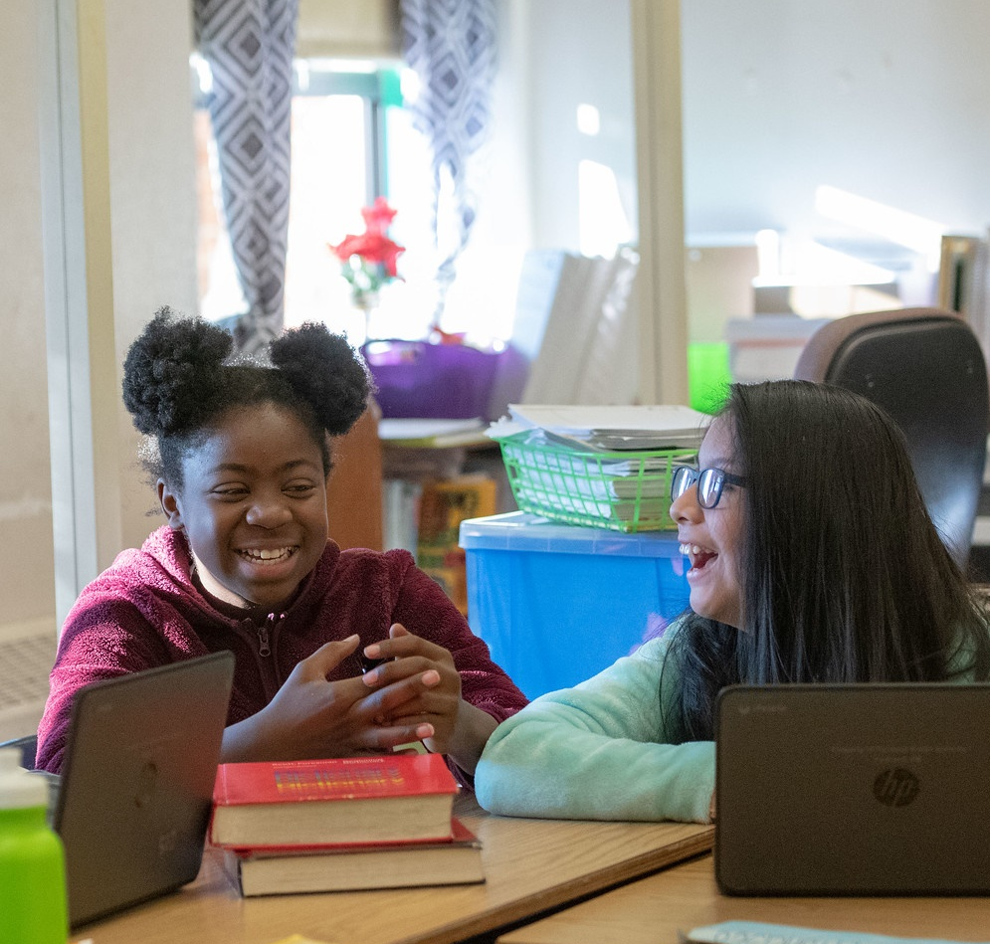
What is Oral Language?
Notes:
20181205_BethConyers_Vernon Elementary_10
https://www.flickr.com/photos/portlandpublicschools/46194951781/

Slide 7
What is oral language? (2)
Which ideas are familiar to you?
Which ideas are new to you?
Literacy development is increasingly understood as a process that begins as the brain develops language – you may recognize the saying, “literacy begins at birth.”
Oral language is the root of literacy development – children use their understanding of language structure as the basis for learning how to read.
Supporting multilingual students with a strong foundation in their home language supports their reading and writing in multiple languages.
Notes:
Talking Points
Let’s start by beginning to answer the question: What is oral language?
As I share information on the slide, think about what ideas are familiar and which are new.
Read slide
Facilitator Considerations
This slide helps build a common understanding of oral language.
Considerations for interactivity:
Invite participants to turn and talk based on the discussion prompt.
Invite a few whole group responses.
Invite participants to jot down their ideas for a later discussion.

Slide 8
Why is oral language important to literacy development?
What are some other reasons oral language is important to literacy learning?
Language is essential for children as they make sense of the world, develop relationships, and understand their role in the community.
Oral language matters for reading and writing – it supports vocabulary, fluency, and writing skills.
Oral language and storytelling play a critical role in learning about self, culture, and tradition
Notes:
Talking Points
We are building a shared definition of oral language. Now let’s start to think about why oral language is so important to literacy development.
This is not a definitive list. As I share these, think about: what are some other reasons oral language is important to literacy learning?
Read slide
Facilitator Considerations
Share information on why oral language is important.
Considerations for interactivity:
Invite participants to turn and talk based on the discussion prompt.
Invite a few whole group responses.
Invite participants to jot down their ideas for a later discussion.

Slide 9
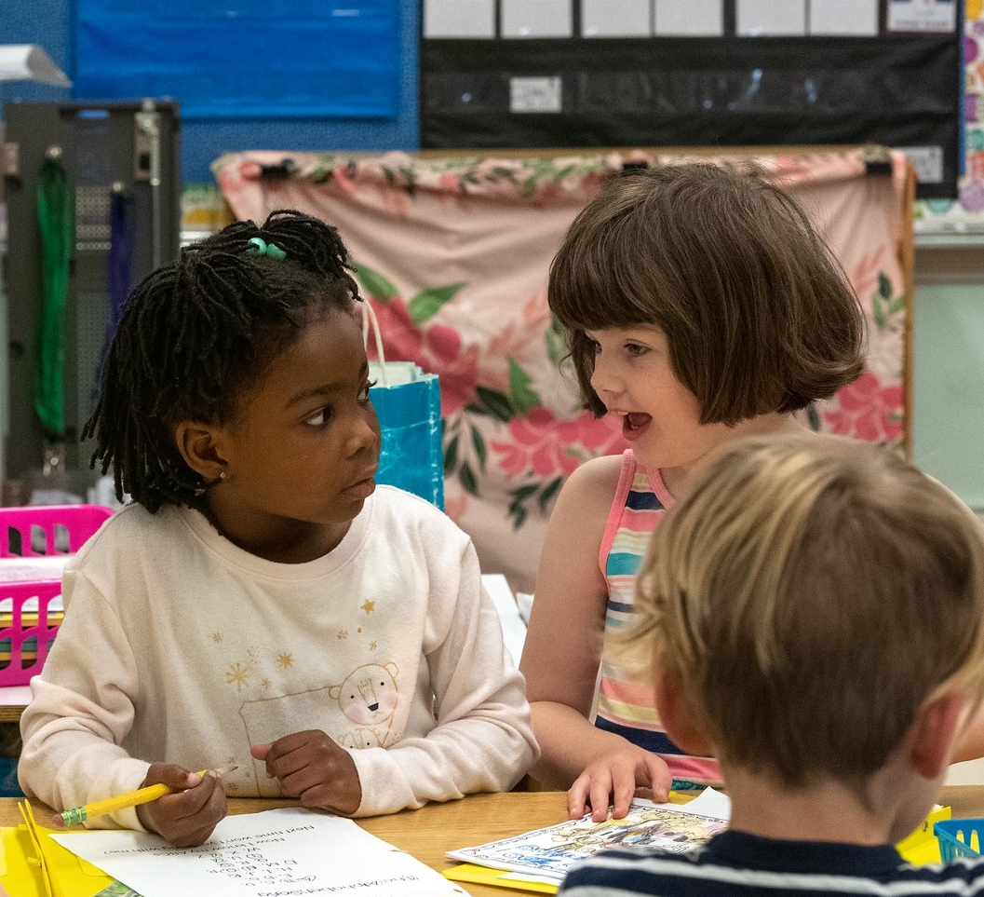
Three Practice Examples
Notes:
https://www.flickr.com/photos/portlandpublicschools/44377812940/
20181205_BethConyers_Vernon Elementary_58

Slide 10
Three effective instructional practices
Which of these are part of your current practice?
Which practices might be growth areas for you?
Affirm and respect students’ home language and culture to support active participation and engagement.
Make conversations with and between students a priority.
Build on the power of storytelling to create connections, pass on traditions, entertain and affirm identities, and promote expressive language.
Notes:
Talking Points
Now we are going to explore three effective instructional practices.
​​After thinking about the what and the why, we will move towards the how by focusing on three effective instructional practices.
We will go into them one by one, to get a little deeper and share some examples and potential pitfalls.
This is an overview of the three practices.
Facilitator Considerations
As you frame the instructional practices it is important to recognize that many teachers are already doing some of these.
As a facilitator you will want to build on the strengths in the room as well as model a stance of curiosity towards how we can always grow our teaching practice.

Slide 11
1. Affirm and respect students’ home language and culture to support active participation and engagement.
Example
A third grade teacher ensures that the books and materials that are central to instruction reflect multiple languages and cultures.
Potential Pitfall
Books and materials are not culturally and linguistically diverse or there are diverse materials, but they are not used during instruction.
Notes:
Talking Points
The first practice is: Affirm and respect…
One example of this is…
We have also provided a potential pitfall.
We are putting these two practices next to each other to help build a more nuanced understanding of what it means to affirm and respect students’ home languages and cultures to support active participation and engagement.
Facilitator Considerations
Examples and non-examples can be a helpful tool for understanding a new concept.
Frame the potential pitfall as an opportunity to look closely at the practice and notice how it does and does not support oral language.
Be aware that some teachers might see themselves in the non-example. It will be important to frame these as shifts that teachers can make in their practice.
Considerations for interactivity:
Invite participants to turn and talk about the example and pitfalls.
Invite participants to share other examples.
Invite a whole group conversation on the differences between the example and potential pitfall.

Slide 12
1. Affirm and respect students’ home language and culture to support active participation and engagement. (2)
Why this matters:
Language varieties are linguistically equal, even when they are not socially equal. When educators learn about the cultural and linguistic backgrounds of the children in their care and learn from families, they can then draw connections, build from linguistic strengths, and better support a student who may not yet be fluent with written text.
Notes:
Talking Points
Let’s go into a little more detail about why this practice matters.
Read Slide
There are many cognitive benefits to learning multiple languages. Multilingual students’ brains get an extra workout because navigating more than one language requires the brain to use problem-solving and task-switching skills. The multilingual brain is wired for powerful literacy and language learning.
There are also linked resources to continue learning about this practice.
Facilitator Considerations
This slide is intended to provide more context around the effective practice.
Considerations for interactivity:
Instead of reading the slide aloud, invite participants to read it to themselves.
If this is online and time permits, participants can link to the resources.

Slide 13
2. Make conversations with and between students a priority.
Example
A first grade teacher uses an interactive read aloud to model academic language and ask students open-ended questions. She encourages peer-to-peer interactions in addition to responding to her.
Potential Pitfall
During interactive read alouds, a first grade teacher primarily asks individual students comprehension questions with limited opportunities to engage in reciprocal peer conversations that build oral language skills.
Notes:
Talking Points
The second practice is: Make conversations…
One example of this is…
We have also provided a potential pitfall.
The potential pitfall is…
Again, we are putting these two practices next to each other to help build a more nuanced understanding.
Facilitator Considerations
When reviewing the second practice and sharing the potential pitfall, notice teachers’ responses. It is possible that teachers will see themselves in both the example and the pitfall.
Considerations for interactivity:
Invite participants to turn and talk about the example and pitfalls.
Invite participants to share other examples.
Invite a whole group conversation on the differences between the example and potential pitfall.

Slide 14
2. Make conversations with and between students a priority. (2)
Why this matters:
Having high-quality conversations means asking thought-provoking questions, responding meaningfully to children’s words, giving your full attention, and using a positive tone of voice. Being intentional in the conversations you have with children and planning and encouraging conversations among the children in your classroom can build their language skills.
When students engage with each other’s thinking with respect and curiosity, it is an opportunity for turn-taking, listening, responding, and asking questions and overall practice with oral language.
Notes:
Talking Points
Let’s go into a little more detail about why this practice matters.
Read slide
Making conversations a priority requires deliberate and purposeful planning. Teachers will want to think about engaging in multiturn conversations, modeling language and providing strategic scaffolds.
Children’s oral language develops as they listen to you model language that includes rich vocabulary, abstract words and concepts and a variety of grammatical forms.
To ensure access points and participation of all students in classroom conversation it is important to have a variety of language scaffolds. These can include asking open-ended questions on topics of interest to the child and thought-provoking questions that encourage students to think of and verbalize other ideas.
There are also linked resources to continue learning about this practice.
Facilitator Considerations
This slide is intended to provide more context around the effective practice.
Considerations for interactivity:
Instead of reading the slide aloud, invite participants to read it to themselves.

Slide 15
3. Build on the power of storytelling to create connections, pass on traditions, entertain and affirm identities, and promote expressive language.
Example
A kindergarten teacher encourages students to tell vivid, elaborative narratives, building on oral traditions to support students’ use of decontextualized language.
Potential Pitfall
A kindergarten teacher focuses her attention and praise on student responses to letter/sound learning while overlooking opportunities to listen to the storytelling and play happening in the classroom.
Notes:
Talking Points
The third practice is: Build on the power of storytelling…
One example of this is…
We have also provided a potential pitfall.
The potential pitfall is…
Again, we are putting these two practices next to each other to help build a more nuanced understanding.
Facilitator Considerations
When reviewing the second practice and sharing the potential pitfall, notice teachers’ responses. It is possible that teachers will see themselves in both the example and the pitfall.
Considerations for interactivity:
Invite participants to turn and talk about the example and pitfalls.
Invite participants to share other examples.
Invite a whole group conversation on the differences between the example and potential pitfall.

Slide 16
3. Build on the power of storytelling to create connections, pass on traditions, entertain and affirm identities and promote expressive language. (2)
Why This Matters:
Educators can structure literacy experiences that hold space for storytelling while centering learning opportunities that affirm and bring to life students’ histories, cultures, and traditions. Using oral language to honor cultural identity while simultaneously creating foundational literacy skills is critical for each and every child.
Notes:
Talking Points
Let’s go into a little more detail about why this practice matters.
Read slide
In addition to building connections, affirming identities and promoting expressive language, in early literacy, the cadence, flow and rhythm of how the story is told supports early language development for young children.
There are also linked resources to continue learning about this practice.
Facilitator Considerations
This slide is intended to provide more context around the effective practice.
Considerations for interactivity:
Instead of reading the slide aloud, invite participants to read it to themselves.

Slide 17
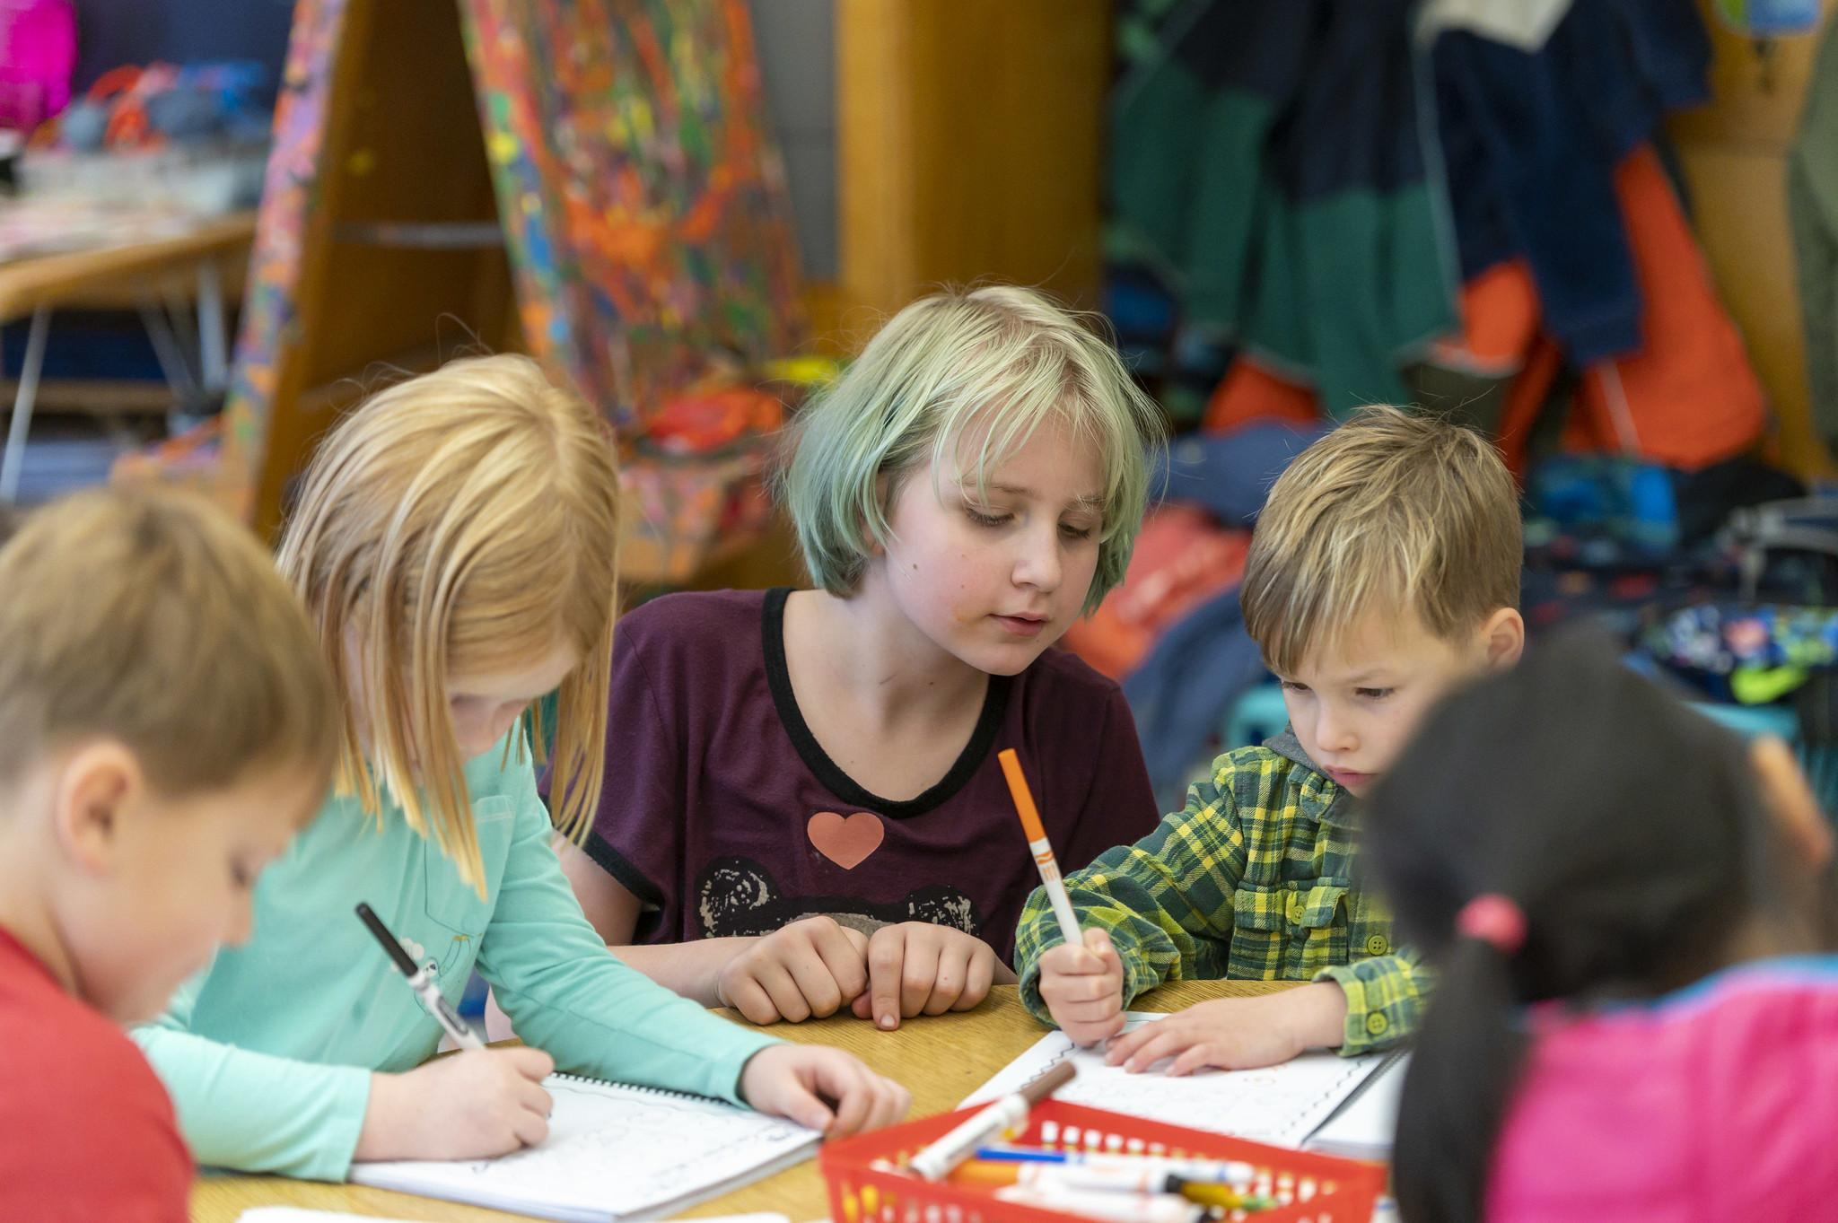
Reflecting On Our Practice
Notes:
20191114_BethConyers_Bridlemile Elementary_91
https://www.flickr.com/photos/portlandpublicschools/49066467578/in/album-72157711785430207/

Slide 18
Pair-share
Select one question to discuss with a partner:
What cultural and linguistic diversity, such as home language and dialect, exists in your classroom? How do you use multilingual students’ home language or dialect knowledge as an asset when teaching?
How can you strategically incorporate strategies that leverage oral language (such as conversations and storytelling) in your classroom?
Notes:
Talking Points
We just spent time thinking about three effective instructional practices that support oral language as a lever of literacy development.
Now we want to think about the children in your classroom and how you can enhance your practices around oral language.
You will see two different questions on the slide.
Read slide
Select one of the questions that you would like to discuss now.
Facilitator Considerations
This marks a shift from learning about practices to begin to think about teacher practices in the classroom.
Think about your audience in advance. These questions can be adapted for leaders – instead of “exists in your classroom,” replace with “exists in your school.” Instead of “how can you strategically incorporate…” replace with “how can the teachers you support strategically incorporate…”
Considerations for interactivity:
Turn and talk
Offer time for participants to jot down their own thoughts before sharing with a partner.
If online it could be possible to post ideas in the chat.

Slide 19
Integrating oral language into core teaching
Return to the current or former student you thought about in the beginning of this session.
What linguistic strengths does your student bring to the classroom?
What instructional strategies could you use to support your student?
What would support you as you integrate oral language into your core instruction?
Notes:
Talking Points
As we come to the end of this session, I want you to think back to that student who you brought to mind at the beginning of the session.
As you have that student in mind, think about these specific questions:
What linguistic strengths does your student bring to the classroom?
What instructional strategies could you use to support your student?
What would support you as you integrate oral language into your core instruction?
This is part of our job as we help all students reach their full literacy promise.
Facilitator Considerations
To conclude the session, invite participants to think back to the student they brought to mind in the beginning of the time together. This might help to begin thinking about classroom practice.
Considerations for interactivity:
Invite participants to think, journal or discuss.

Slide 20
Learn More
Oregon’s Early Literacy Framework
Oregon’s Early Literacy Framework Website
https://oregoninstructionalframeworks.org/
https://oregoninstructionalframeworks.org/wp-content/uploads/2024/04/Literacy-Framework_2023.pdf

Slide 21
Next Steps
This slide can be adapted for the next steps at your site.
Notes:
Talking Points
As a community our next steps are…
Thank you for your participation today.
Facilitator Considerations
Personalize this slide for your school/site community.
Integrate closing routines as helpful.

