Slide 1
Framework Overview
Oregon’s Early Literacy Framework
Notes:
Talking Points
Welcome to our learning session.
This will be an interactive experience. While I will be sharing some key information, I will also be inviting your insights, expertise and experience.
Our focus today is on an overview of Oregon’s Early Literacy Framework (OELF).
Facilitator Considerations
Consider also inserting a slide about collaborative norms that you and your community can use or have used in the past to engage with one another.
In person considerations:
•If possible, set seating so that participants can easily talk with a partner.
Online considerations:
•If possible, enable breakout rooms for conversations between participants.

Slide 2
Oregon's Vision
Children have access to consistent, culturally responsive and research-aligned literacy instruction that guarantees reading and writing proficiency in at least one language.
Parents and caregivers are supported as full partners in their children’s literacy development.
Teachers are prepared and supported to identify individual student strengths and needs, and to teach reading and writing in research-aligned ways.
Notes:
Talking Points
Oregon’s Early Literacy Framework offers a vision for children, families/caregivers and teachers.
[Read slide text.]
The time today will focus specifically on the high level themes of the Framework as an orientation to this guidance document.
Facilitator Considerations Considerations for interactivity:
Invite participants to read a section aloud.
After you read the text, invite participants to share words or phrases aloud that resonate with them.

Slide 3
Making Connections
Notes:
https://www.flickr.com/photos/portlandpublicschools/32636250090/in/album-72157677082974343/
20170217__Vernon - Black History Read In 02-17-2017_6

Slide 4
Reflect on your experience
Think back to when you were a child.
What are your favorite memories of speaking, reading and writing?
What literacy memories do you have from school?
How did your parents and caregivers support you to speak, read and write?
Notes:
Talking Points
We are going to start by making connections and activating our own prior knowledge. It is important to connect our literacy vision to our own experiences and students.
[Read slide text.]
Facilitator Considerations
The purpose of this slide is to activate background knowledge in the room and make a personal connection to oral language.
Considerations for interactivity:
Invite participants to share with one another to build community and foster engagement.

Slide 5
Reflect on a student
Now think about a current or former student. Picture that child in your classroom.
What do you know about them as a reader and a writer?
What supports have been helpful to their growth?
What assets do they contribute to your classroom community?
Notes:
Talking Points
You have now had a moment to think about your own early experiences with literacy. Now let’s shift to thinking about a current or former student.
[Read slide text.]
I invite you to keep this student in your mind throughout our time together today.
Facilitator Considerations
This slide continues to make connections.
Considerations for interactivity:
Invite participants to share with one another to build community and foster engagement.

Slide 6
Early Literacy Framework Overview
Notes:
https://www.flickr.com/photos/portlandpublicschools/44377812940/
20181205_BethConyers_Vernon Elementary_58

Slide 7
What is the Literacy Framework?
Oregon’s Early Literacy Framework emphasizes core instructional practices that benefit all students, with an intentional emphasis on how those practices can be leveraged to best serve students who have been historically marginalized by education systems, including multilingual learners and students experiencing disabilities.
THE CORE PURPOSES OF THE FRAMEWORK ARE TO:
Build statewide coherence, clarity, and common ground
Fuel action and improvement
Provide a practical road map for schools and districts to support leading for a literacy lift
Serve as a shared north star for educators and community
Align with Governor’s vision for improving student literacy outcomes
Which of these purposes is most relevant to your role?
How might the Framework connect to your work?
Notes:
Talking Points
As I share information on the slide, think about which purpose is most relevant to you in your role.
[Read slide text.]
Facilitator Considerations
This slide helps build a common understanding of oral language.
Considerations for interactivity:
Invite participants to turn and talk based on the discussion prompt.
Invite a few whole group responses.
Invite participants to jot down their ideas for a later discussion.

Slide 8
Guiding principles
Which three principles resonate the most with you?
Why?
Early literacy begins at birth.
Children are full of literary promise.
Families and communities play an important role.
Multilingualism benefits everyone.
Foundational skills matter.
Teacher knowledge and practice are critical.
Every student can be taught to read and write.
Notes:
Talking Points
Explain that these seven principles underlie the whole Framework. Ask participants: Which three principles resonate the most with you?
[Read the slide text.]
Facilitator Considerations
Ask participants to choose three principles that resonate the most with them and discuss with a partner or share with the group.

Slide 9
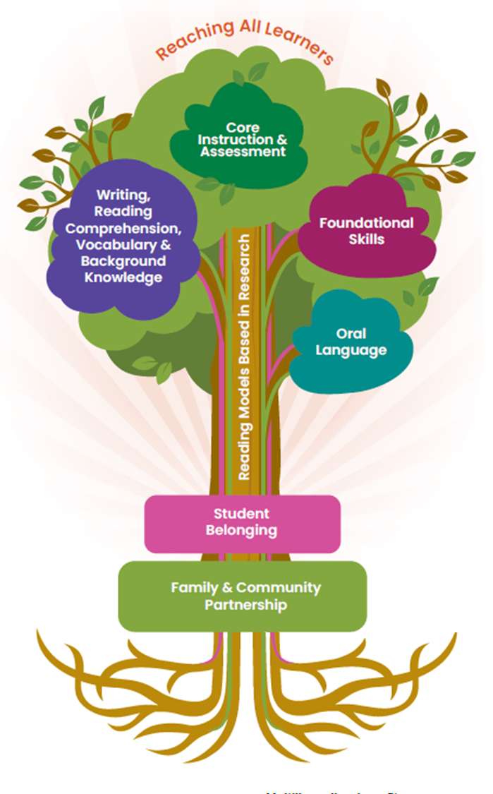
Key sections
Section 1: Student Belonging – A Necessary Condition for Literacy Learning
Section 2: Family & Community Partnerships
Section 3: Oral Language as the Root of Literacy Development
Section 4: Reading Models Based in Research
Section 5: Foundational Skills
Section 6: Writing, Reading Comprehension, Vocabulary, & Background Knowledge
Section 7: Core Instruction & Assessment
Section 8: Reaching All Learners
Notes:
Talking points
Explain that the Framework is organized according to eight sections or strands and the tree illustrates how the strands are all related.
[Read the slide text.]
Facilitator Considerations
Describe how family and community partnership and student belonging form the foundation of the Framework and how core instruction is central to the Framework. Emphasize the importance of each part of the framework.

Slide 10
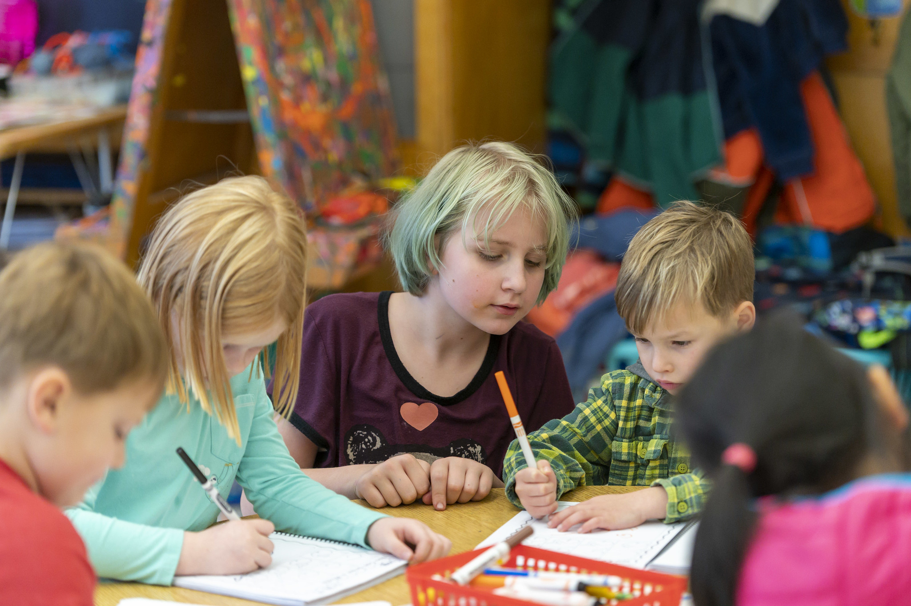
Three Cross-Cutting Themes
Notes:
20191114_BethConyers_Bridlemile Elementary_91
https://www.flickr.com/photos/portlandpublicschools/49066467578/in/album-72157711785430207/

Slide 11
Student belonging
Would you identify any of these areas as strengths in your current practice?
Which practices might be growth areas for you?
Teachers and students engage in opportunities to learn about and reflect upon their identities and the identities of others.
Students participate as a community of learners and have opportunities to voice their opinions, ask meaningful questions and influence the trajectory of their learning.
Teachers and students value each member of the classroom as scholars in their discussions and actions.
Notes:
Talking Points
Now we are going to explore a cross-cutting theme of the Framework: student belonging.
[Read slide text.]
Ask participants to reflect on the bullets: Would you identify any of these areas as strengths in your current practice? Which practices might be growth areas for you?
Facilitator Considerations
As you frame the instructional practices, it is important to recognize that many teachers are already doing some of these.
As a facilitator, you will want to build on the strengths in the room, as well as model a stance of curiosity toward how we can always grow our teaching practice.

Slide 12
Pair-share (1)
Select one question to discuss with a partner:
What are some strategies for helping students to feel like they belong?
How can the classroom environment or culture support student belonging?
What evidence do you see of student belonging in your classroom or school?
Notes:
Talking Points
You will see three different questions on the slide.
[Read slide text.]
Select one of the questions that you would like to discuss now.
Facilitator Considerations
Think about your audience in advance. These questions can be adapted for leaders: “classroom environment or culture” can be replaced with “school environment or culture.” Instead of “What are some strategies . . .,” it could be about “How do the teachers you support . . .”
Considerations for interactivity:
Turn and talk.
Offer time for participants to jot their own thoughts before sharing with a partner.
If online, it could be possible to post ideas in the chat.

Slide 13
Reading, writing, speaking and listening
Would you identify any of these areas as strengths in your current practice?
Which practices might be growth areas for you?
Guaranteed access to comprehensive, high-quality core literacy instruction matters. Access to core instruction is an equity issue for children learning to read and write.
Reading, writing, speaking and listening are embedded in all learning activities. Children are taught foundational literacy skills, as well as comprehension, vocabulary, writing and critical thinking.
Students engage with rich, complex and diverse texts that invite children to both see themselves and learn about others.
Notes:
Talking Points
Now we are going to explore a cross-cutting theme of the Framework: core literacy instruction and the integration of reading, writing, listening and speaking.
[Read slide text.]
Ask participants to reflect on the bullets: Would you identify any of these areas as strengths in your current practice? Which practices might be growth areas for you?
Facilitator Considerations
As you frame the instructional practices, it is important to recognize that many teachers are already doing some of these.
As a facilitator, you will want to build on the strengths in the room, as well as model a stance of curiosity toward how we can always grow our teaching practice.

Slide 14
What is core instruction?
Core instruction is . . .
". . . high-quality instruction in the general education setting that is aligned to grade-level standards, centered around grade-level-aligned materials, and inclusive of every student in the classroom, regardless of performance level.
Sometimes also referred to as Tier I instruction, this is the primary prevention for reading and writing difficulty. It maximizes learning by providing access to peer learning models, the classroom teacher, and grade-level-aligned texts and tasks."
Source: Oregon Department of Education. (2023). Oregon’s early literacy framework: A strong foundation for readers and writers (K-5), p.3. https://www.oregon.gov/ode/educator-resources/standards/ELA/Documents/ Literacy%20Framework_2023.pdf
Notes:
Talking Points
Explain that it's important to build a common understanding of core instruction.
[Read slide text.]

Slide 15
Implementing core instruction
Key actions:
Select and implement high-quality instructional materials for core instruction that provide guaranteed and viable curriculum.
Know and understand how reading develops, how to align instruction to standards, how to identify students on the learning progression and how to effectively use differentiated practices and tiered instructional supports.
Consider engagement, representation, action and expression when designing instruction.
Use assessment data to learn about student needs and offer increasing levels of support through differentiated core instruction within the general education setting.
Notes:
Talking Points
Explain that the Framework emphasizes the importance of high quality materials for core instruction, standards and learning progressions, student engagement and monitoring through assessment.
[Read slide text.]

Slide 16
Pair-share (2)
Select one question to discuss with a partner:
What are some challenges you have experienced in supporting students to access core content?
What are some successes you have had in supporting students to access core content?
What evidence do you see of rich, complex and diverse texts in your school?
Notes:
Talking Points
You will see three different questions on the slide.
[Read slide text.]
Select one of the questions that you would like to discuss with a partner.
Facilitator Considerations
Think about your audience in advance. These questions can be adapted for leaders: “challenges you have experienced” can be replaced with “challenges your teachers have experienced.”
Considerations for interactivity:
Turn and talk.
Offer time for participants to jot their own thoughts before sharing with a partner.
If online, it could be possible to post ideas in the chat.

Slide 17
Culturally and linguistically responsive, asset-oriented instruction
Which of these are part of your current practice?
Which practices might be growth areas for you?
Educators ensure that student and family knowledge, stories, language and cultures are reflected in the classroom environment.
Educators maintain high literacy expectations for all students, by providing scaffolds for students to access standards-based content.
Teachers frame students’ home languages and dialects as strengths, while building English language skills.
Notes:
Talking Points
Now we are going to explore a cross-cutting theme of the Framework: culturally and linguistically responsive, asset-oriented instruction.
[Read slide text.]
Reflect on the bullets: Which of these are part of your current practice? Which practices might be growth areas for you?
Facilitator Considerations
As you frame the instructional practices, it is important to recognize that many teachers are already doing some of these.
As a facilitator, you will want to build on the strengths in the room, as well as model a stance of curiosity toward how we can always grow our teaching practice.

Slide 18
Pair-share (3)
Select one question to discuss with a partner:
What are some strategies for learning more about the families in your classroom?
How can the classroom environment or culture support high expectations for all students?
What evidence do you see of framing languages and dialects as strengths in your school?
Notes:
Talking Points
You will see three different questions on the slide.
[Read slide text.]
Select one of the questions that you would like to discuss now.
Facilitator Considerations
Think about your audience in advance. These questions can be adapted for leaders: e.g. “classroom environment or culture” can be replaced with “school environment or culture.”
Considerations for interactivity:
Turn and talk.
Offer time for participants to jot their own thoughts before sharing with a partner.
If online, it could be possible to post ideas in the chat.

Slide 19
Looking Ahead
Notes:
20170217__Vernon - Black History Read In 02-17-2017_14
https://www.flickr.com/photos/portlandpublicschools/32891730461/in/album-72157677082974343/

Slide 20
The Framework in action
What strengths does your classroom—or school—demonstrate in alignment with the Framework?
What are some additional areas for growth, learning or exploration?
What would support you as an educator to enact the Framework vision?
Notes:
Talking Points
As we come to the end of this session, I want you to think back to that student who you brought to mind at the beginning of the session.
As you have that student in mind, think about the questions on the slide. [Read questions on slide.]
This is part of our job as we help all students reach their full literacy promise.
Facilitator Considerations
To conclude the session, invite participants to think back to the student they brought to mind in the beginning of the time together. This might help to begin thinking about classroom practice.
Considerations for interactivity:
Invite participants to think, journal or discuss.

Slide 21
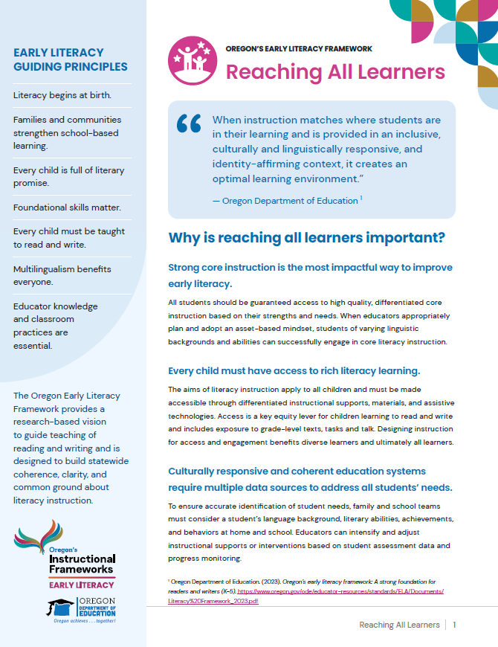
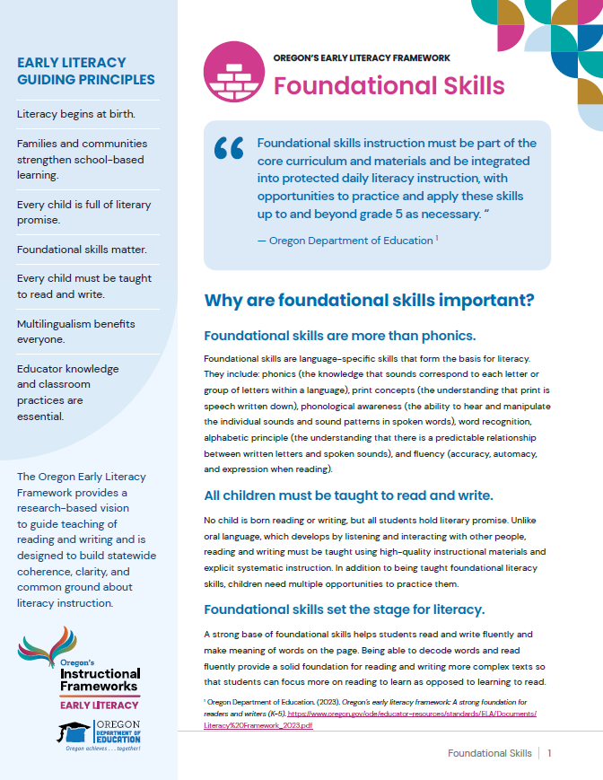
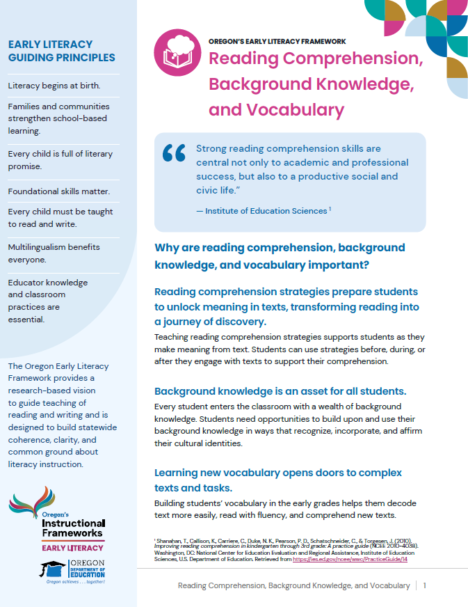
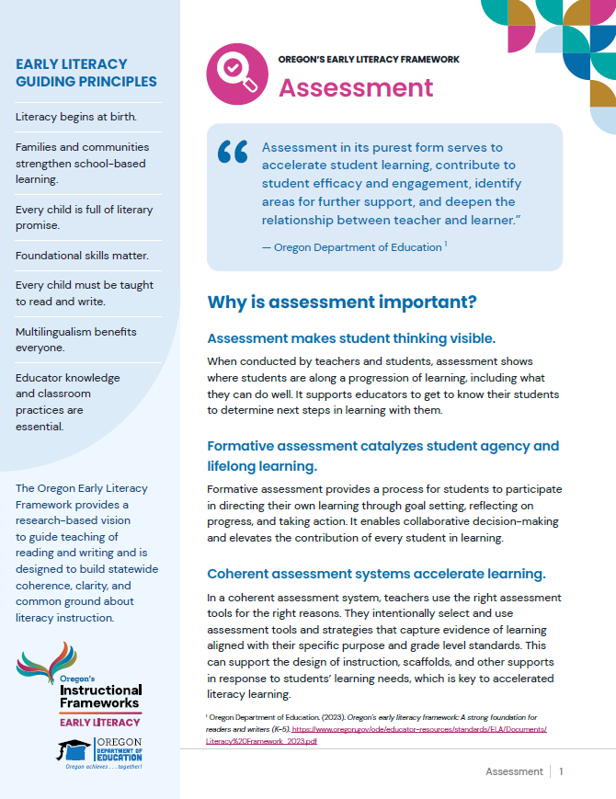
Explore resources
Snapshots
Reflect on our practice slides Decks
Notes:
Talking points
Explain that there are additional resources to do a deeper dive into each section of the framework: two-page snapshots and slide decks for professional learning.

Slide 22
Learn more
Oregon’s Early Literacy Framework
Oregon’s Early Literacy Framework website
https://oregoninstructionalframeworks.org/
https://oregoninstructionalframeworks.org/wp-content/uploads/2024/04/Literacy-Framework_2023.pdf

Slide 23
Next steps
This slide can be adapted for the next steps at your site.
Notes:
Talking Points
As a community, our next steps are . . .
Thank you for your participation today.
Facilitator Considerations
Personalize this slide for your school/site community.
Integrate closing routines as helpful.

