Slide 1
Family and Community Literacy Partnerships
Oregon’s Early Literacy Framework
Notes:
Talking Points
Welcome to our learning session.
This will be an interactive experience. While I will be sharing some key information, I will also be inviting your insights, expertise and experience.
Our focus today is on an overview of Oregon’s Early Literacy Framework (OELF).
Facilitator Considerations
Consider also inserting a slide about collaborative norms that you and your community can use or have used in the past to engage with one another.
In person considerations:
If possible, set seating so that participants can easily talk with a partner.
Online considerations:
If possible, enable breakout rooms for conversations between participants.

Slide 2
Oregon’s Early Literacy Framework—Family and Community Partnerships
Oregon’s vision
Children have access to consistent, culturally responsive and research aligned literacy instruction that guarantees reading and writing proficiency in at least one language.
Parents and caregivers are supported as full partners in their children’s literacy development.
Teachers are prepared and supported to identify individual student strengths and needs, and to teach reading and writing in research aligned ways.
Notes:
Talking Points
Oregon’s Early Literacy Framework offers a vision for children, families/caregivers and teachers.
[Read slide text.]
The time today will focus specifically on how we can leverage family and community partnerships to support this literacy vision within your classrooms.
Facilitator Considerations
This slide is designed to situate family and community partnerships and Oregon’s Early Literacy Framework in the greater vision.
Considerations for interactivity:
Invite participants to read a section aloud.
After you read the text, invite participants to share words or phrases aloud that resonate.

Slide 3
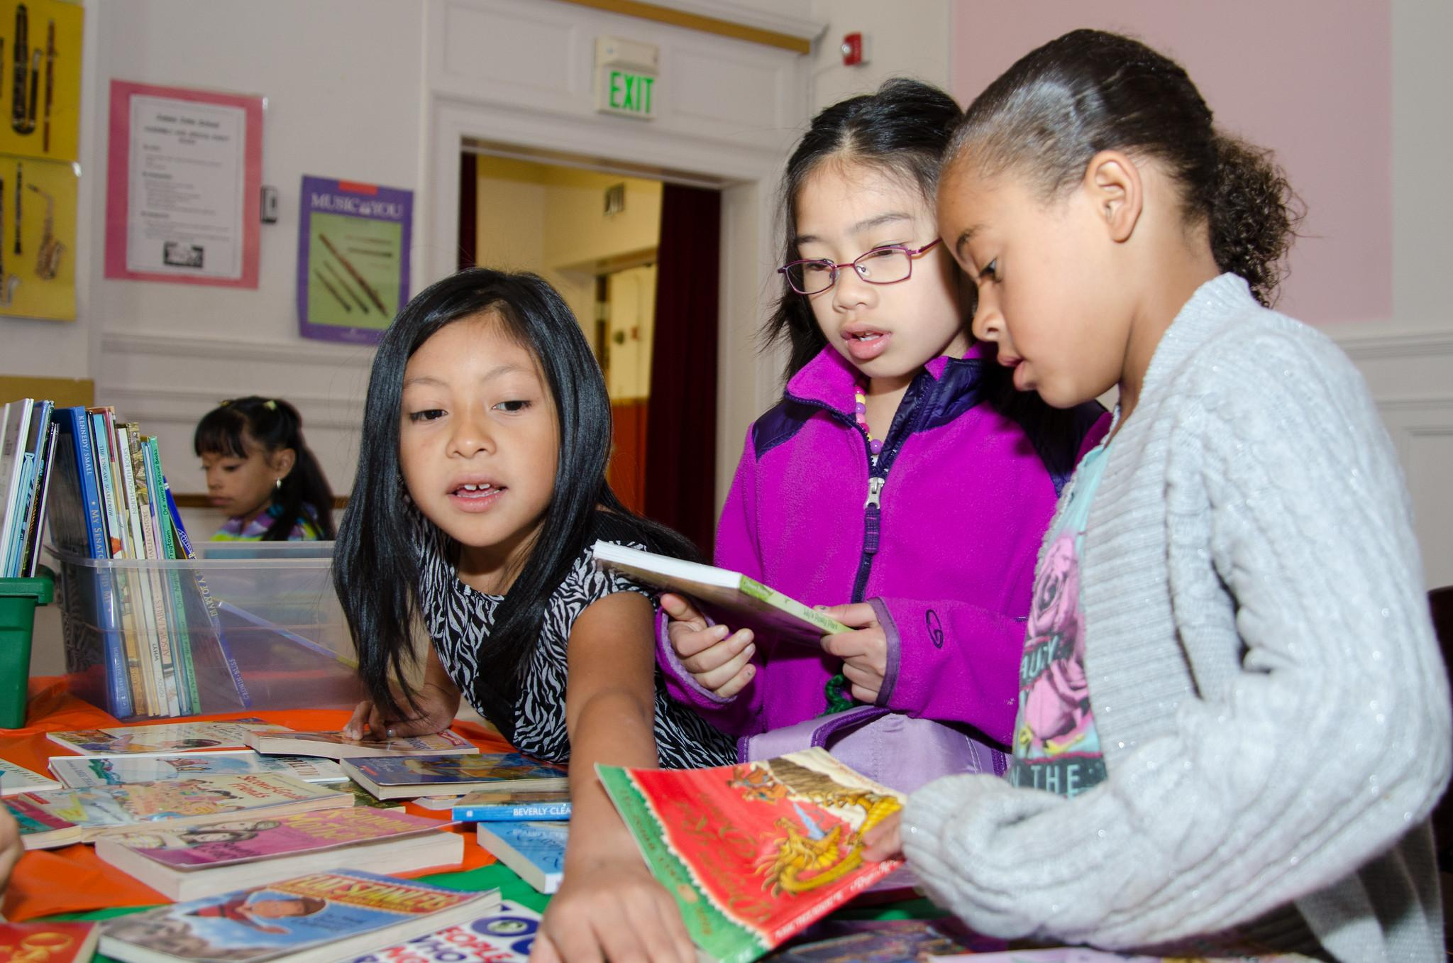
Making Connections
Notes:
Childrens Book Harvest - James John School
https://www.flickr.com/photos/portlandpublicschools/14207267190/in/album-72157644701248739/

Slide 4
Reflect on your experience
Take the next five minutes to reflect on the following questions in writing:
What was the relationship like between your favorite teacher and your family?
When you were a student, in what ways did your family support your reading, writing and speaking?
Notes:
Talking Points
We are going to start by making connections and activating our own prior knowledge. It is important to connect our literacy vision to our own experiences and students.
[Read slide text.]
Facilitator Considerations
The purpose of this slide is to activate background knowledge in the room and make a personal connection to family and community partnerships.
Considerations for interactivity:
Invite participants to share their reflections with one another to build community and foster engagement.

Slide 5
Reflect on a student
Now think about a current or former student. Picture that child in your classroom and consider the questions below. Spend the next five minutes writing your reflections.
What is your relationship like with that student and their family?
What does your communication and collaboration with their family currently look like?
How might you rely on the family for their expertise or insights regarding their child to support your instruction?
Notes:
Talking Points
You have now had a moment to think about your own early experiences with family and community partnerships. Now let’s shift to thinking about a current or former student.
[Read slide text.]
You may choose to write about one of these points or touch on all of them.
I invite you to keep this student in your mind throughout our time together today.
Facilitator Considerations
Invite participants to share with one another to build community and foster engagement.

Slide 6
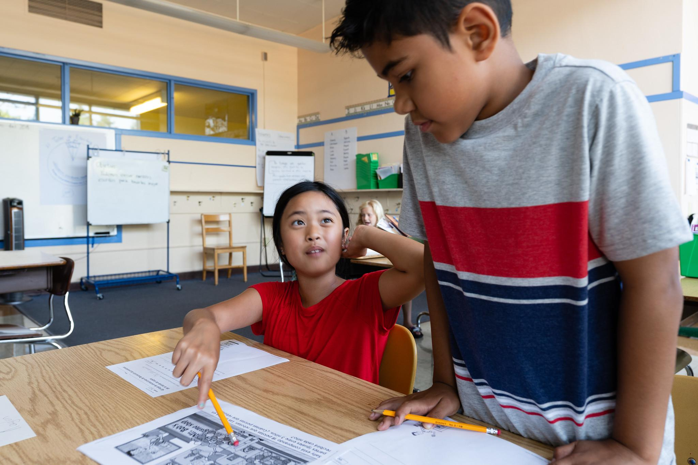
What Are Family and Community Partnerships?
Notes:
20180807_BethConyers_DSL Summer Institute_19
https://www.flickr.com/photos/portlandpublicschools/43967597952/

Slide 7
What are family and community partnerships?
Which of these aspects of partnerships do you see in action in your school community?
Family and community partnerships are reciprocal relationships between families, caregivers, communities, and schools.
These partnerships are mutual and bi-directional.
These collaborative partnerships foster a culture of literacy inside and outside of the classroom and contribute to positive learning environments.
Notes:
Talking Points
Let’s start by beginning to answer the question: What are family and community partnerships?
As I share information on the slide, think about which aspects of partnerships you see in your school community.
[Read slide text, with the following additional information:]
Family and community partnerships are reciprocal relationships, bi-directional relationships where educators leverage the deep insights and expertise that families and communities have about their children’s needs, interests and strengths to enhance learning.
These are partnerships where support and learning are mutual and bi-directional between schools and families.
Strong collaborative partnerships foster a culture of literacy inside and outside of the classroom by supporting student development, effectively addressing educational challenges and fostering positive learning environments.
Facilitator Considerations
This slide helps build a common understanding of family and community partnerships.
Considerations for interactivity:
Invite participants to turn and talk based on the discussion prompt.
Invite a few whole group responses.
Invite participants to jot down their ideas for a later discussion.

Slide 8
Why are family and community partnerships important to literacy development?
What are some other reasons that family and community partnerships are important to literacy learning?
Strong family and school partnerships effectively address educational challenges and foster positive learning environments.
Home and school partnerships are foundational for early literacy development. Language experiences at home strengthen children’s learning at school.
Family and community partnerships deepen students’ connections to their education and support literacy learning.
Notes:
Talking Points
We are building a shared definition of family and community partnerships. Now let’s start to think about why these partnerships are so important to literacy development.
This is not a definitive list. As I share these, think about: what are some other reasons that family and community partnerships are important to literacy learning?
[Read slide text, with the following additional information:]
Strong family and school partnerships support student literacy development by effectively addressing educational challenges and fostering positive learning environments.
Families and caregivers are the primary educators in a child’s life and teach language and literacy learning from an early age. This early engagement in language and literacy at home is crucial for brain development and sets the stage for future learning.
Family and community partnerships deepen students’ connections to their education and support literacy learning. When educators build authentic relationships and leverage the diverse strengths of students’ communities and cultures, they create personalized, engaging learning experiences that deepen students' connection to their education.
Facilitator Considerations
Share information on why oral language is important.
Considerations for interactivity:
Invite participants to turn and talk based on the discussion prompt.
Invite a few whole group responses.
Invite participants to jot down their ideas for a later discussion.

Slide 9
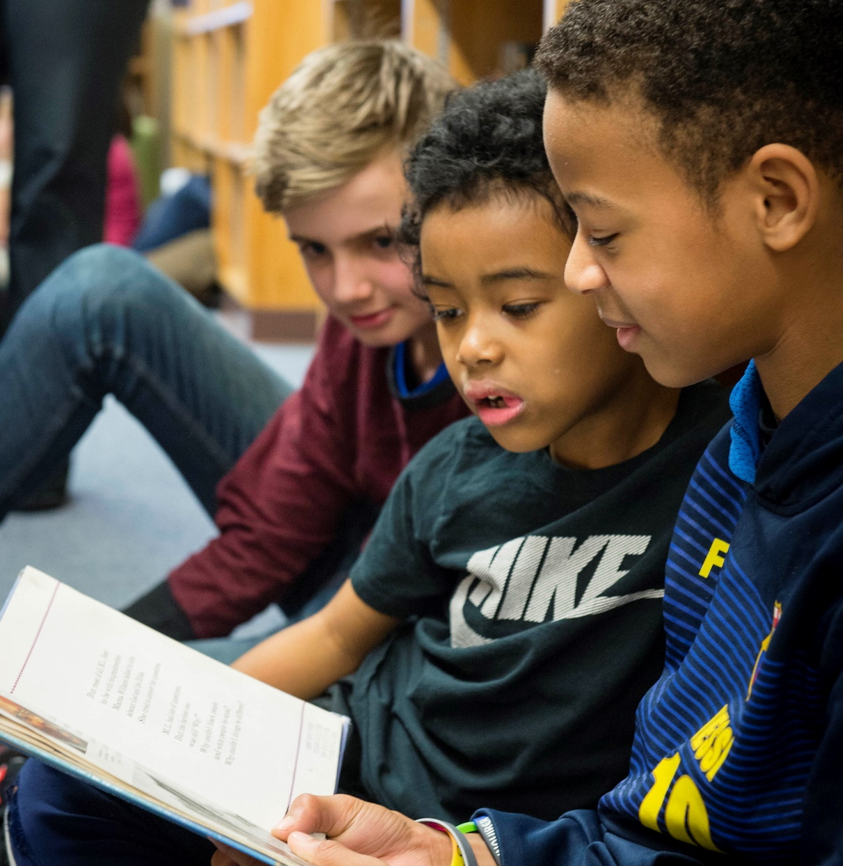
Three Practice Examples
Notes:
https://www.flickr.com/photos/portlandpublicschools/32636250090/in/album-72157677082974343/
20170217__Vernon - Black History Read In 02-17-2017_6

Slide 10
Three effective instructional practices
In what ways do these show up in your current practice?
Which practices might be growth areas for you?
Proactively establish authentic, purposeful and respectful partnerships with parents, caregivers and families, engaging in reciprocal communication that fosters meaningful family involvement in schools.
Work collaboratively with families and the greater community to foster a culture of literacy outside of the classroom.
Leverage the deep insights and expertise that families have about their children’s needs, interests and strengths to enhance learning.
Notes:
Talking Points
Now we are going to explore three effective instructional practices.
After thinking about the “what” and the “why,” we will move toward the “how” by focusing on three effective instructional practices.
We will go into them one by one, to get a little deeper and share some examples and potential pitfalls.
This is an overview of the three practices.
[Read slide text.]
Facilitator Considerations
As you frame the instructional practices, it is important to recognize that many teachers are already doing some of these.
As a facilitator, you will want to build on the strengths in the room, as well as model a stance of curiosity toward how we can always grow our teaching practice.

Slide 11
1. Proactively establish partnerships that foster meaningful family involvement in schools.
Example
The caregivers of a first grade class are invited to engage in their students’ learning in multiple ways by participating in storytelling sessions, co-creating projects with their students and supporting classroom activities and field trips.
Potential pitfall
These activities are only scheduled during the day or at the school site, or require background checks, making them inaccessible to diverse caregivers.
Notes:
Talking Points
The first practice is: [Read slide text.]
One example of this is: [Read slide text.]
We have also provided a potential pitfall. [Read slide text.]
We are putting these two practices next to each other to help build a more nuanced understanding of what it means to acknowledge and respect the background, culture and time of families to support active engagement and relationship building.
Facilitator Considerations
Examples and non-examples can be a helpful tool for understanding a new concept.
Frame the potential pitfall as an opportunity to look closely at the practice and notice how it does and does not support family and community partnerships.
Be aware that some teachers might see themselves in the non-example. It will be important to frame these as shifts that teachers can make in their practice.
Considerations for interactivity:
Invite participants to turn and talk about the example and pitfall.
Invite participants to share other examples.
Invite a whole group conversation on the differences between the example and the potential pitfall.

Slide 12
1. Proactively establish partnerships that foster meaningful family involvement in schools. (2)
Why this matters
These partnerships are crucial for student development, tackling educational obstacles, and creating nurturing learning. They form a vital community that leverages valuable insights from families and encourages a collaborative educational experience that benefits the overall development and academic success of students.
Notes:
Talking Points
Let’s take a moment to consider the importance of this practice.
[Read slide text.]
Strong relationships between families and schools form the cornerstone of student success. Utilizing the expertise of parents and caregivers about their children and fostering robust connections are key strategies to enhance student achievement both inside and outside of the classroom.

Slide 13
2. Work collaboratively with families and the greater community to foster a culture of literacy outside of the classroom.
Example
A kindergarten teacher supports parents by creating a shared resource that includes reading and writing strategies, diverse book lists, local reading events and places to get free books, while also offering a space for parents to contribute their recommendations, thus collaboratively building a comprehensive literacy toolkit.
Potential pitfall
Educators limit resources and events to English-only formats, rather than embracing opportunities that promote biliteracy and multilingualism.
Notes:
Talking Points
The second practice is: [Read slide text.]
One example of this is: [Read slide text.]
We have also provided a potential pitfall: [Read slide text.]
Once again, we want to showcase these two practices next to each other to continue to build a more nuanced understanding.
Facilitator Considerations
When reviewing the second practice and sharing the potential pitfall, notice teachers' responses. It is possible that teachers will see themselves in both the example and the pitfall.
Considerations for interactivity:
Invite participants to turn and talk about the example and pitfall.
Invite participants to share other examples.
Invite a whole group conversation on the differences between the example and the potential pitfall.

Slide 14
2. Work collaboratively with families and the greater community to foster a culture of literacy outside of the classroom. (2)
Why this matters
Learning is an interconnected process that happens between home and school environments. As primary educators, families and caregivers play a crucial role in early language and literacy, directly enhancing learning and development at school.
Collaboration between home and school ensures that children receive consistent and meaningful language experiences that support their overall learning and development in and outside of school.
Notes:
Talking Points
Let’s unpack why this practice matters.
[Read slide text.]
Literacy and learning don’t just happen within the classroom. By bridging the gap between home and school, we create a seamless learning continuum that nurtures students’ linguistic and cognitive growth. Engaging families in educational dialogues and activities reinforces the language and literacy skills initiated at home, enriching the academic journey. This collaborative approach guarantees that students benefit from a harmonious and enriched learning environment, laying a solid foundation for their comprehensive development and future success.
Facilitator Considerations
This slide is intended to provide more context around the effective practice.
Considerations for interactivity:
Instead of reading the slide aloud, invite participants to read it to themselves.

Slide 15
3. Leverage the deep insights and expertise that families have about their children’s needs, interests and strengths.
Example
A third grade teacher uses an interpreter for a family meeting at the start of the year, to establish a relationship, set up student goals and create personalized support plans. This collaboration informs the teacher’s integration of the student’s language and culture into school activities, enriching the learning environment for all students in the classroom.
Potential pitfall
Educators may hesitate to connect with families who speak another language or limit family engagement to times when families are working, rather than exploring alternative ways to build cultural and linguistic connections for the student.
Notes:
Talking Points
The third practice is: [Read slide text.]
One example of this is: [Read slide text.]
We have also provided a potential pitfall: [Read slide text.]
Again, we are putting these two practices next to each other to help build a more nuanced understanding.
Facilitator Considerations
When reviewing the practice and sharing the potential pitfall, notice teachers’ responses. It is possible that teachers will see themselves in both the example and the pitfall.
Considerations for interactivity:
Invite participants to turn and talk about the example and pitfall.
Invite participants to share other examples.
Invite a whole group conversation on the differences between the example and the potential pitfall.

Slide 16
3. Leverage the deep insights and expertise that families have about their children’s needs, interests and strengths. (2)
Why this matters
Family engagement is crucial for a child’s success, as it involves collaboration between schools and families to support learning and development. It is important because it fosters mutual respect, builds trust and creates a cohesive learning environment for the child.
Furthermore, involving families in decision-making and advocacy efforts at the program level can positively impact a child’s educational outcomes.
Notes:
Talking Points
Let’s go into a little more detail about why this practice matters.
[Read slide text.]
When schools actively partner with families, they lay the foundation for a supportive and unified learning journey bridging the gap between home and school environments and creating a thriving learning community for educators, families and students.
Additionally, encouraging parents to participate in school boards or parent councils allows them to contribute their perspectives and insights, thereby enriching the educational program and tailoring it more closely to meet the diverse needs of all students.
Facilitator Considerations
This slide is intended to provide more context around the effective practice.
Considerations for interactivity:
Instead of reading the slide aloud, invite participants to read it to themselves.

Slide 17
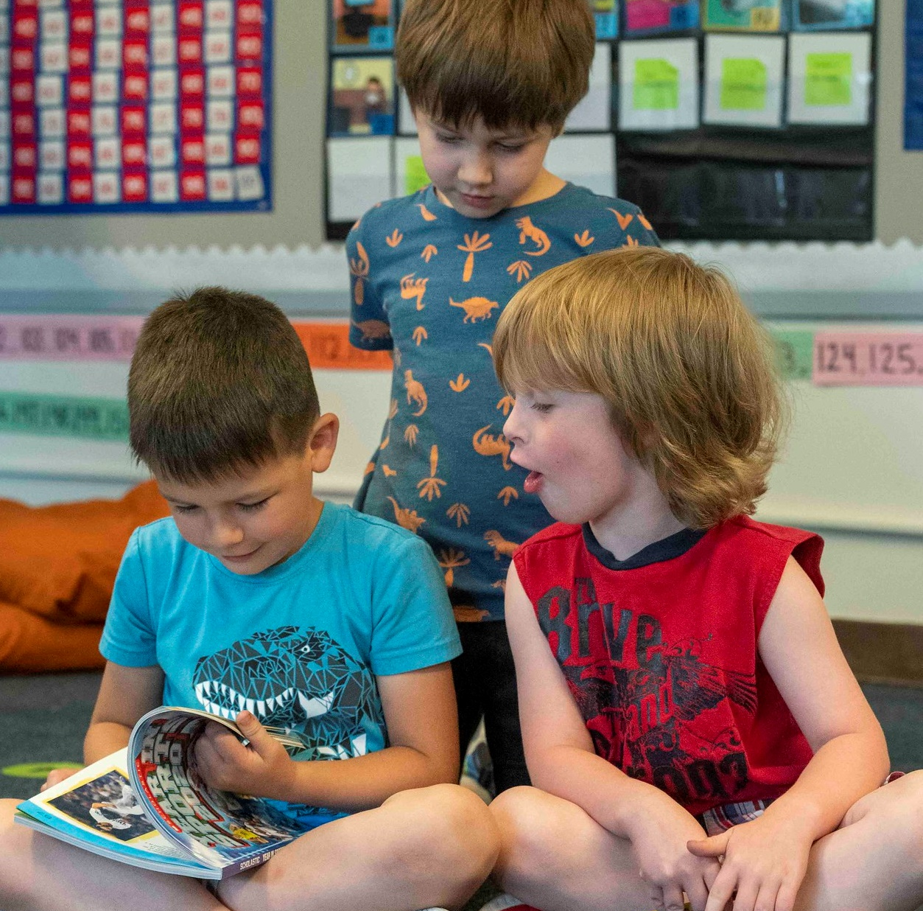
Reflecting on Our Practice
Notes:
20230519_BethConyers_2023_05_19 Jason Lee_23
https://www.flickr.com/photos/portlandpublicschools/52917167409/in/album-72177720308469830/

Slide 18
Pair-share
Select one question to discuss with a partner:
How are you building authentic relationships with students, families and the greater community?
How can you utilize families’ expertise to effectively support literacy learning in your classroom?
Notes:
Talking Points
We just spent time thinking about three effective instructional practices that support family and community partnerships as a lever of literacy development.
Now we want to think about the children in your classroom and how you can enhance your practices around creating and maintaining these family and school relationships.
You will see two different questions on the slide.
[Read slide text.]
Select one of the questions that you would like to discuss now.
Facilitator Considerations
This marks a shift from learning about practices to beginning to think about teacher practices in the classroom.
Think about your audience in advance. These questions can be adapted for leaders: e.g. “in your classroom” can be replaced with “in your school.”
Considerations for interactivity:
Turn and talk.
Offer time for participants to jot their own thoughts before sharing with a partner.
If online, it could be possible to post ideas in the chat.

Slide 19
Integrating family and community partnerships into the classroom
Consider the student you reflected on at the beginning of our session:
What role could families play within and outside of your classroom?
What new strategies could you use to strengthen your relationship with their family?
How are you currently using your knowledge of this student's cultural and linguistic background in your classroom?
Notes:
Talking Points
As we come to the end of this session, I want you to think back to that student who you thought of at the beginning of the session.
As you have that student in mind, think about these specific questions:
What role could families play within and outside of your classroom?
What new strategies could you use to strengthen your relationship with their family?
How are you currently using your knowledge of this student’s cultural and linguistic background in your classroom?
Creating and bolstering these relationships is part of our job as we help all students reach their full literacy promise.
Facilitator Considerations
To conclude the session, invite participants to think back to the student they considered in the beginning of the time together. This might help them to begin thinking about classroom practice.
Considerations for interactivity:
Invite participants to think, journal or discuss.

Slide 20
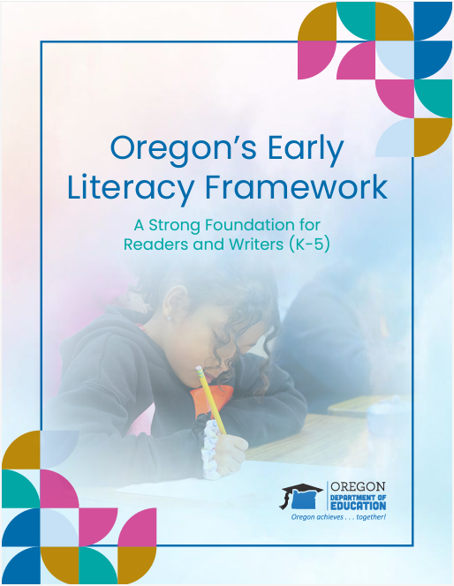
Learn more
Oregon’s Early Literacy Framework
Oregon’s Early Literacy Framework website
https://oregoninstructionalframeworks.org/
https://oregoninstructionalframeworks.org/wp-content/uploads/2024/04/Literacy-Framework_2023.pdf

Slide 21
Next steps
This slide can be adapted for the next steps at your site.
Notes:
Talking Points
As a community, our next steps are . . .
Thank you for your participation today.
Facilitator Considerations
Personalize this slide for your school/site community.
Integrate closing routines as helpful.

